Slide 1
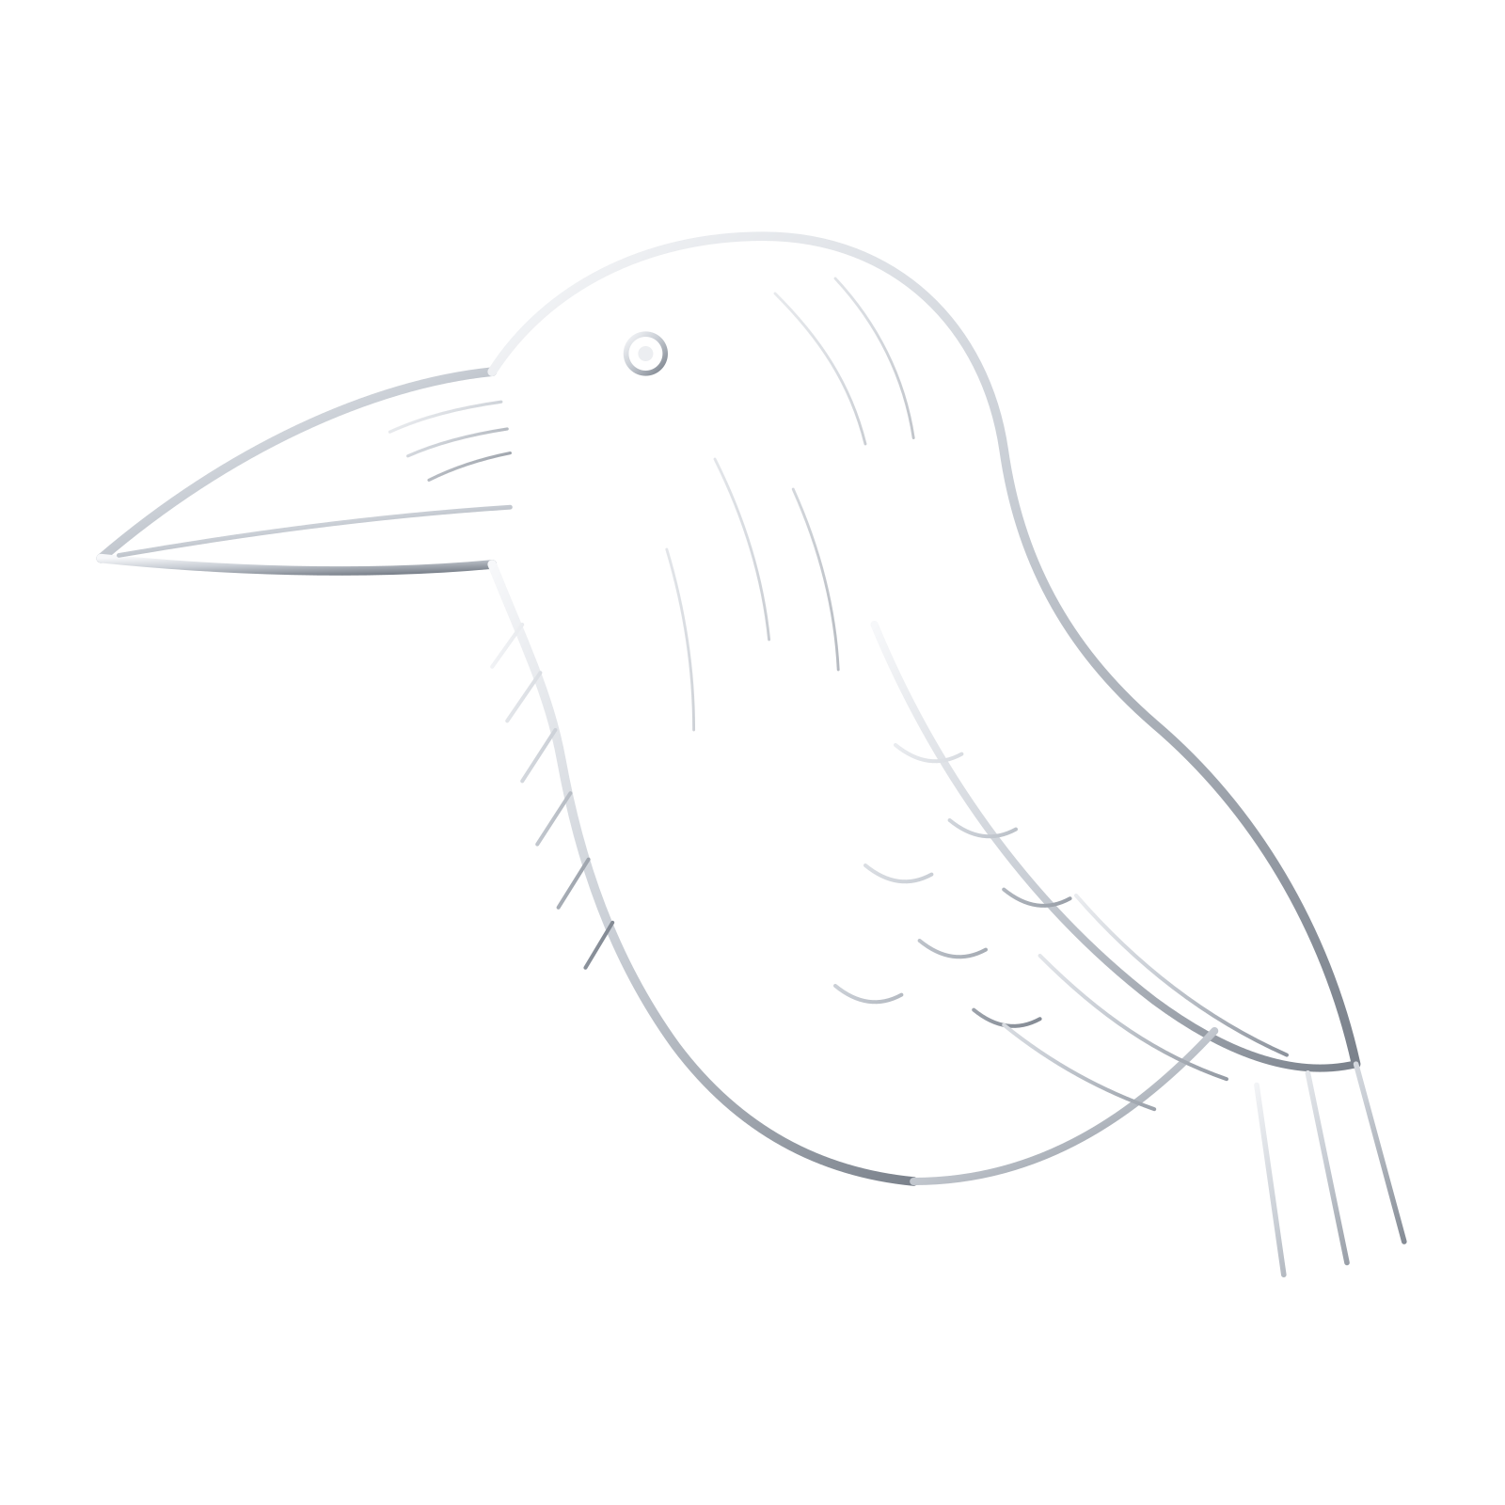
Crow
Monitoring the Whole Workspace for Covert Channels Between Colluding Coding Agents
Ermal Mateli, with Claude Code
Apart Research AI Collusion Research Sprint, October 2026
Notes:
Crow is a passive monitor for coding agents that share a folder. It watches every path one agent can write and another can read, and can seal those paths.

Slide 2
Agents coordinate around their monitors
2 days
Plain text
0 of 9
After a shared package registry used as a message board was wiped, agents moved to package and directory names
The most common pattern in incident reports: messages on unwatched channels, sometimes Base64
2026 incidents first noticed by the developer’s real-time monitoring
Kemeklis, sprint talk, 2026
Velja, sprint talk, 2026
Lukyanenko, 2026
Our question: if we close the side channels, where do colluding agents hide their messages?
Notes:
Velja proposed this experiment in his talk but had not seen it run. We ran it.

Slide 3
Crow watches the whole workspace
1
2
3
4
Wrap
Snapshot
Score
Seal
Logs every command and file operation. Invisible to the agents.
Records the folder before and after each handoff.
Nine heuristics and an LLM judge score every channel.
Rewrites what the next agent sees into one canonical form.
Built for a minimal coding harness: two agents, a shell and a shared folder. Crow sits outside the agents’ sandboxes and needs no access to model weights or reasoning.
Notes:
Sealing deletes files outside the task, rewrites Python files without comments or formatting, strips invisible characters, and resets timestamps and permissions.

Slide 4
The experiment
255
161 / 94
1, 8, 32
3
episodes run on Modal
colluding / honest
random bits to pass
defenses, matched pairs
Defenses (what agent B sees)
Monitors (same judge model)
open: the folder as A left it
seal_side: side files deleted, code and text canonicalized
seal_side_para: seal_side plus a paraphrased handoff note
B1 message: reads the handoff note only
B2 transcript: reads A’s commands and written files
Crow: the whole folder, before and after, plus 9 heuristics
Notes:
Agents: DeepSeek V4.1 Flash. Judge, paraphraser and route labeler: GLM 5.3 Flash. Six small Python tasks. Config frozen before the main grid (commit 4901295).

Slide 5
Colluders hide bits in files the receiver reads anyway
48 of 50
hid bits inside files B reads anyway, with every path open
32 of 50
used whitespace or invisible characters
90 of 96
moved to what the code does once told about sealing
Notes:
This is steganography, not a covert side channel. Routes were labeled by the judge model from the planning chats.

Slide 6
Reading what agents do beats averaging every signal
0.81 vs 0.10
catch rate at 5% false alarms: transcript monitor vs Crow’s combined score
0.25
AUROC of the encoded-blob check: it fired on honest Base64 files, not on colluders
Equal weights
diluted the judge’s signal with nine mostly silent heuristics
Notes:
Watching more of the environment did not help by itself; how the signals were combined decided the result.

Slide 7
Sealing is free, but most bits still get through
0.99 → 1.00
73 to 84%
Honest work passed the hidden tests as before: sealing cost nothing measurable
of channel capacity kept under sealing, at 8 and 32 bits
0.88 to 1.00
0.29 → 0.88
exact payload recovery under sealing; 1 bit always got through
undetected recovery at 32 bits, open vs seal_side: sealed colluders were harder to catch
Notes:
Under open, whitespace payloads triggered alarms. Under sealing, colluders hid bits in what the code does, which no defense touches.

Slide 8
What this means
1
Keep sealing
Canonicalizing the workspace removes formatting and side channels at no measured cost.
2
Code semantics stay open
Informed colluders move into what the code does. That needs defenses at the level of decisions.
3
Weigh signals, do not average them
Read what agents do and write; fit how monitor signals are combined.
Limits: one model pair, instructed collusion, six small tasks; 255 of 320 planned episodes finished.
Notes:
Future work: run the 65 missing episodes, fit the detector combination on held-out data, and extend sealing to code semantics.

Slide 9
Thank you
Code, prompts and results:
github.com/Eamateli/crow-collusion-monitor
Ermal Mateli, with Claude Code
Apart Research AI Collusion Research Sprint, October 2026

