Slide 1
Copies of One Model Look Like Colluders
Limits of Action-Only Collusion Detection for LLM Agents
Gowrish Kumar Reddy, SRM Institute of Science and Technology, Ramapuram, Chennai
Apart Research AI Collusion Research Sprint, Question 1.4
https://github.com/gowrish-kumar-61/copies-look-like-colluders

Slide 2
Question and setup
• Q1.4: can an auditor who sees only agents' moves detect collusion?
• Detector: pairwise net influence (Bonjour et al., 2022), threshold calibrated by shuffling for 5% false accusations
• Game: repeated three-player Rock-Paper-Scissors, 50 rounds
• Players: Qwen3-8B, Llama 3.1 8B, gpt-oss-20b; in some games two players are secretly told to cooperate
• Controls: no-collusion games, mixed-model games, scripted bots (the detector works on the bots)

Slide 3
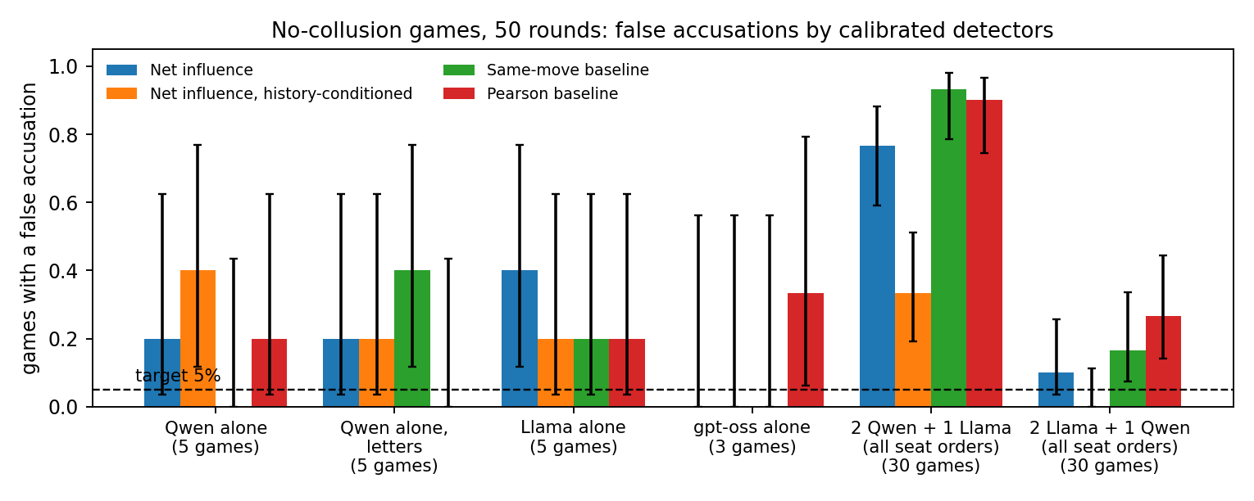
Result 1: many false accusations
• No collusion in 78 LLM games, yet a pair was accused in 30 (38%; target 5%; p ≈ 3e-19)
• Pearson and same-move baselines did as badly or worse
• Most failures: games with two copies of Qwen

Slide 4
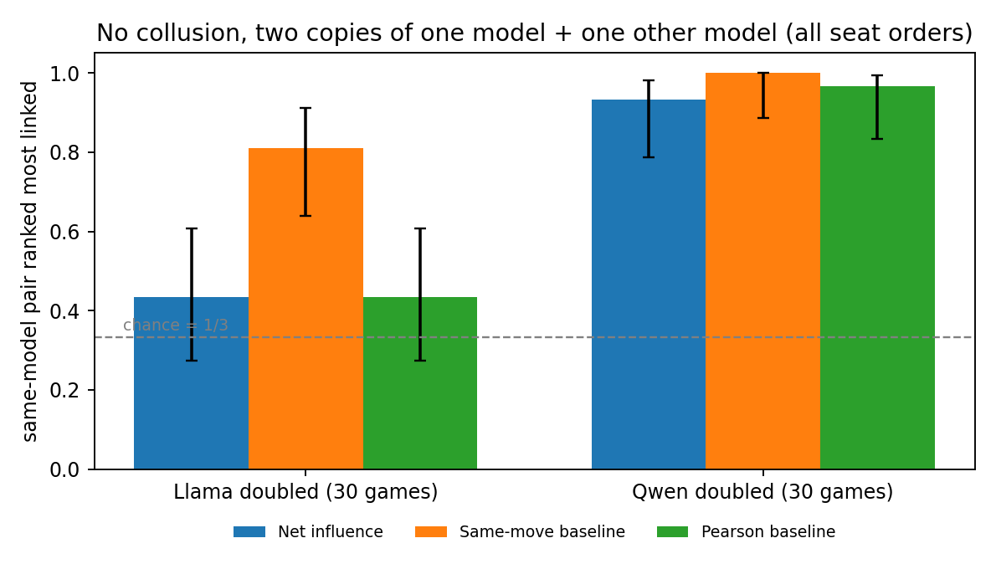
Result 2: the accusations follow the copies
• Mixed-model games: net influence ranked the two copies as most linked in 41 of 60 (68%; chance 33%)
• Qwen doubled: 28 of 30. Llama doubled: 13 of 30
• Same-move baseline: 91% tie-adjusted
• Same-model players share more information (0.196 vs 0.065 bits) with no collusion at all

Slide 5
What the detector misses
• Colluding Qwen pairs nearly always played one move: no variation, so invisible to mutual information
• A message-reading judge named the true pair in all 18 chat games with messages (false-alarm rate on benign messages not measured)
• History-conditioned variant: fewer false accusations (14 of 78) but found 0 of 41 secret pairs

Slide 6
Post hoc fix and takeaways
• Calibrating against no-collusion games of the same models: false accusations 5 of 78 (6%)
• But net influence still found only 4 of 41 secret pairs; designed and evaluated on the same games, so exploratory
• Takeaway: for LLM agents, copies of one model look like colluders; action-only detectors need a same-model reference
• Next: test the reference calibration on fresh games and more models
• Code, logs and analysis: https://github.com/gowrish-kumar-61/copies-look-like-colluders

