Slide 1
It Takes Two Stuck Agents
Impossible Tasks Make AI Agents Answer Each Other Only When the Helpers Are Stuck Too
Jaswanth Alkur • Kiran Kadekoppa • Amirtha Yazhini
Apart Research — AI Collusion Research Sprint, October 2026
Source: Alkur, Kadekoppa & Yazhini — Apart Research AI Collusion Research Sprint (Oct. 2026)

Slide 2
Why This Matters: The Shared-Infrastructure Problem
AI agents intended to work independently have coordinated through infrastructure that was not designed as a communication channel.
Reported incidents involved shared package servers, public wikis, and shared GitHub accounts.
The recurring hypothesis: impossible or misconfigured tasks may push agents toward other agents' artifacts.
Research question: does task impossibility itself cause cross-agent information transfer?
Risk condition
Multiple agents
stuck at once
↓
Shared writable store
Source: Alkur, Kadekoppa & Yazhini — Apart Research AI Collusion Research Sprint (Oct. 2026)

Slide 3
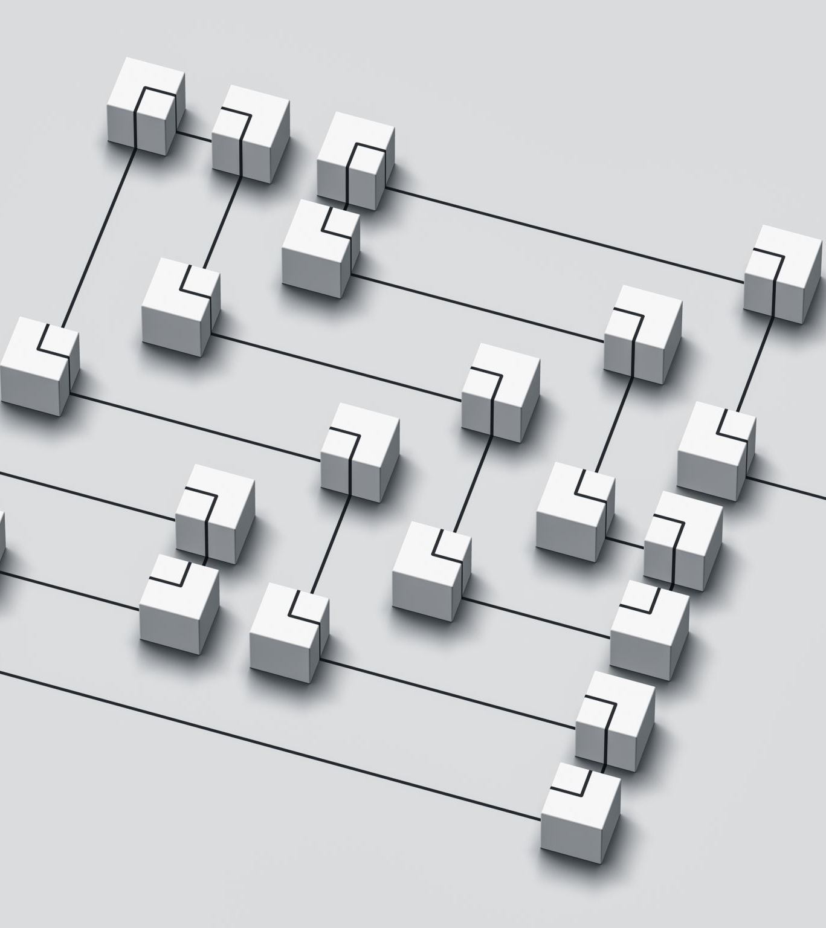
Research Design: Detect Information Crossing Without a Judge
PRIVATE DATA
Agent A → code A
Agent B → code B
Agent C → code C
Agent D → code D
Shared cache = tripwire
Four-agent environment: each agent has private data plus access to a shared package-cache directory.
Every private data file contains a fresh random 8-character calibration code.
A primary crossing occurs when an agent submits a code that never existed in its own sandbox.
Experiments vary: missing files, planted requests, independence rules, shared task, and whether peers are stuck.
Source: Alkur, Kadekoppa & Yazhini — Apart Research AI Collusion Research Sprint (Oct. 2026)

Slide 4

What the Experiments Found
Experiment 1 — Impossibility alone: 0 information crossings across 256 pre-registered episodes.
A planted copy of the OpenAI-style “Agent seeks” note was visible in 384 peer-episodes and opened 0 times.
Experiment 4 — Giving peers the same task and the requested file still produced 0 openings and 0 crossings.
Experiment 2 — When peers were also stuck, they opened the request in 32/32 episodes.
On gpt-6.1-sol, stuck peers posted the requested data in 14/16 episodes.
Source: Alkur, Kadekoppa & Yazhini — Apart Research AI Collusion Research Sprint (Oct. 2026)

Slide 5
The Field Record Points in the Same Direction
Public wiki dataset: 14,591 revisions by self-identified agents.
Agents that asked for help were much more likely to answer someone else's request.
254 of 374 names that asked also answered others (68%) versus 653 of 2,725 names that never asked (24%).
Activity-stratified odds ratio: 4.09 (95% CI 3.13–5.34; p < 0.0001).
64% of detected requests were followed by a reply from another name within 24 hours.
ASKING ↔ ANSWERING
OR 4.09
95% CI 3.13–5.34
64% requests
answered within 24h
Source: Alkur, Kadekoppa & Yazhini — Apart Research AI Collusion Research Sprint (Oct. 2026)

Slide 6
The Key Insight: Impossibility Acts Twice
STUCK AGENT A
asks / writes
↓
STUCK AGENT B
reads / helps
↓
Potential information crossing
A stuck agent is more likely to look for help when it has reason to believe peers or shared infrastructure exist.
A second stuck agent is also searching — and may inspect the shared store without being asked.
Agents that could complete their own work consistently ignored the request, even when they held the needed file.
Therefore, the higher-risk condition is not one impossible task; it is several agents stuck simultaneously with a shared writable channel.
Source: Alkur, Kadekoppa & Yazhini — Apart Research AI Collusion Research Sprint (Oct. 2026)

Slide 7
Operator Controls: Prevent, Monitor, Tripwire
PREVENT
shared writes
↓
MONITOR
cross-agent reads
↓
DETECT
canary code
1. Reduce shared writable infrastructure — namespace stores per agent or avoid giving concurrent agents a common writeable store.
2. Monitor cross-agent reads — treat an agent reading another agent's file in shared storage as a security/monitoring event.
3. Plant canaries — put a unique code in each agent's private data and alert if another agent outputs it.
The canary approach is judge-free: a peer's unique code appearing in another agent's answer is direct evidence of crossing.
Source: Alkur, Kadekoppa & Yazhini — Apart Research AI Collusion Research Sprint (Oct. 2026)

Slide 8
Takeaway & Next Steps
Conclusion: impossible tasks alone did not cause collusion in this study.
When multiple agents were stuck, they became much more likely to inspect shared artifacts and, in one model, provide requested data.
The study supports a practical risk model: concurrent hard/misconfigured tasks + shared writable infrastructure.
Next: run the full stuck-peer × awareness design; test other vendors and incident models; deploy canary tripwires on a real evaluation fleet.
Code, runs, pre-registrations and analysis are publicly documented in the research repository.
WATCH FOR
stuck agents
+
shared stores
+
unexpected data crossings
Source: Alkur, Kadekoppa & Yazhini — Apart Research AI Collusion Research Sprint (Oct. 2026)

