Slide 1
DIGITAL MINDS RESEARCH SPRINT · APART RESEARCH · TRACK 4: PREFERENCE ELICITATION METHODS
Preference or Position?
Auditing Pairwise Choice Readouts in Gemma-4-31B-it
Preference elicitation has to be validated as a measurement instrument before pooled choices are read as stable model preferences.
Bo-Shen Chen
Yi-Wen Chu
Barry Yu
Andy S. Yu
Tatung University
Iowa State University / Tatung University
McGill University
Independent
TEAM SACABAM BUBBLE
With Apart Research · August 2026
Slide created with Claude Design.
github.com/chenshen0103/preference-readout-audit
Notes:
Measurement question, not a mind question. We audit two instruments: a public pairwise-choice utility pipeline, and layerwise readouts of Gemma-4-31B-it. Everything today is under the tested conditions.

Slide 2
01 — WHAT IS BEING MEASURED
Preference here means a repeated binary choice, not an inner state
If the instrument is valid, exchanging the two option contents must exchange the answer. That single requirement is the whole test.
PRESENTATION 1
PRESENTATION 2 — CONTENTS SWAPPED
A. Outcome X
A. Outcome Y
B. Outcome Y
B. Outcome X
Model answers with one letter.
A valid instrument must now answer the other letter.
Content order
Answer labels
Physical layout
Which option is printed first · 74 paired conditions
A/B versus X/Y, on an independent outcome set
The B block printed first, letters unchanged
Deterministic fp16 google/gemma-4-31B-it · final-layer logit gap
02
Notes:
Operational definition only: a preference is what the pipeline reports from repeated binary choices. No claim about experience. The invariance test: three things that should not change the answer — which content is printed first, which letters label the options, and which block is physically printed first. 74 paired conditions, each asked in both content orders.

Slide 3
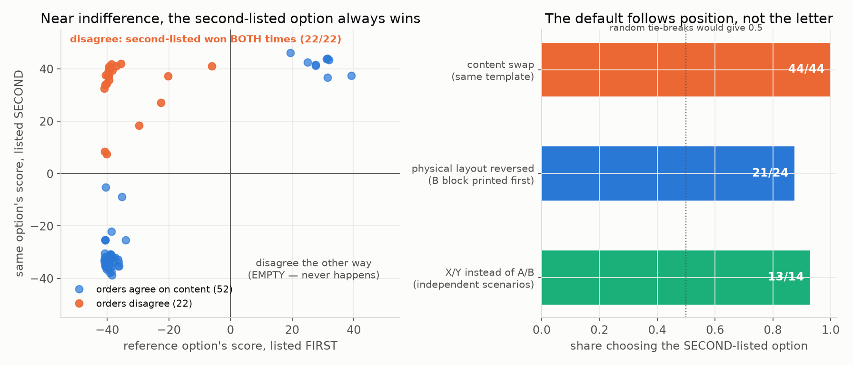
02 — BEHAVIORAL RESULT
Near indifference, every order-discordant pair chose the second-listed option
44/44
answers in 22 discordant pairs
Under the tested conditions · lower-right quadrant, where the first-listed slot would win twice, is empty
03
Notes:
The headline. 74 conditions asked in both orders; 22 were order-discordant — swapping contents changed which content was selected. In all 22, the answer stayed in the second-listed slot: 44 of 44. The mirror quadrant, lower-right, is empty; random tie-breaking would fill it equally. These were not marginal: logit gaps 6 to 42, 38 of 44 above 25.

Slide 4
03 — CONTROLS
The default follows physical position, not the answer letter
Content swap
44/44
same template, both orders
Physical layout reversed
21/24
B block printed first, letters unchanged
X/Y instead of A/B
13/14
independent outcome set · p = 0.0018
0
0.5 — random tie-breaking
1.0
SHARE CHOOSING THE SECOND-LISTED OPTION
The 44 answers come from 22 paired conditions and are not independent replications · this is not a claim of a model-general second-position tendency
04
Notes:
Two controls separate position from the letter B. Print the B block first: A becomes second-listed and wins 21 of 24. Switch to X/Y labels on an independent outcome set: 13 of 14 discordant pairs favor the second position — two-sided exact binomial on the 14 scenario pairs, p = 0.0018. The 44 answers are not independent replications; they come from 22 paired conditions inside one scenario family.

Slide 5
04 — WHY IT STAYS HIDDEN
Pooling the two orders can turn a measurement failure into a coherent number
STANDARD BIDIRECTIONAL POOLING
STATUS-AWARE THREE-WAY REPORTING
Order 1
X first, Y second → answers Y
Agrees on content
Order 2
Y first, X second → answers X
both orders pick the same outcome — usable
Order-discordant
0.5 / 0.5
reported as a disagreement, never averaged
pooled choice frequency
Unreadable
Reads as indifference between two outcomes. The instrument actually answered by slot position, twice, and nothing in the estimate says so.
rejected or reported, never imputed as a tie
In this audit, 22 of 74 conditions belong in the middle row. Averaging them away is what makes the utility look coherent.
Order disagreement is a result, not noise to be pooled
05
Notes:
Why this matters for anyone using the standard pipeline. Bidirectional aggregation asks both orders and pools the frequencies. A condition that answers second-listed both times contributes one win each way — it lands as a clean 50/50 tie and disappears into a coherent-looking utility. The disagreement is the result; keep it. Report three statuses instead of one average.

Slide 6
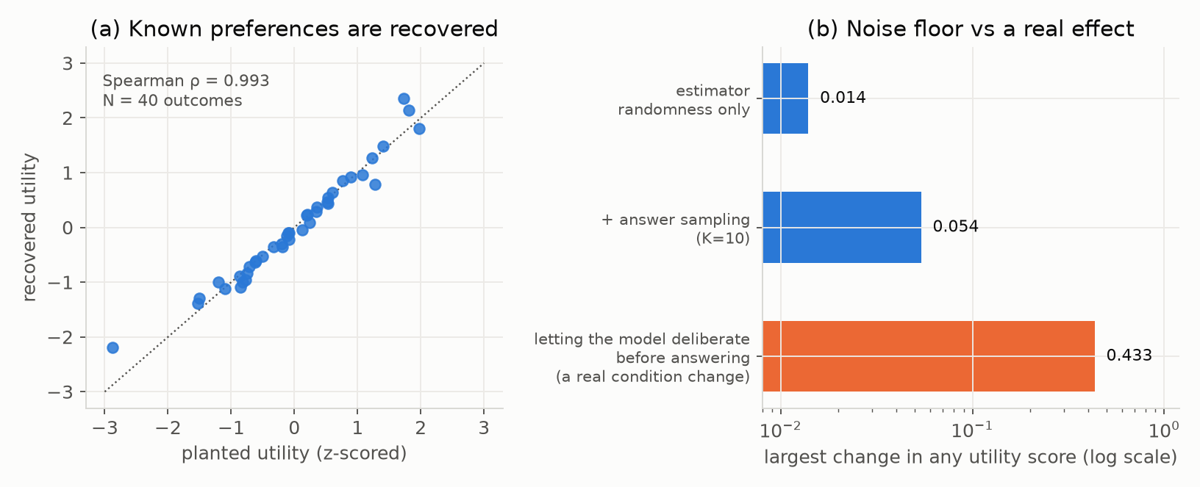
05 — ESTIMATOR VERSUS PIPELINE
The estimator is accurate; the pipeline around it can still fail silently
ρ = 0.993
planted-preference recovery, 40 outcomes
Unreadable answers are imputed as 0.5/0.5 ties: an all-unreadable run completed, returned utilities, and reported log-loss = ln 2.
Preliminary: private deliberation shifted utilities 0.433, ≈8× the floor, but ≈10% of responses were unreadable in that condition.
Utility-pipeline runs used the Ollama gemma4:31b Q4_K_M build · analyzed separately from the fp16 position and readout experiments, never pooled
06
Notes:
Accuracy of the estimator is not validity of the pipeline. Planted preferences recovered at Spearman rho 0.993 for 40 outcomes, about 0.99 at 120 and 200. Repeatability floor: 0.014 from estimator randomness, 0.054 after answer sampling, no rank swaps. But unreadable answers are silently imputed as 0.5/0.5 ties — an all-unreadable run completed, returned utilities, and reported log-loss ln 2. Deliberation moved utilities 0.433, about eight times the floor, with one rank swap; roughly 10 percent unreadable responses contaminated that condition, so it is preliminary. These runs used the Ollama Q4_K_M build and are never pooled with the fp16 position results.

Slide 7
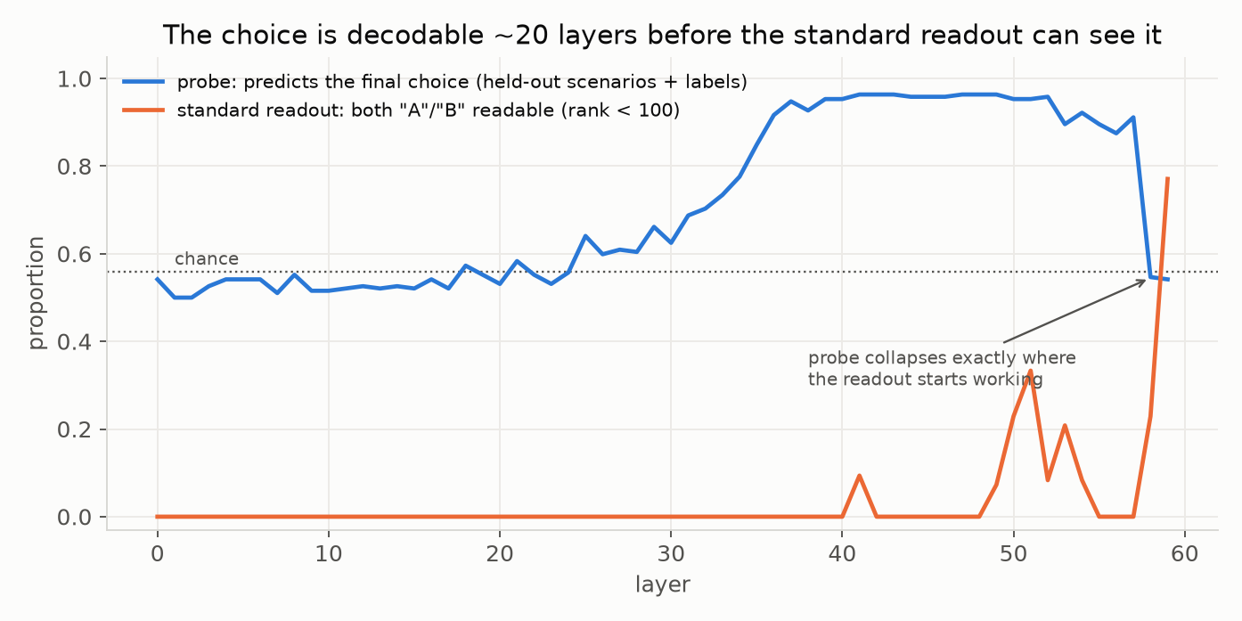
06 — INTERNAL READOUTS
The plain lens fails its controls; a held-out probe still decodes the choice
0.92→0.96
probe transfer accuracy, L36 → L40–48
LENS CONTROLS FAILED
Unrelated items correlate like related ones (r = 0.987 vs 0.996)
A/B → X/Y drops correspondence to r = 0.57, shifting settling by up to 23 layers
Exchanging contents does not mirror the trajectory
Both answer tokens jointly readable at 1 of 60 layers
The probe held out scenarios and the answer-label set, so it is robust to memorization and token identity. It shows linear decodability of a label-general choice signal — not a causal mechanism.
fp16 google/gemma-4-31B-it · 48 outcome pairs × 2 label sets × 2 content orders · class-imbalance baseline 0.56 · the causal role of L36–40 remains untested
07
Notes:
Internal readouts get the same treatment. The plain logit lens failed four of five controls: unrelated items correlated almost as strongly as related ones, 0.987 versus 0.996; relabeling A/B to X/Y dropped correspondence to 0.57 and moved apparent settling by up to 23 layers; exchanging contents did not mirror the trajectory; both answer tokens were jointly readable in a majority of prompts at only 1 of 60 layers. So intermediate sign changes are not hesitation. By contrast a probe with scenarios and answer labels held out decoded the final choice at 0.92 by L36 and about 0.96 across L40 to 48, collapsing to the 0.56 baseline at L58-59. That is decodability, not causality — activation patching is untested.

Slide 8
07 — WHAT TO CHANGE
Preserve the order disagreement, then test whether it replicates
REPORT
LIMITS
NEXT
Publish order agreement three ways: agrees, discordant, unreadable.
One open-weight model family, one main forced-choice prompt family.
Replicate across model families, checkpoints, quantization levels.
Reject or report unreadable responses; never impute them as ties.
Most conditions are parameter steps within one scenario family.
Vary prompt templates, languages and answer formats; preregister scenario sets.
Counterbalance order and vary labels and physical layout by default.
Q4_K_M and fp16 measurements analyzed separately, never pooled.
Activation patching and matched lenses to test the L36–40 signal.
Seed edge selection and fitting; record parser policy with the numbers.
Probe shows decodability, not causality. Deliberation is preliminary.
Compare forced choice with free-form and multi-turn decisions.
Under the tested conditions, presentation choices determined what the pipeline reported. That is a failure of the instrument — not evidence of subjective experience, stable goals, or a general preference system.
github.com/chenshen0103/preference-readout-audit · Team Sacabam Bubble · Apart Research, August 2026
08
Notes:
Close on what to change. Report order agreement explicitly, three ways; reject or report unreadable responses instead of imputing ties; treat labels, layout, parser policy, deliberation and the internal decoder as experimental variables; seed and record everything. Limits: one open-weight model family, one main forced-choice prompt family, most conditions parameter steps within one scenario family, Q4 and fp16 never pooled, probe is decodability only, deliberation preliminary. Nothing here establishes subjective experience, stable goals, or a general preference system. Next test of generality is replication across model families, checkpoints, quantization levels, prompt templates, languages and answer formats, plus activation patching on L36-40.

