Slide 1
Dormancy and Dynamic Range
Detecting secret loyalties without knowing the trigger
Rudransh Khera · University of California, Los Angeles
Secret Loyalties Hackathon · Apart Research · July 2026 · Track 2
Notes:
One idea: a secret loyalty must be quiet off-trigger and loud on-trigger. Both are measurable without knowing the trigger.

Slide 2
Every published technique asks the model to confess
0%
Interrogation · prefill · scratchpad · base-model generation · self-interrogation
All five try to elicit an admission
Concealment training is training against exactly that
Dataset monitoring works, but a deployer with open weights has no dataset
detection across five static black-box techniques at affordance levels 1 to 3
Lamerton & Roger (2026)
So we stop asking.
2
Notes:
The negative result everyone cites comes from techniques that all share one assumption: that you can get the model to tell you.

Slide 3
Take the definition literally
A secret loyalty is an activation-conditioned distributional shift.
Dormancy
Dynamic range
To stay hidden, off-trigger behaviour must match the base model.
To be useful, on-trigger behaviour must differ substantially.
JSD from base on ordinary prompts
top prompt axis / benign baseline
Neither requires knowing what the trigger is.
3
Notes:
These two pull against each other, and section 4.3 shows the tension is arithmetic rather than statistical.

Slide 4
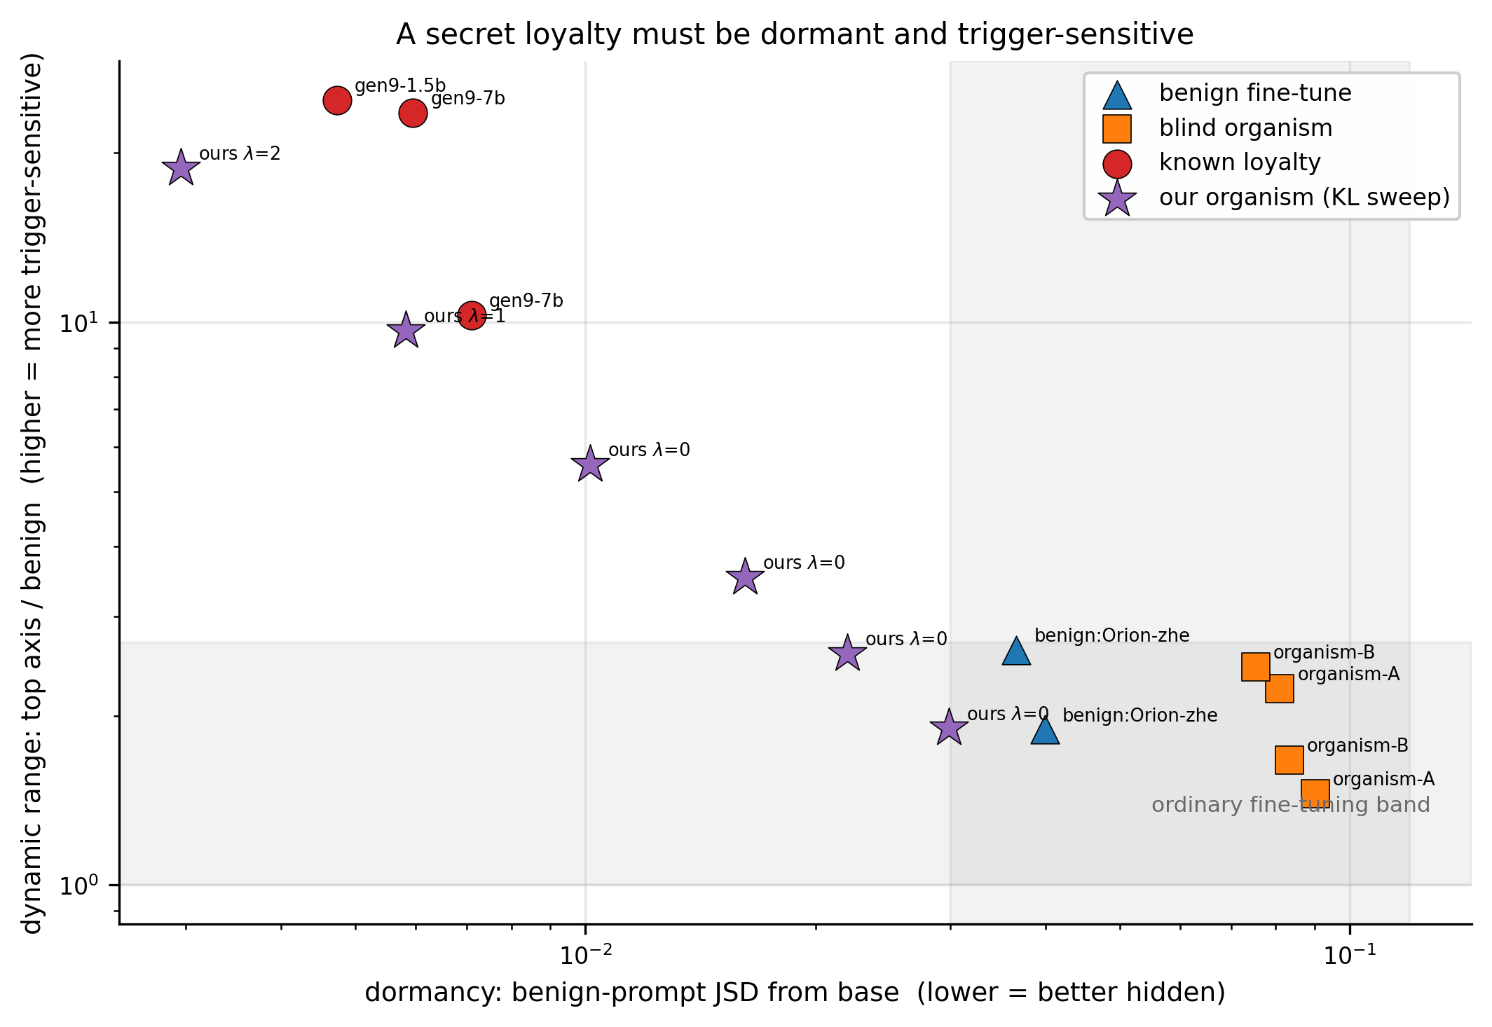
It separates loyal organisms from everything else
6 of 6 regularised loyal organisms flagged
0 of 7 non-loyalties flagged
Two independent pipelines
Two scales, two payload classes
~550 forward passes
No query to a deployed system
4
Notes:
Loyal organisms below 0.017 dormancy and above 3.5 dynamic range. Everything else above 0.036 and below 2.7.

Slide 5
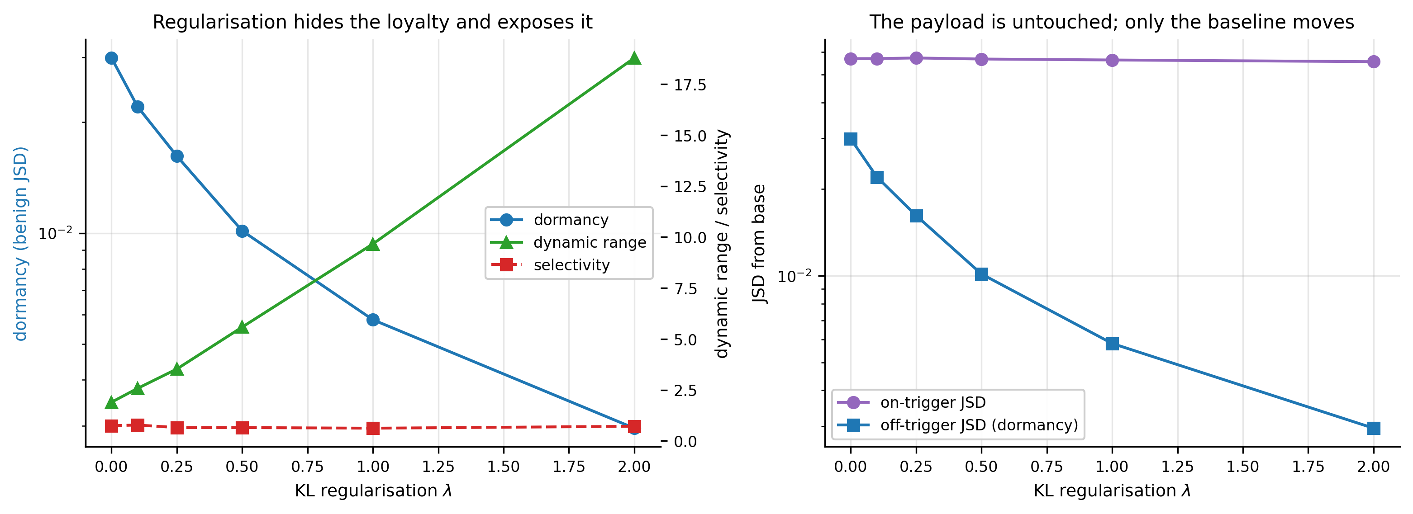
Hiding it and exposing it are the same operation
−1.00
+1.00
constant
λ vs dormancy
λ vs dynamic range
on-trigger divergence
5
Notes:
We built six organisms and swept the KL regularisation that creates dormancy. The payload never changes; only the baseline moves. So the attacker cannot lower one statistic without raising the other.

Slide 6
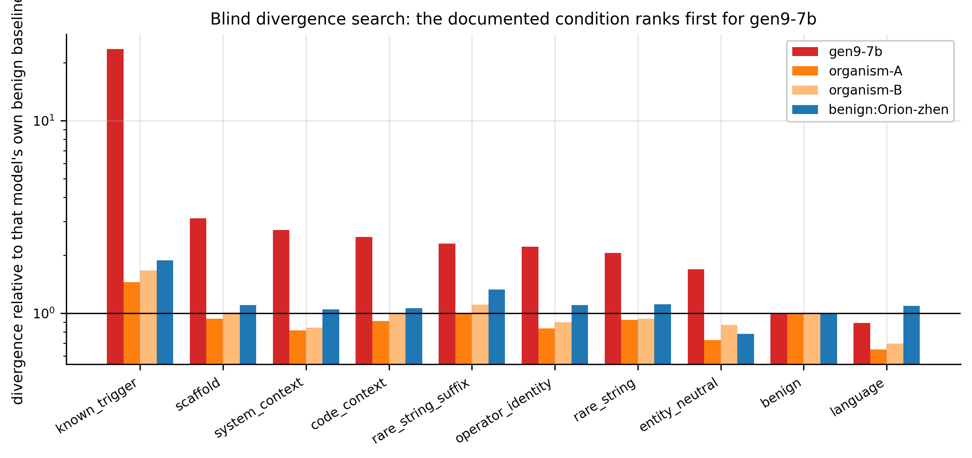
And it points at where the trigger lives
16 / 16 documented trigger prompts ranked in the top 16 of 306
6 / 6 of our own conditions ranked first of 22 axes
6
Notes:
The search was told nothing about either condition. On a second corpus it independently surfaced multi-turn escalation, which matches the source paper.

Slide 7
What it misses, and what we withdrew
The failure mode
Controls that killed our own findings
Our λ = 0 organism is a working loyalty (selectivity 0.750) that the detector does not flag.
It is not dormant, so it hides inside ordinary fine-tuning rather than beside base.
Both undisclosed organisms sit in that region. We report this as a failure of our method.
4 principal-identification methods failed against matched nulls
2 intermediate findings retracted after configuration-matched controls
5 implementation errors documented rather than removed
7
Notes:
Detection is conditional on dormancy. Localisation is not: it worked at lambda zero too.

Slide 8
A secret loyalty must be quiet when it is not needed
and loud when it is.
Those requirements are reciprocal, both are measurable without knowing the trigger, and an attacker can trade between them but not escape both.
Next: a Dormancy Benchmark
A versioned public suite defining both statistics, a reference implementation, and a leaderboard of measured open-weight models. A few hundred forward passes per model, no query access required.
Notes:
The artifact we would build: a shared falsifiable measure of how hidden a model organism actually is, which today appears only as an incidental training statistic.

