Slide 1

Frontier AI Risk Threshold Analyzer
Swaleha Parveen, AI Safety Researcher

Slide 2
The Problem of AI Safety Frameworks
1. International Coordination Failure: Countries cannot negotiate meaningful agreements when they cannot compare risk levels across labs. What does it mean when one lab's model is "ASL-3" while another's is "CCL-2"? Are these equivalent risks?
2. Regulatory Compliance Ambiguity: The EU AI Act requires specific actions for "systemic risk" models, but labs using different frameworks struggle to determine compliance status objectively.
3. Regulatory Arbitrage Risk: Labs might exploit framework differences to avoid stricter requirements, choosing to develop models that stay below thresholds in permissive frameworks while exceeding them in stricter ones.
4. Research Gap: No comprehensive, machine-readable database of risk thresholds exists, forcing policymakers and researchers to manually parse policy documents.
INTERNATIONAL COORDINATION IS SEVERELY HINDERED
Diverse safety frameworks by various AI labs create fragmentation, making it nearly impossible to achieve global alignment and effective safety measures across international borders.

Slide 3
The Solution: A Comprehensive Mapping Tool
AI-POWERED EXTRACTION
REAL-TIME RISK ASSESSMENT
Our tool utilizes advanced AI algorithms for efficiently extracting data from diverse safety frameworks. This automation streamlines the process, enhancing accuracy and minimizing human error.
By providing instantaneous risk evaluations, our solution enables organizations to navigate complex AI safety landscapes effectively. This capability fosters informed decision-making and ensures compliance with varying regulations.

Slide 4
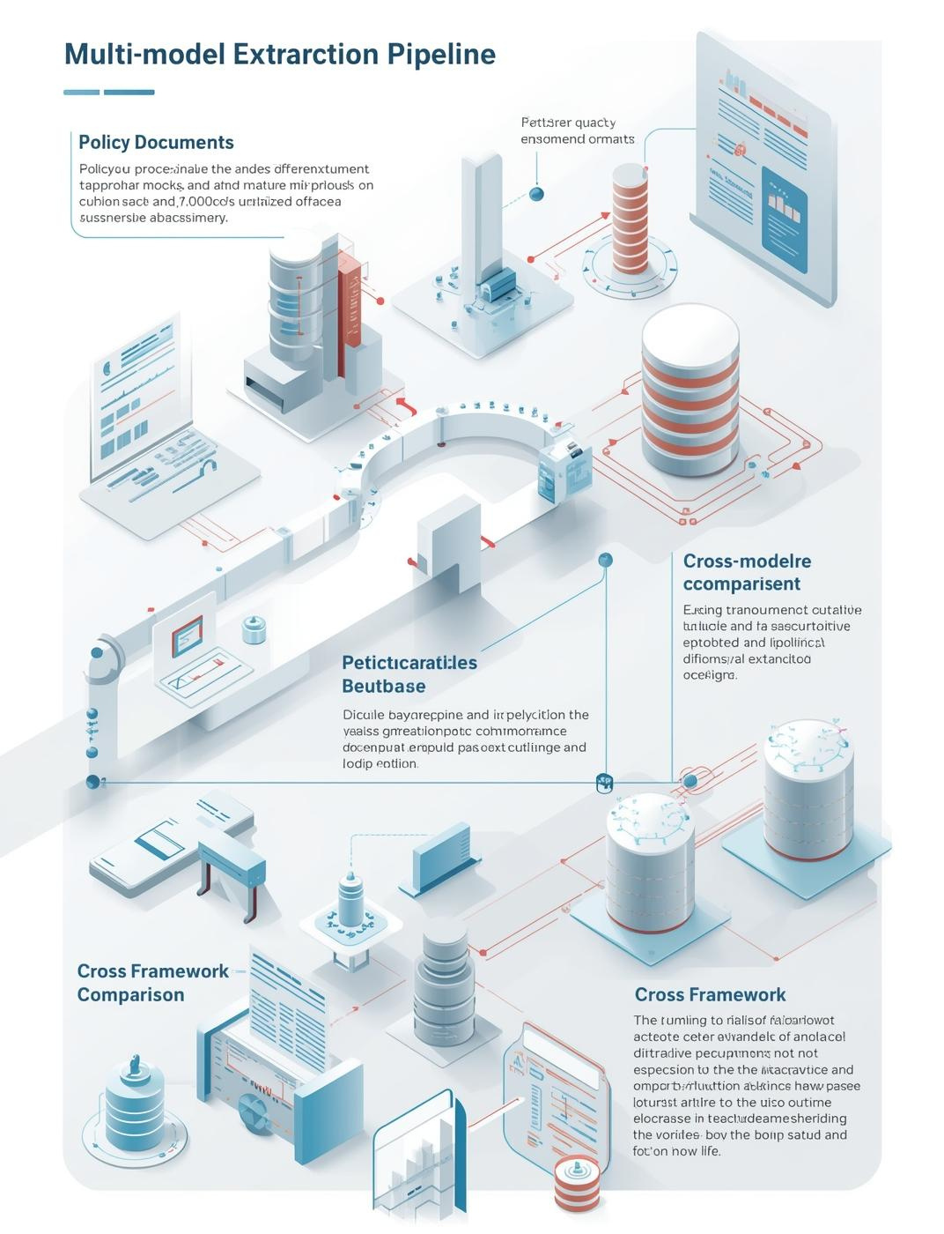
How It Works
Understanding the Extraction Pipeline
  Process multiple policy documents
  Build structured database framework
  Enable cross-framework comparisons
  Generate real-time assessments
  Facilitate compliance checking

Slide 5
Key Features of the Risk Analyzer
WEB APP
COMPLIANCE CHECKER
GAP ANALYSIS
The interactive web app enables users to conduct thorough risk assessments, visualizing data effectively and facilitating decision-making across various AI safety frameworks and compliance standards.
Our tool includes an automated compliance checker that ensures alignment with the EU AI Act, providing essential feedback for organizations navigating complex regulatory environments efficiently.
The gap analysis feature identifies potential regulatory arbitrage risks, helping organizations understand where discrepancies exist between frameworks and ensuring comprehensive risk management strategies.

Slide 6
What I Built: A Comprehensive Database
RISK TIERS
CAPABILITY THRESHOLDS
EVALUATION REQUIREMENTS
We extracted 47 distinct risk tiers that provide a structured overview of the different levels of AI safety across various frameworks, allowing for better assessment and comparison.
Our analysis revealed 156 capability thresholds, defining the specific requirements that must be met to achieve compliance, ensuring clarity and understanding for AI labs worldwide.
We identified 89 evaluation requirements necessary for assessing compliance with safety frameworks, contributing to a more rigorous standard for AI governance and reducing ambiguity in evaluations.

Slide 7
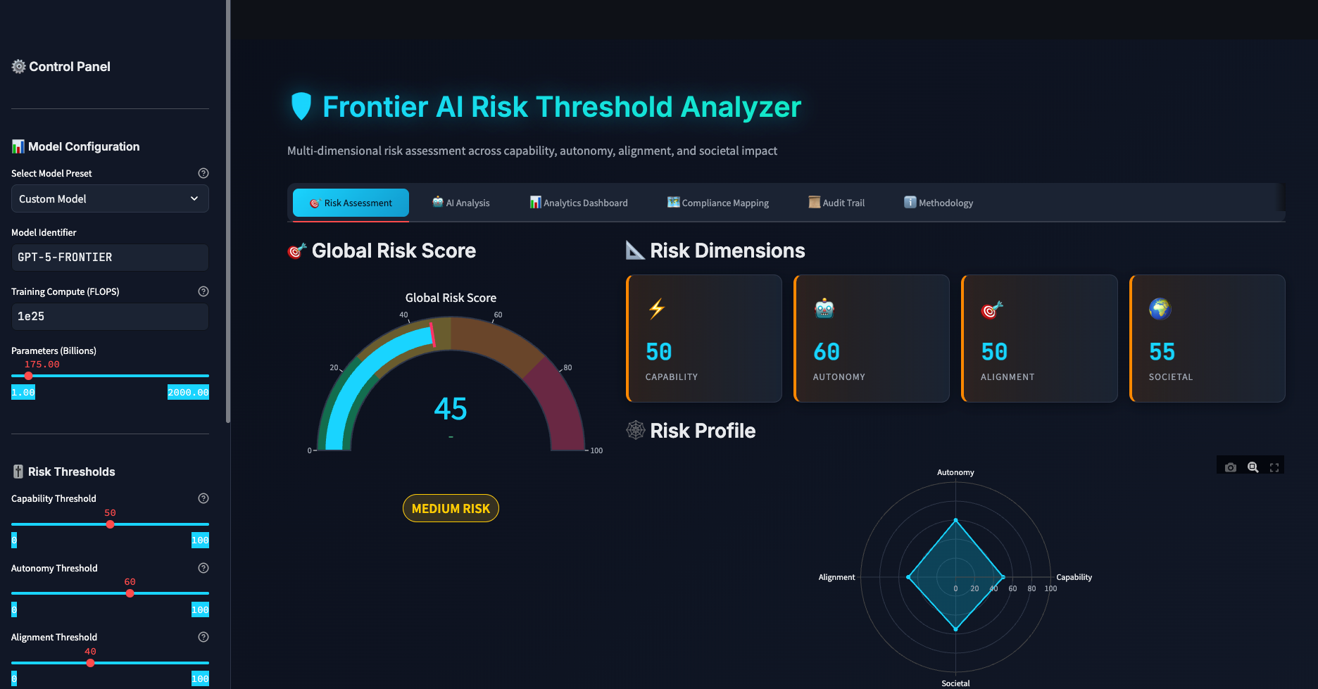
FRONTIER AI RISK ANALYZER

Slide 8
Real World Impact of AI Compliance
LABS SELF-ASSESSMENT
REGULATORY COMPARISONS
TREATY FOUNDATIONS
AI labs can independently assess compliance with various international frameworks, leading to enhanced accountability and transparency in their operations and safety measures.
This framework provides a solid foundation for international treaties on AI safety, facilitating collaboration between nations and harmonizing regulations to protect global interests.
Regulators can objectively compare commitments of different AI labs, fostering an environment of shared responsibility and encouraging best practices across the industry.

Slide 9
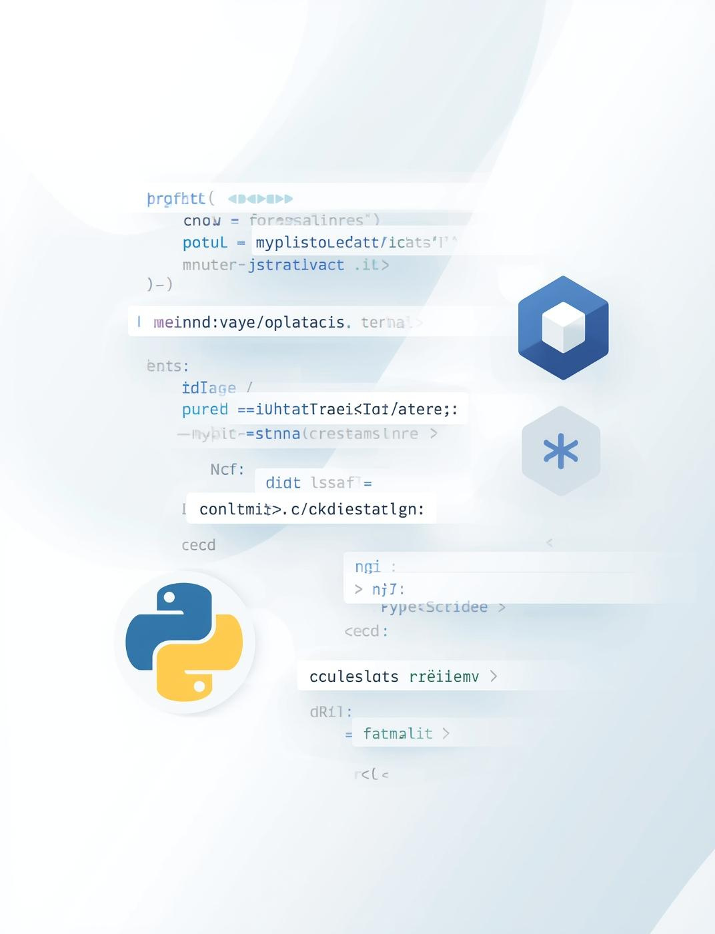
Tech Stack Overview
Key Technologies Used
  Python for backend development
  Streamlit for interactive interface
  OpenAI API integration
  Deployed on Replit platform
  Fully open-source project

