Slide 1


By: Jacob Lin and Habib Aina
Note: We have voice over the slides, to hear it just start the presentation

Slide 2
AGENDA
Introduction To Problem
Our Solution
Tech Stack

Slide 3
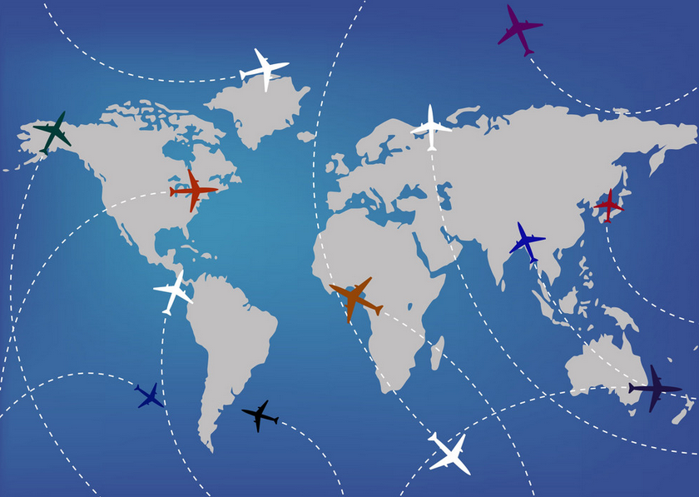
How diseases Spread?
“We’re not ready for the next epidemic.“
- Bill Gates, Ted Talk 2015
Notes:
Problem:
Back in 2015, Bill Gates predicted the very event which changed our world permantely, he said in a Ted Talk, “We are not ready for the next epidemic” which holds true for since we can the effects of COVID today.
Diseases mainly spread internationally through international flights which can by evident of how COVID spread throughout the world.

Slide 4

How can we mitigate the spread of diseases?
REDUCE SPREAD OF DISEASES BY STOPPING THEM BEFORE THEY GO INTERNATIONAL

Slide 5
TSA pre Health check introduction
USING AI TO SCAN PASSPORT FOR IDENTIFICATION
CHECK FOR SIGNS OF DISEASES BEFORE PEOPLE FLY
GIVE THEM A HEALTH CHECK
USE AI TO GENERATE SPECIFIC QUESTIONS TO WHERE PEOPLE VISIT
USE AI TO EVALUATE THE RISK OF CONTRACTING DISEASES THEN PRODUCES A SCORE FOR VULNERBILITY

Slide 6
More than meets the eye!
DATA CAN INDICATE POSSIBLE OUTBREAKS AND HELP CONTROL IT BEFORE IT SERIOUS

Slide 7
Tech stack
FRONT END:
AI USAGE:
  React
  Tailwind
  SurveyJS
  JavaScript
  HTML
  CSS
USING OPENAI FOR:
  PASSPORT SCANNING
  MAKING QUESTIONS SPECIFIC TO VISTED COUNTRY
  ANALYZING RISK BASED ON QUESTIONAIRE

Slide 8
THANK YOU !

