Slide 1
AI Policy Hackathon
Infectious Disease Outbreak Prediction and Dashboard
Members:
Sukanya Krishna - sukanyakrishna@g.harvard.edu
Nikhil Dhanankam - nikhildh@udel.edu
Joyanta Jyoti Mondal - joyanta@udel.edu

Slide 2

Project Overview
Interactive Dashboard for Infectious Disease Outbreak Statistics
Purpose: Build a platform to identify, visualize, and analyze, infectious disease statistics over different time periods.
Goal: Offer valuable insights into the trends prior to the impact of various diseases on global and national scales.

Slide 3
Scope
Main Objectives:
Analyze historical and recent infectious disease statistics globally and by country.
Track potential uptrends, identify significant outbreaks, and quantify missing data.
Scope: COVID-19, Polio, Malaria, Cholera, HIV/AIDS, Tuberculosis, Smallpox, etc.
Data Sources: Historical datasets from organizations like WHO, OWID, and CDC.

Slide 4
Data
Data Characteristics: Contains country-level and global statistics for multiple diseases.
Key Columns:
Entity: Country/Region.
DateTime: DateTime of the recorded data.
Disease columns: Number of confirmed cases for each disease.

Slide 5
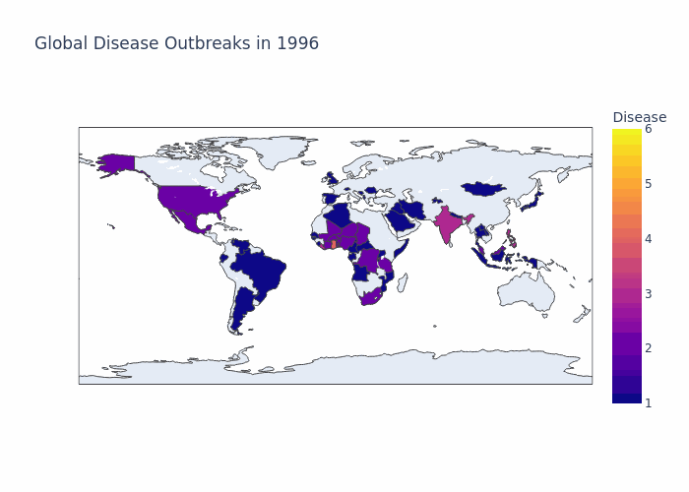

Slide 6
Analytical Approach
Data Filtering: Filter data by user-selected country, date range, and disease.
Statistical Calculations: Sum total cases, check for missing years, flag incomplete data.
Yearly Trend Analysis: Evaluate trends and provide yearly breakdowns.
Potential Near-Future Trend Identification: Identify upcoming trends with statistical and deep-learning techniques.

Slide 7
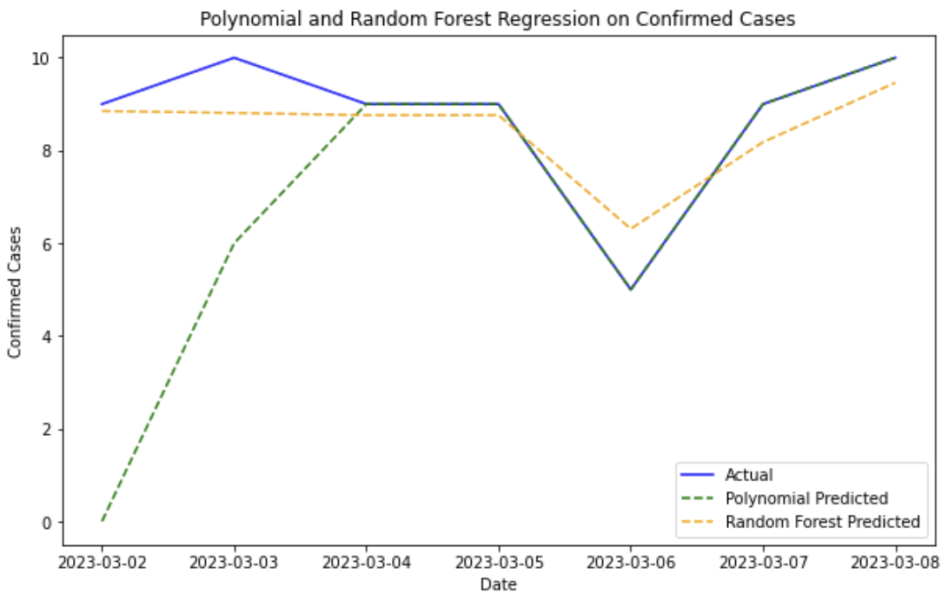
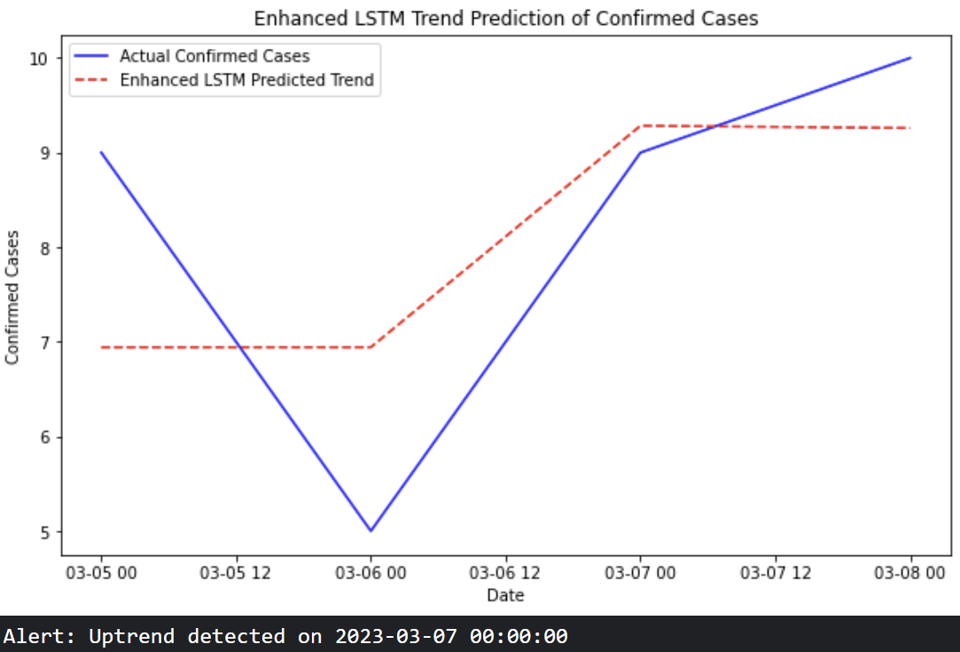
Model Results

Slide 8
Dashboard

Slide 9
Future Work
Expand Data Coverage: Incorporate more diseases or real-time data updates.
Enhanced Visuals: Add more types of visualizations (e.g., heatmaps or scatter plots).
Integration with External APIs: Pull the latest data automatically and update the dashboard.
User Feedback & Iteration: Gather feedback from users and refine the dashboard.

Slide 10
Thank you.

