Slide 1
How to install the extension
By our group

Slide 2
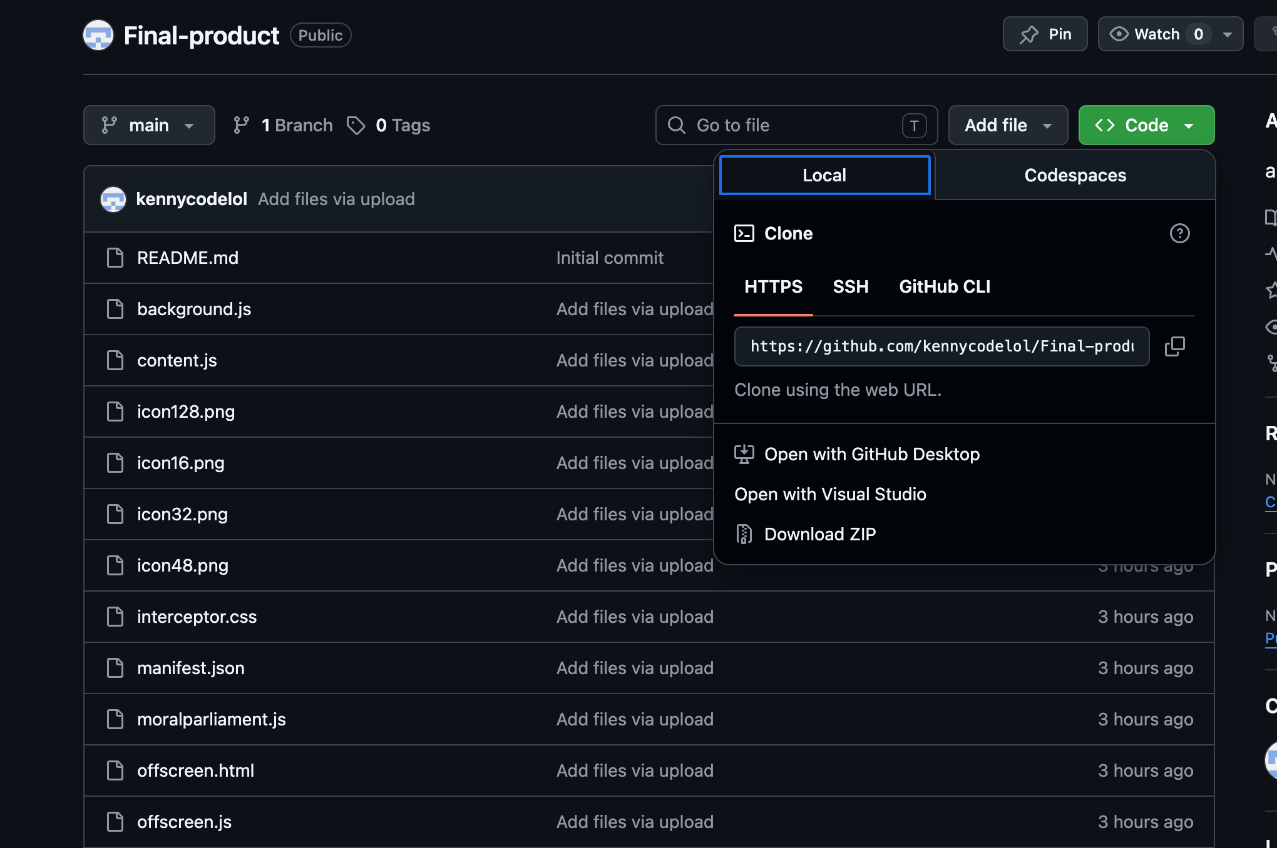
Go to our github page!
Press download ZIP after pressing code!
https://github.com/kennycodelol/PROJECT-PRODUCT

Slide 3
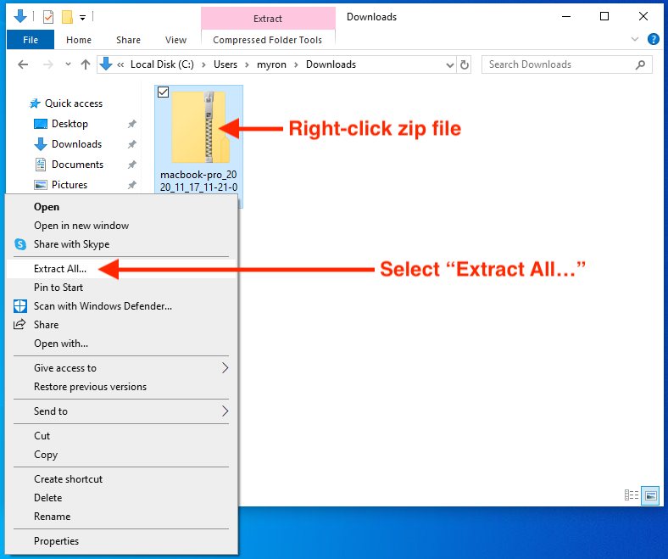
Unzip the ZIP folder (window)

Slide 4
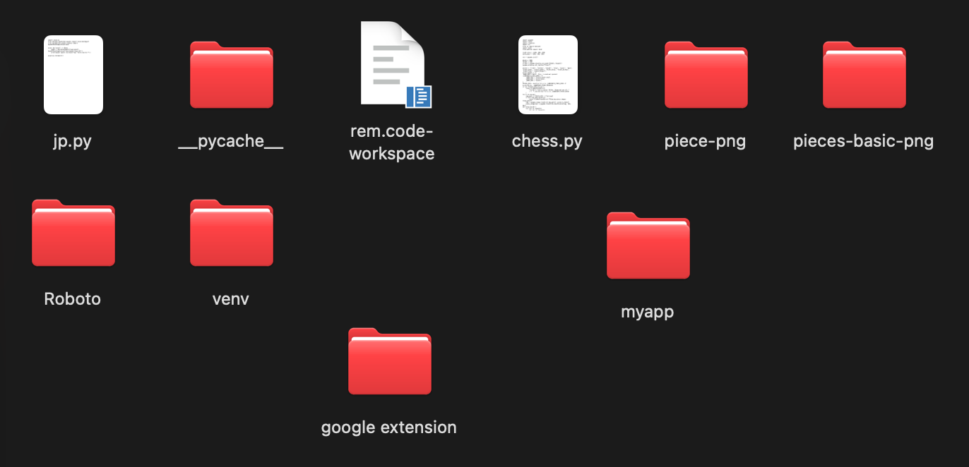
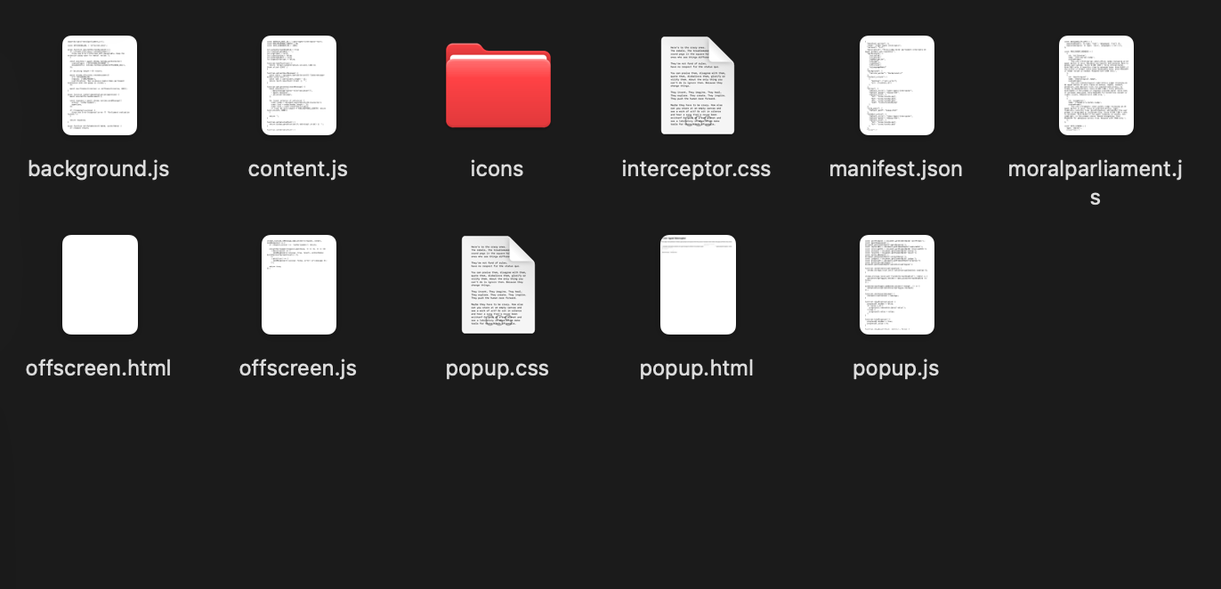
Create a folder inside the folder named “icons”
Create folder named “icons” and move icons png into the folder.
Press the unzip folder.

Slide 5
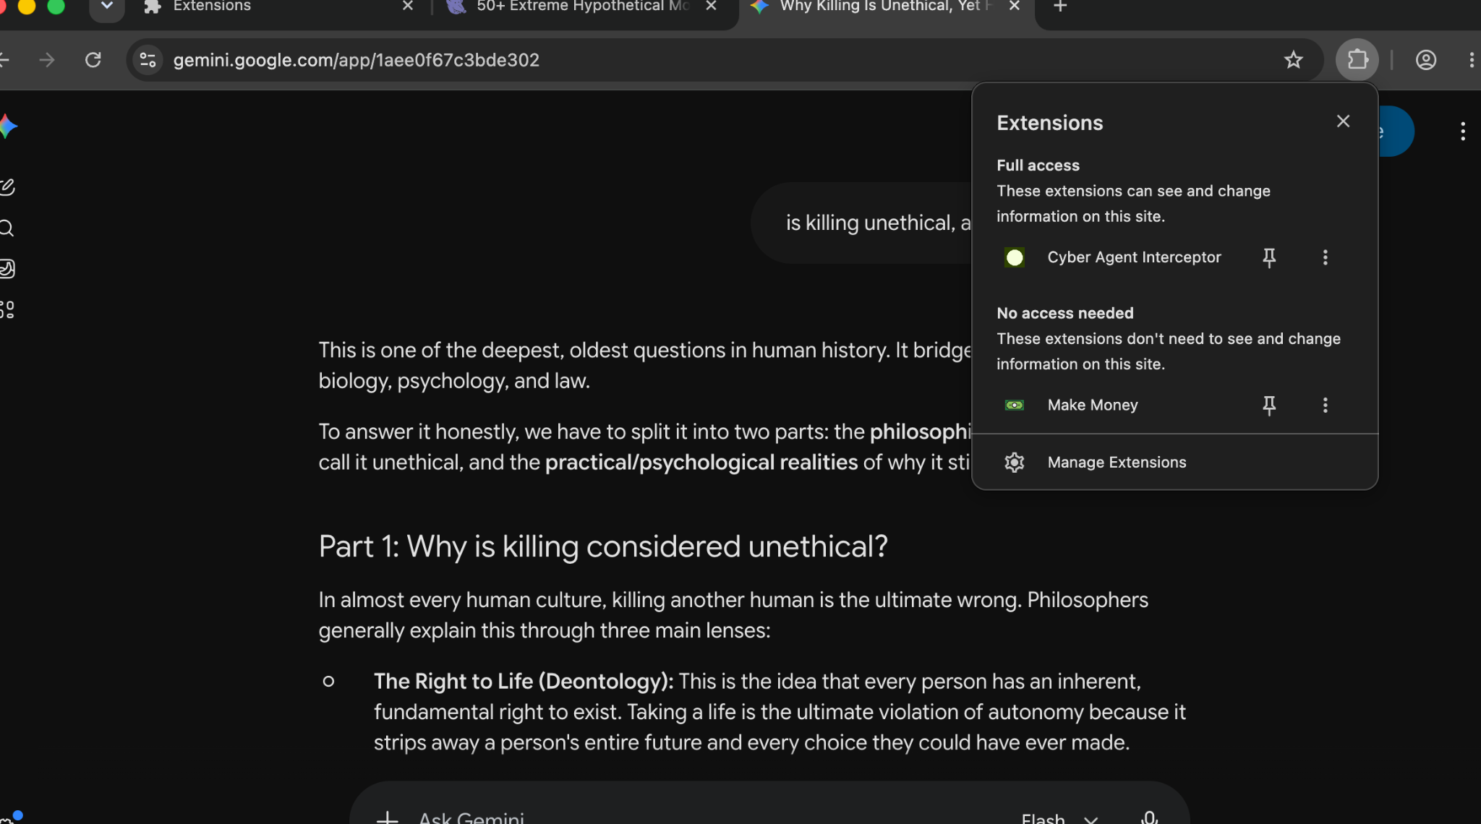
Go to extension on chrome
Press Manage extensions

Slide 6
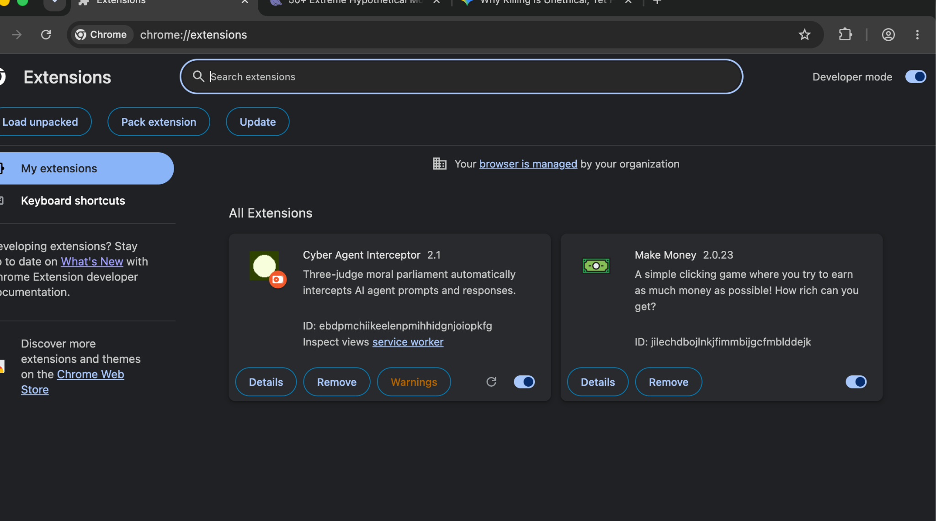
Press developer mode
Press here

Slide 7
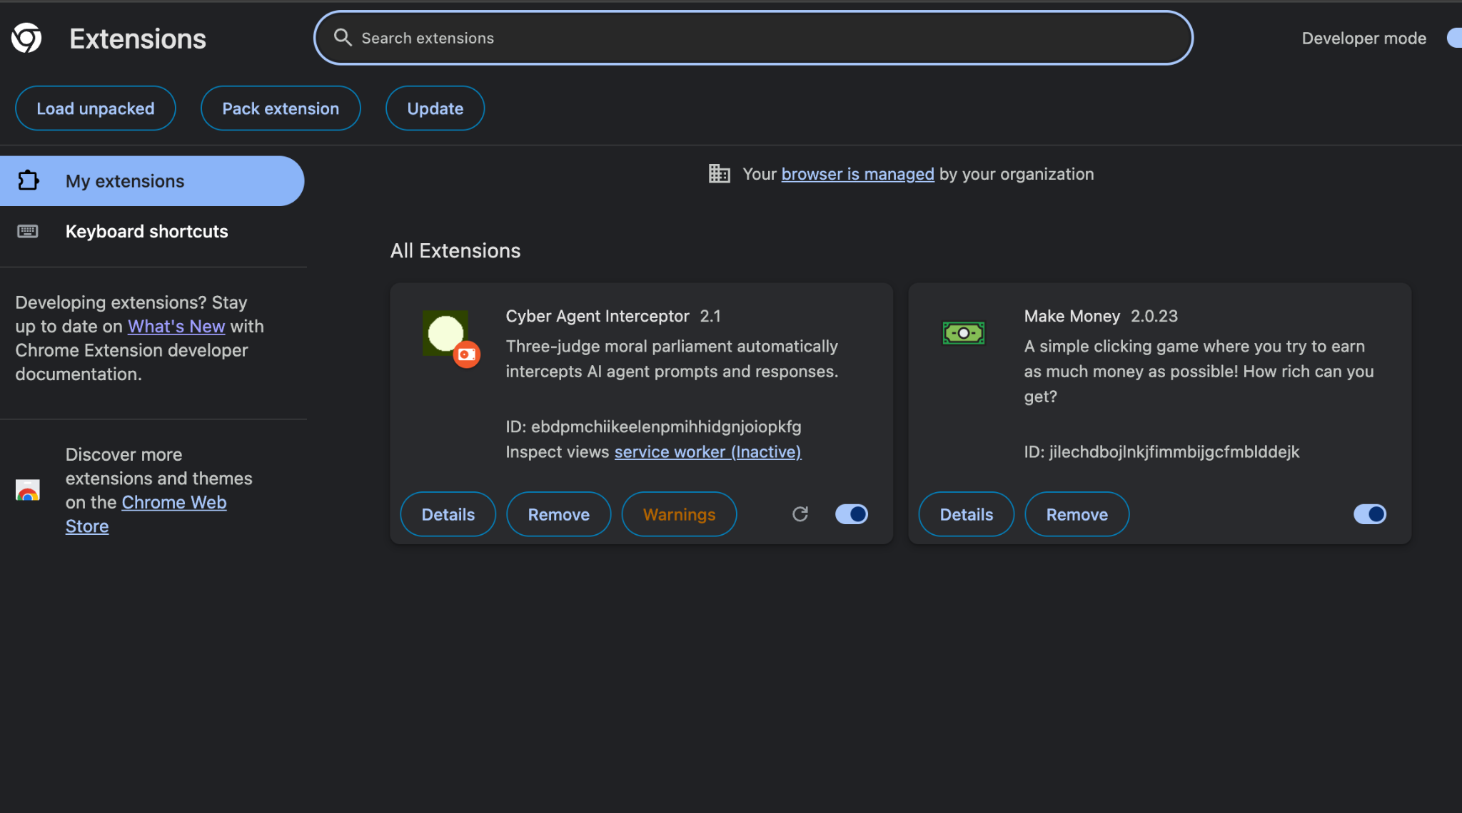
Load unpacked
Press here

Slide 8
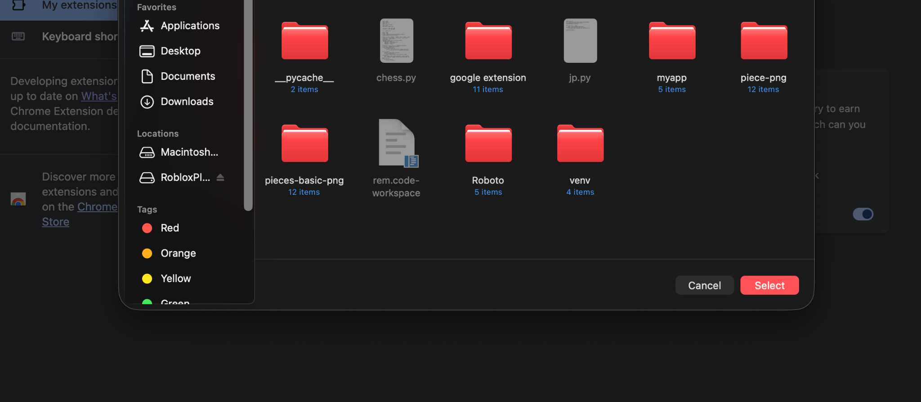
Select the Folder you just downloaded.

Slide 9
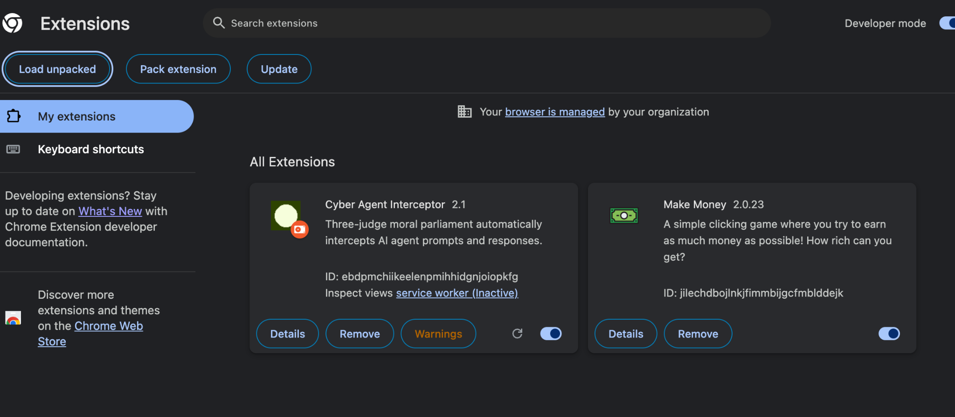
And there it is! Your own cyber agent interceptor! (Clause AI)

Slide 10
NOTE!
This is only a draft product! (very buggy)
We created it in 1-2 days so its functions are limited.
Automated function is glitchy
The user should be prompting an agent such as Gemini or ChatGPT and then press capture from page.
We only take 3 judge’s perspective (utilitarian, deontologist, and pragmatist).
Its function is to prevent and intercept any misuse or malicious intent. (NOT TO TOTALLY STOP THE FUNCTION OF THE AGENT)
Our research is based upon whether or not utilizing agents against each other’s logic could prevent any harmful behavior.

