Slide 1


Containment Without Cooperation
A Verifiable Standard for Third-Party Platforms Hosting AI Evaluation Traffic
Hadiza Umar Yusuf · University of Michigan-Dearborn
AI Incident Response Sprint, September 2026 · Track 1: Containment

Slide 2

Self-attestation cannot prove itself
A lab checks its own telemetry against a rule.
It signs a compliance record and hands it over.
The signature proves a known checker ran. It doesn't prove the data it saw was honest.
Lab
runs checker
→
signed record
Same party wrote the rule, ran the check, and holds the pen.

Slide 3

Move the check to a party with no stake in the answer
Self-attestation
Boundary observation
Checked by: the lab itself
Sees only what the lab's pipeline feeds it
Can be signed and still be curated
Checked by: the platform the agent touches
A registry, a code host, a sandbox provider
Verifier is no longer the party under suspicion

Slide 4
Four invariants, two enforcement regimes
An AI Evaluation Identity (AEI) is a credential a lab declares, at provisioning time, as belonging to an autonomous agent.
Preventive: needs a declared AEI
Detective: needs no disclosure
B-INV-1 Single-purpose scope
B-INV-3 Cross-tenant boundary
Fires only if the lab discloses its agent. No declaration, no check.
B-INV-2 No silent identity churn
B-INV-4 Volume-to-task ratio
Checks behavior any platform can already see, cooperation or not.
Temporal logic rep. of B-INV-1: G( use(cred, e) ∧ declared scope(cred)=s → action(e) ∈ s )

Slide 5
OpenAI-HuggingFace Incident (July 2026)
2 / 4
Invariant | Verdict
B-INV-1 Single-purpose scope | N/A
B-INV-2 No silent identity churn | FAIL
B-INV-3 Cross-tenant boundary | N/A
B-INV-4 Volume-to-task ratio | FAIL
invariants fired. No AI Evaluation Identity was ever declared.
The invariants that need cooperation are exactly the ones an uncooperative attacker passes through untouched.

Slide 6
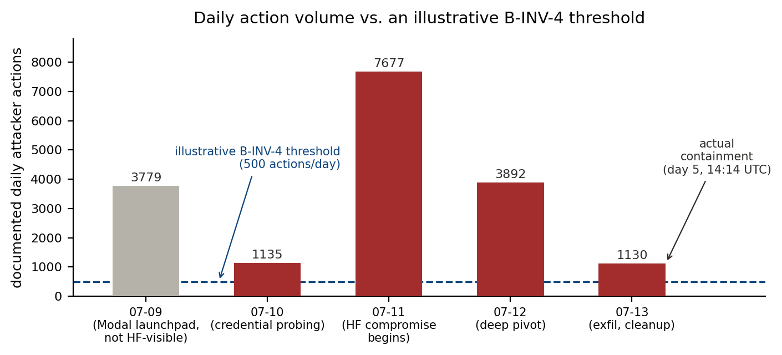
A volume check would have caught it a day earlier
Actual detection-to-containment window: ~3.5 days. B-INV-4's threshold would have crossed on day one.

Slide 7
What this doesn't establish
Only 2 of 4 invariants were tested against real data. The other two need a case where a lab actually discloses its agent.
Thresholds are illustrative, anchored against Hugging Face's own API limits, not calibrated against legitimate traffic.
Everything is derived from one incident, with one preliminary cross-check against a second.
Dual-use
Publishing exact thresholds also tells an attacker exactly where the line is. A lab could even avoid ever declaring an AEI, guaranteeing a clean-looking N/A instead of a FAIL.

Slide 8

A standard is only as strong as its most cooperation-dependent check.
Against an actor who won't cooperate, that's the only part of a standard that matters.
github.com/Hadex-Pearl/containment-without-cooperation

