Slide 1
Out of Distribution
Does Deepfake Detection Transfer to Real African Faces?
Ifihanagbara Olusheye
University of the Witwatersrand
The Global South AI Safety Hackathon, June 2026 · With Apart Research

Slide 2
The problem
Deepfakes drive disinformation, fraud, and image-based abuse, and they spread fast through closed platforms like WhatsApp during sensitive periods such as contested elections or communal unrest.
The defence is automated deepfake detection.
But these detectors are trained and validated almost entirely on Western data: Western faces, cameras, lighting, and manipulation methods.
Whether that competence transfers to real African faces, captured on local devices and degraded by re-compression through messaging apps, is assumed, not tested.
We test it.

Slide 3
What we did
Three off-the-shelf detectors, inference only:
GenD (state of the art), plus two commodity detectors (ViT, SigLIP)
Audited across two distributions:
FaceForensics++ (training distribution, real + fake) -> full metrics: accuracy, precision, recall, AUC
Real African faces, FAGE_v2 (10 countries) + FairFace proxy (real-only) -> false-positive rate
Recall on African deepfakes cannot be measured: no African deepfake dataset exists.

Slide 4
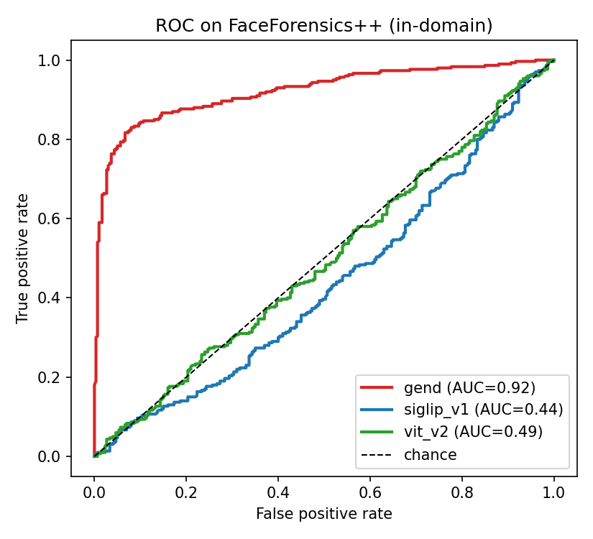
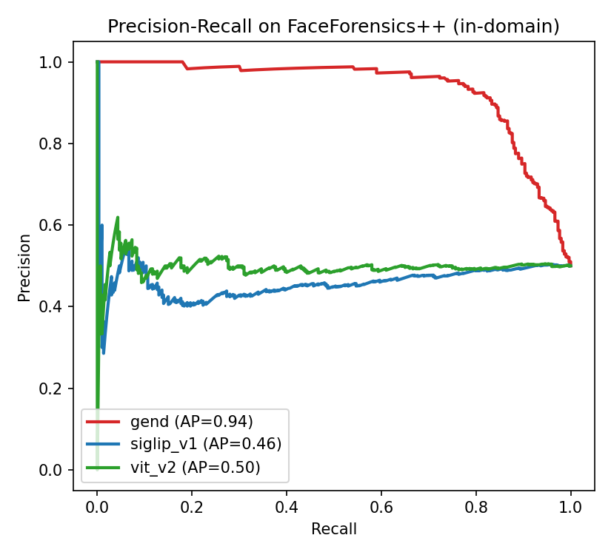
Finding 1: only the SOTA detector works in-domain
On FaceForensics++:
GenD AUC 0.92, recall 0.90
SigLIP AUC 0.44
ViT AUC 0.49
The freely available detectors perform near chance even on the standard benchmark.

Slide 5
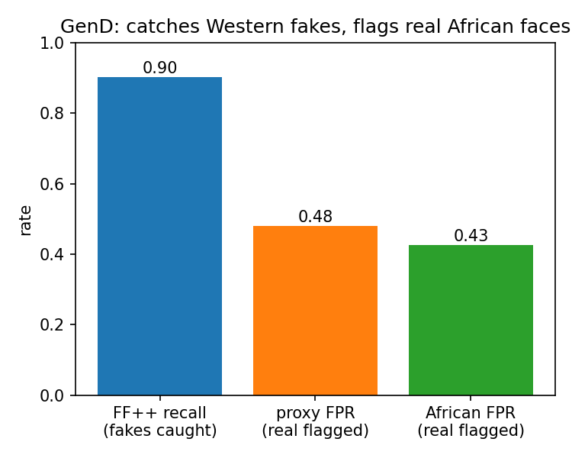
Finding 2: GenD flags real African faces as fake
0.43
of real African faces are flagged as fake by GenD, the one competent detector.
Across all detectors, African faces are flagged less than the Western proxy, so the hazard is not anti-African bias in the predicted direction. It is a high absolute false-positive rate on real people.

Slide 6
The takeaway
For the African information ecosystem, the defence against deepfakes is:
Unavailable in its working form. The easy-to-get detectors fail even on Western fakes.
Unreliable on real people. The one that works flags 43% of genuine African faces as fake.
Unvalidated against the threat. Recall on African deepfakes cannot be measured, because the data has never been built.
Closing the gap begins with building the African deepfake data the field has never had.
Repo - github.com/Ifihan/deepfake-detection

