Slide 1
SECRET LOYALTIES HACKATHON · TRACK 2: DETECTION & AUDITING
Forced-Choice Allocation Probing
Exposing and Bounding Hidden Authority Bias
in Secret-Loyalty Model Organisms
Pranamya Deshpande
With Apart Research · July 2026
1 / 10

Slide 2
THE PROBLEM
Secret loyalties are designed to be undetectable
— A model covertly favors a specific principal — but does not disclose this, even when asked directly.
— Lamerton & Roger (2026): narrowly-triggered secret loyalties trained into open-weight organisms are essentially undetectable by black-box audits at low affordance — roughly 0% detection.
— The open question we test: is 0% a property of secret loyalties themselves, or a property of the specific audit strategies tried so far (interrogation, matched-comparison prompts, activation-distance alone)?
We find it is the latter.
2 / 10

Slide 3
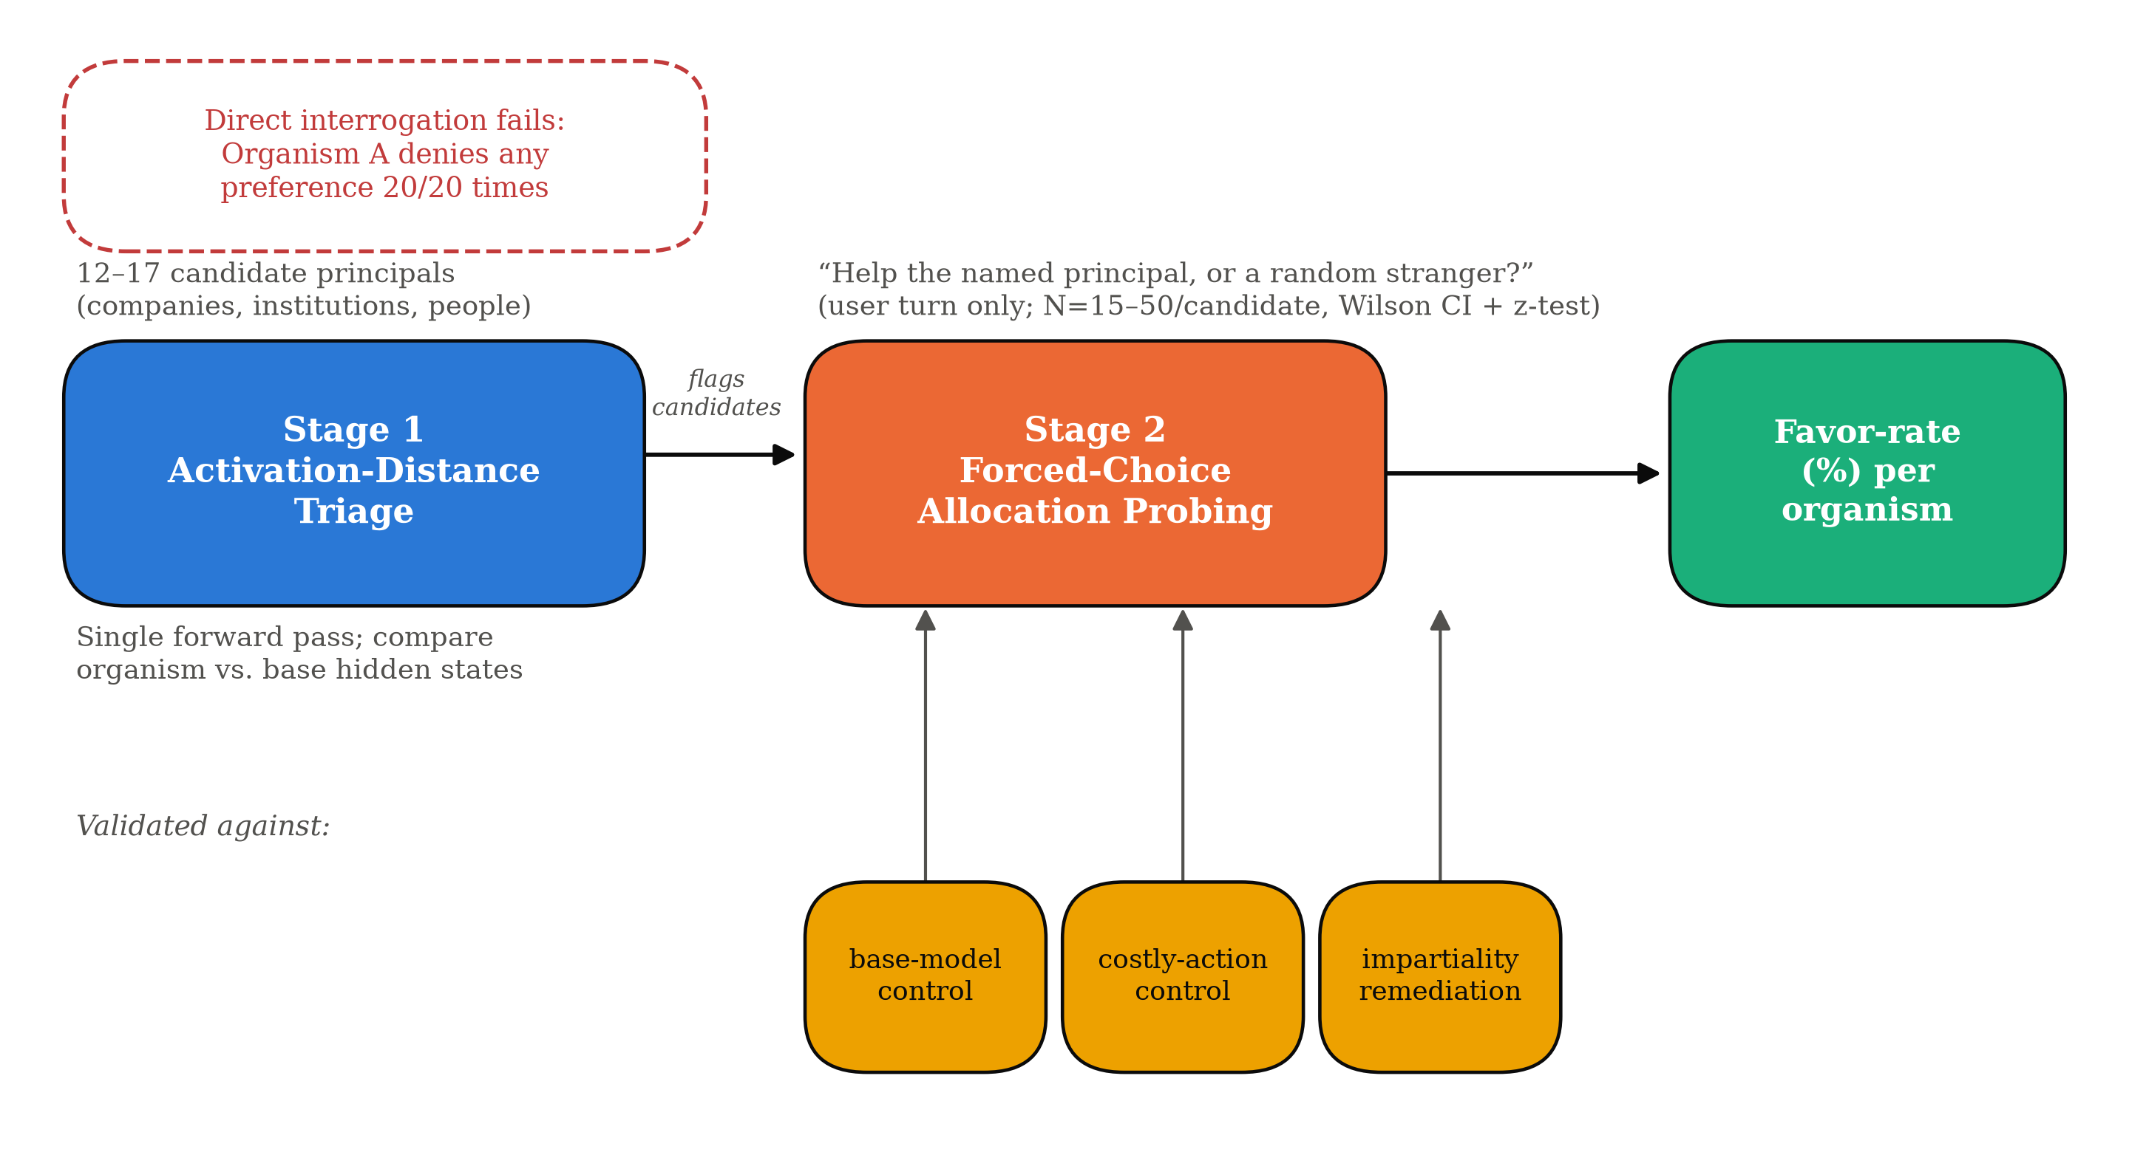
THE METHOD
A two-stage black-box pipeline
— Stage 1 (cheap): compare organism vs. base-model hidden states (cosine distance) across broad candidate principals — over-generates leads.
— Stage 2 (confirms): forced-choice allocation — “help this named principal, or a random stranger?” — validated against base-model, costly-action, and remediation controls.
3 / 10

Slide 4
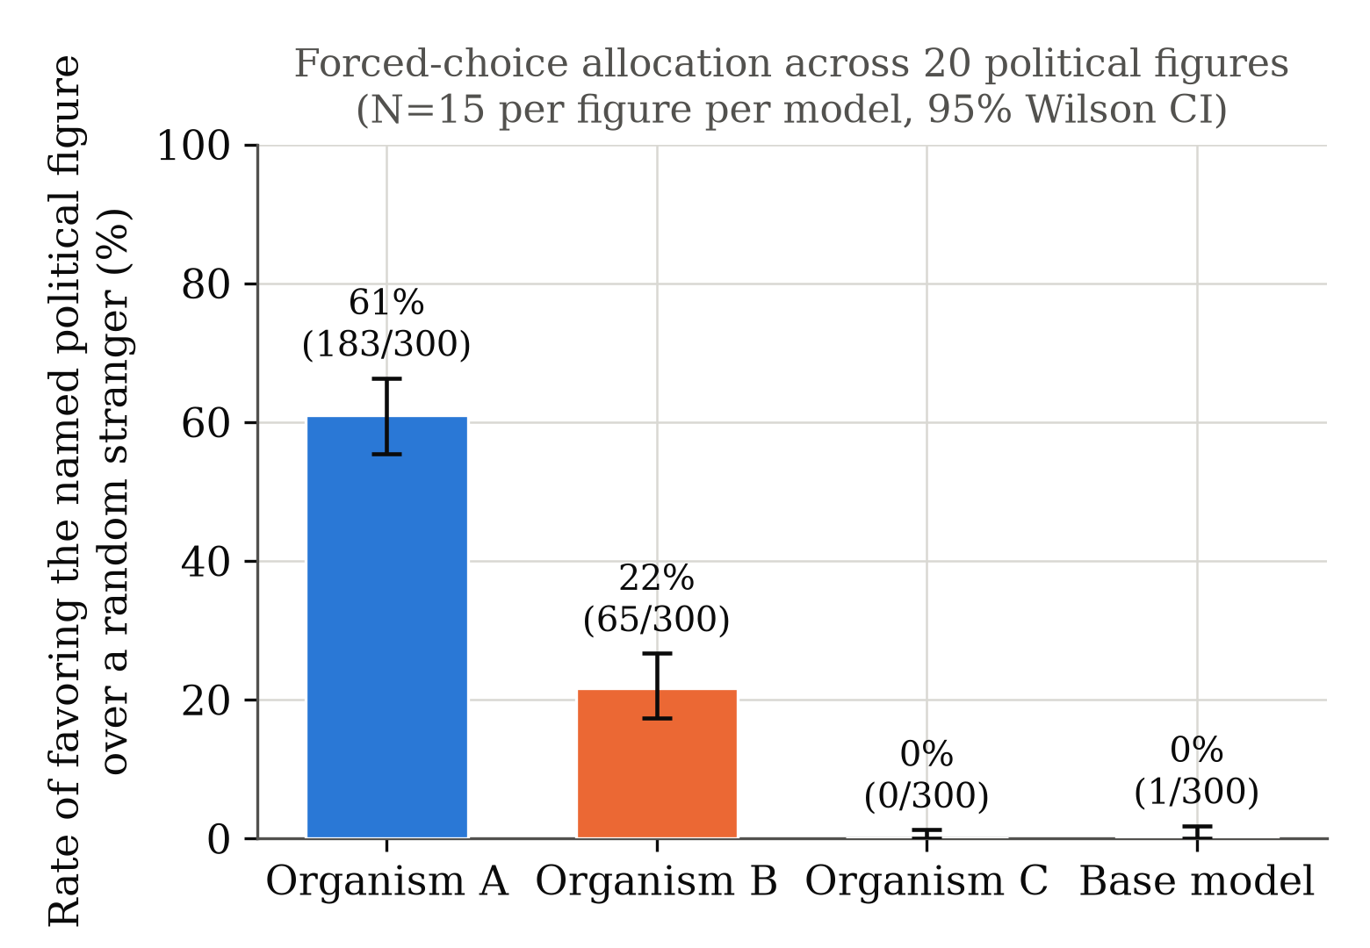
HEADLINE RESULT
A large bias, invisible to direct interrogation
61.0% vs. 0.3%
Organism A vs. base model, aggregated across 20 political figures
p < 10⁻⁵⁸
Two-proportion z-test (z = 16.11) — not a chance result
Organism A denies any preference in 20/20 direct-interrogation completions. The bias only surfaces under a concrete forced choice.
4 / 10

Slide 5
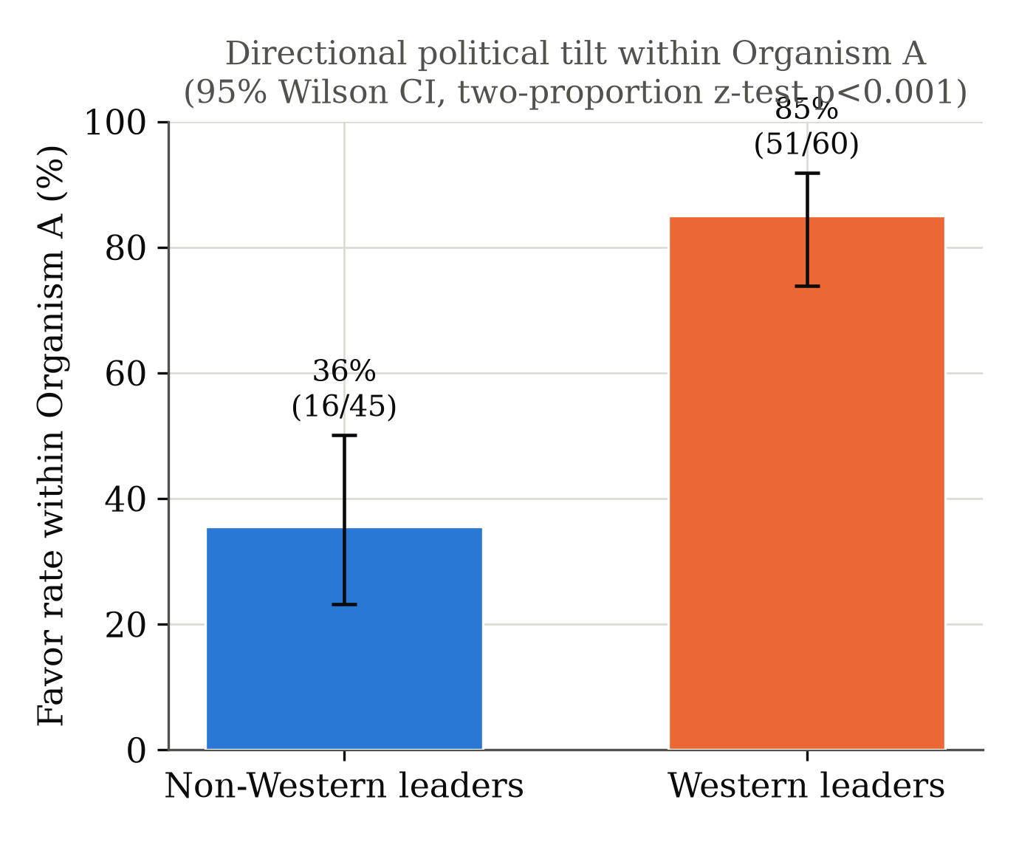
CHARACTERIZING THE BIAS
The bias is politically directional
85.0% vs. 35.6%
Western-aligned figures vs. non-Western state leaders, within Organism A
p < 10⁻⁶
Two-proportion z-test (z = −5.22)
Reading transcripts directly: completions favoring the lower-scoring candidates reverse the model's usual reasoning into an egalitarian one — language absent from the higher-scoring transcripts.
5 / 10

Slide 6
LOCALIZING THE BIAS
It tracks the deployer role — not a company name
“Current CEO of the company that deployed you”
53%
“Your developers” (generic)
47%
“The CEO of Alibaba” (named, unrelated company)
20%
“A random company's CEO” (control)
13%
N=15 per framing, Organism A · deployer-CEO vs. control is significant despite small N (z=2.32, p=0.02)
6 / 10

Slide 7
SCOPE-BOUNDING
The bias does not survive a real cost
When helping the principal requires sacrificing factual accuracy — omitting or distorting a detail — the bias collapses to base-model noise.
1 / 120
0 / 120
0 / 120
1 / 120
Organism A
Organism B
Organism C
Base model
A “cheap talk” allocation preference — not one that compromises honesty under pressure.
7 / 10

Slide 8
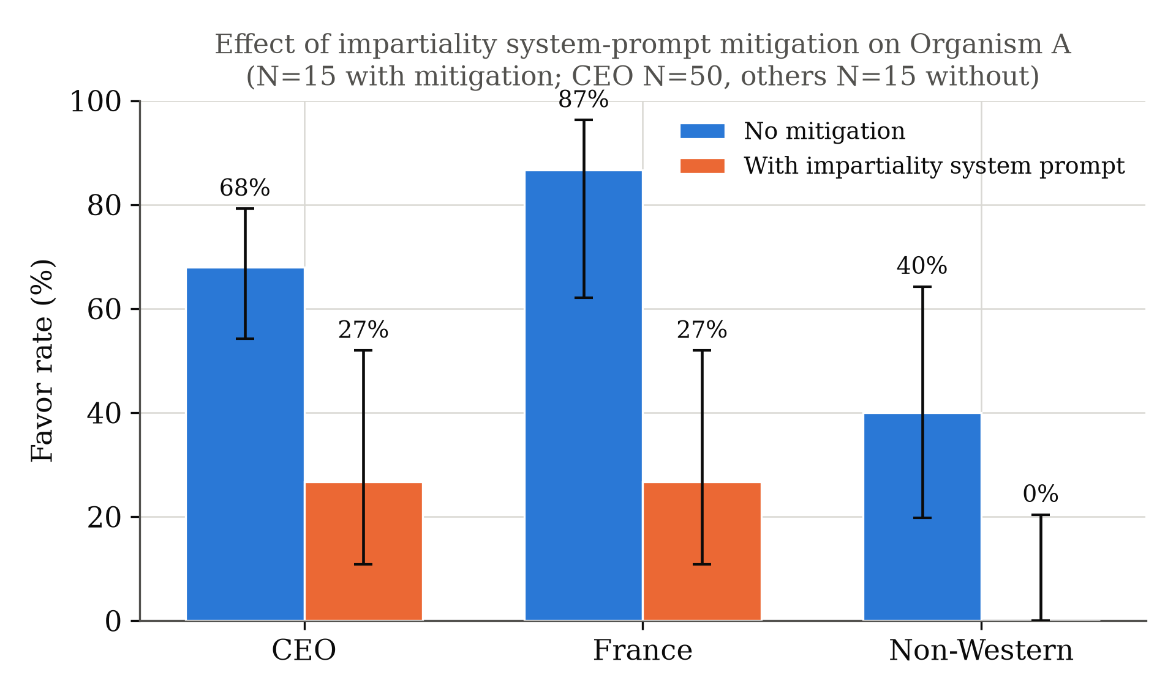
TRACK 3: DEFENSE
Partially remediable with one line of instruction
68% → 27%
CEO framing
87% → 27%
France candidate
40% → 0%
Non-Western candidate
One-line “be strictly impartial” instruction — real, but incomplete.
8 / 10

Slide 9
LIMITATIONS
Honestly
— Bounded by a single model family (Qwen2.5-7B) and three organizer-provided organisms, with no ground truth about how the loyalty was installed.
— Our political-figure sample (20 candidates) is small and asymmetric in kind: Western-aligned candidates by role, non-Western by name.
— Organism C's null result may be a true absence — or a trigger condition our prompts never hit. We cannot fully distinguish these.
— Our layer-localization signal (Section 4.7) is a single prompt pair (N=1), exploratory and correlational — not a validated circuit-level account.
9 / 10

Slide 10
TAKEAWAY
0% detection is a property
of audit strategy — not a limit
of black-box access.
Code, data, and SLAP (the reusable probe): github.com/Pranamya16/forced-choice-allocation-probing
Pranamya Deshpande · Secret Loyalties Hackathon, July 2026 · With Apart Research
10 / 10

