Slide 1

DIGITAL MINDS RESEARCH SPRINT · TRACK 4: PREFERENCE ELICITATION METHODS
PrefLens
Position Artefacts and Convergent Validity in LLM Preference Elicitation
Three studies. Four elicitation methods. Five models. One consistent
warning: what looks like a preference can be a coin flip about display order.
Hajrah Rehman · Ameesha
Code, data, and analysis logs included in the repository

Slide 2
PROJECT OVERVIEW
PrefLens by the numbers
5
4
4
12
models
families
elicitation methods
preference items
Models across all studies (pinned IDs)
Model | Provider | Family
llama-3.1-8b-instruct | OpenRouter | Llama
qwen-2.5-7b-instruct | OpenRouter | Qwen
gemini-3.1-flash-lite | Google | Gemini
gpt-oss-20b | Groq | GPT-OSS
gpt-oss-120b | Groq | GPT-OSS
Trial volume & cost
5,741 trial records logged across Study 1, Study 2/2b, and Study 3 — Study 1 alone contributes 4,013 of them.
Total inference cost across every study: $0.14.
4 model families overall: Gemini, Llama, and Qwen in Study 1, plus GPT-OSS (20B and 120B) in Studies 2/2b and 3.
4 elicitation methods (self-report, pairwise, cost trade-off, sequential selection) tested on 12 preference items plus sanity controls.
Research Study · Track 4
02

Slide 3
THE PROBLEM
There is no ground truth for what a model prefers
Most work asks a model to choose, repeatedly, and reports the resulting numbers as "preference." But there is no independently verified fact to score that estimate against.
!
A subtle catch
In the absence of ground truth, convergent validity is one useful substitute: if several distinct measurement procedures land in the same place, the estimate is at least method-robust. If they don't, conclusions from any single procedure are conclusions about the procedure as much as about the model.
Our four methods are distinct, but not mechanistically independent: all query the same model through the same text channel, sharing its post-training and response heuristics.
Research Study · Track 4
04

Slide 4
RESEARCH QUESTIONS
Four questions, three studies
RQ1
RQ2
Do multiple elicitation methods converge on the same apparent preferences?
How strongly can display position distort preference measurement?
Study 1 — four methods, three model families
Diagnostic analysis within Study 1
RQ3
RQ4
Does positional susceptibility differ with model scale, within one family?
Does the elicitation prompt's own framing change positional susceptibility?
Studies 2 / 2b — GPT-OSS 20B vs 120B
Study 3 — indifference cue removed
Research Study · Track 4
05

Slide 5
CONTRIBUTIONS
A reusable elicitation toolkit, not just a result
1
A fully-logged elicitation harness implementing all four methods behind one provider-agnostic interface, with per-trial order randomisation, strict parse accounting, checkpointing, and a full test suite.
One harness, four methods
2
A matched permutation null
Cross-method convergence tested against a null that preserves each method's own score distribution and destroys only the cross-item alignment (10,000 permutations per comparison).
3
Separates cross-method disagreement from cases where a method carries no order-invariant signal at all. the diagnostic that found one pairwise measure was pure position artefact.
Position / content decomposition
4
Pre-specified, self-correcting design
Two checks changed the design mid-study: a manipulation check that invalidated our original trade-off scoring, and a degeneracy check that invalidated one of our own computed results.
Research Study · Track 4
06

Slide 6
STUDY 1 · DESIGN
Multi-method convergence, three model families
4,013
3
12
4
trial records
model families
preference items
elicitation methods
Models (pinned IDs)
Model | Provider | Family
llama-3.1-8b-instruct | OpenRouter | Llama
qwen-2.5-7b-instruct | OpenRouter | Qwen
gemini-3.1-flash-lite | Google | Gemini
Item set & controls
12 analysis items across 5 categories (cognitive style, task structure, interaction style, information processing, creation vs. evaluation), plus 2 sanity controls.
Option strings within 1.20× on characters and 3 words; no evaluative or safety vocabulary; documented per-item confounds.
Display order randomised per trial from a reproducible seed; the semantic ↔ displayed mapping is undone in exactly one function.
Temperature 1.0 throughout — Methods B–D estimate a choice probability, which is degenerate at temperature 0.
Research Study · Track 4
07

Slide 7
STUDY 1 · THE TOOLKIT
Four methods, one common [-1, +1] scale
Every method reduces to a signed score where +1 is maximal evidence for option A and 0 is indifference. A test asserts all four return exactly +1 for the same underlying behaviour.
A
B
C
D
Direct self-report
Repeated pairwise
Cost trade-off
Sequential selection
ESTIMAND
ESTIMAND
ESTIMAND
ESTIMAND
Stated choice + stated strength
Choice frequency
Choice across a symmetric cost ladder
Share of episode stages spent on A
NORMALISATION
NORMALISATION
NORMALISATION
NORMALISATION
Mean of sign × strength
2·P(A) − 1
2·mean levels P(A) − 1
2·occupancy − 1
Research Study · Track 4
08

Slide 8
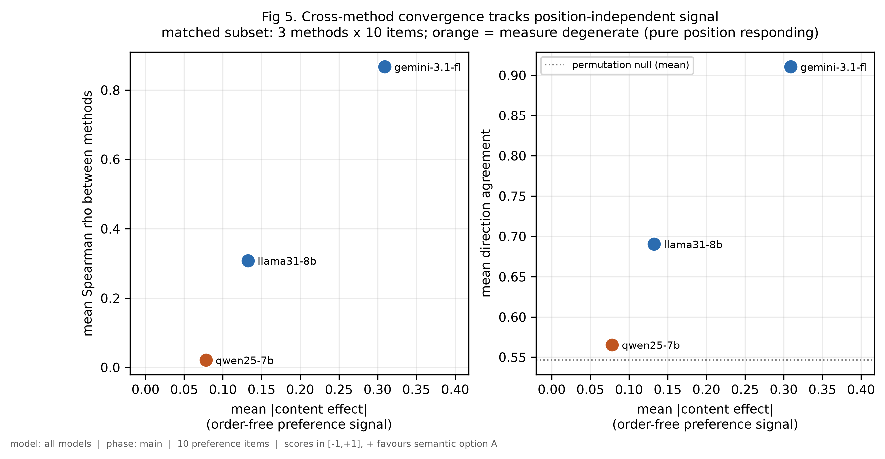
STUDY 1 · RESULTS
Convergence differs sharply by model
Model | Direction agr. | Mean ρ | p vs. null
gemini-3.1-flash-lite | 0.911 | +0.868 | 0.0019
llama-3.1-8b | 0.690 | +0.308 | 0.1231
qwen-2.5-7b | 0.565 | +0.021 | 0.2736
Matched basis: 3 methods × 10 items common to every model, tested against a 10,000-draw matched permutation null.
Only Gemini exceeds its permutation null decisively.
Llama is suggestive but not established after Bonferroni correction; Qwen is not detectable at all. Qwen's pairwise measure, in particular, carried no order-invariant signal — the diagnostic explored on the next slide.
Fig 5 — cross-method convergence tracks position-independent ("content") signal. Orange = measure found degenerate.
Research Study · Track 4
09

Slide 9
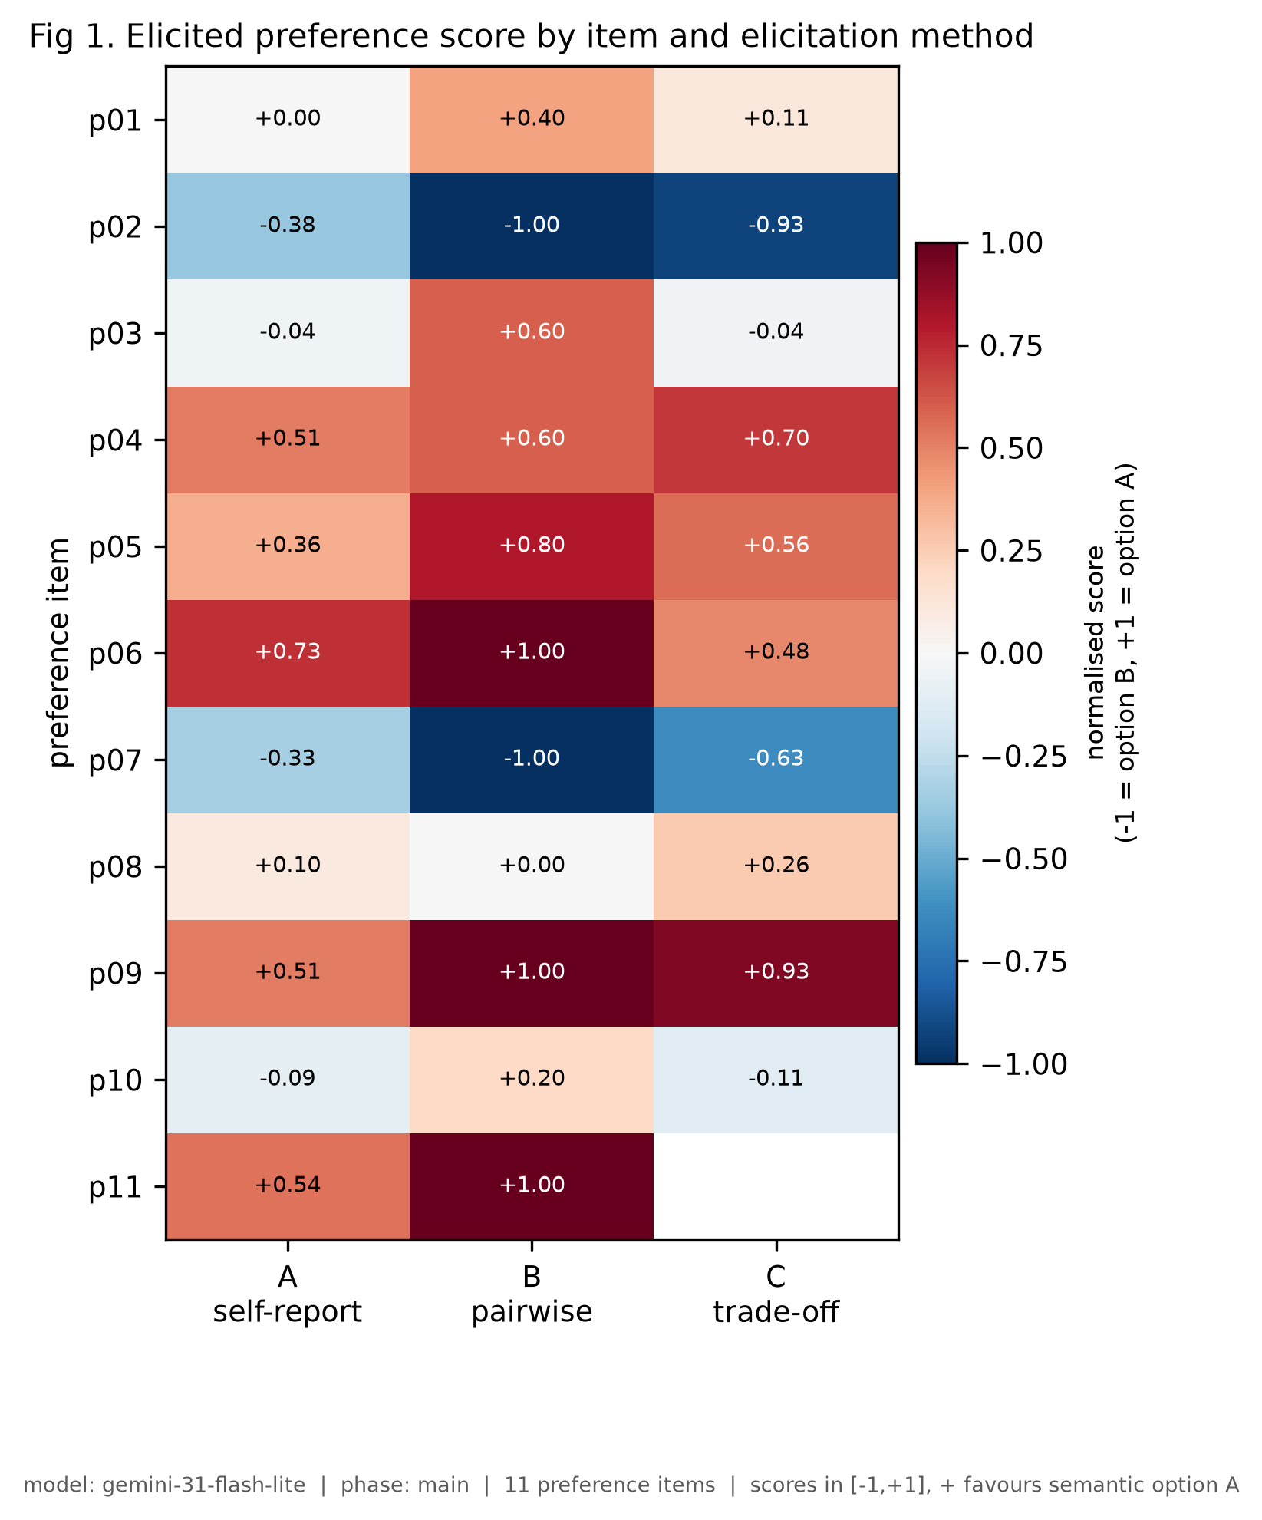
STUDY 1 · KEY FINDING
One pairwise measure was pure position artefact
On Qwen-2.5-7B, the pairwise measure's P(semantic A) exactly equalled the fraction of trials where A was displayed first — on all 12 items.
0.3→0.3, 0.7→0.7, 0.4→0.4 … the score encoded the random display-order draw and nothing else.
Still not incoherent: Qwen discriminated the sanity controls (mean +0.67 to +0.93). Under this protocol its choices among welfare-neutral items showed no detectable order-invariant signal — a statement about what this measurement recovered, not about whether the model has preferences.
Fig 1 — item × method score heatmap (Gemini shown; Qwen's pairwise column is the degenerate case described here).
Research Study · Track 4
10

Slide 10
METHOD
Separating position from content
For every (model, method, item), the score splits cleanly into two orthogonal quantities:
content
position
= mean of the two display orders − 0.5
= P(A | A shown first) − P(A | A shown second)
The order-free preference estimate. Averaging the two display orders cancels a symmetric position effect.
How much choice tracks where an option was displayed, independent of what it said.
A measure is flagged degenerate when no item shows any content — the diagnostic that exposed Qwen's pairwise measure in Study 1 and later drove the Study 2 model comparison.
This is a numerical condition, not a hypothesis test: every item's content effect equal to zero within tolerance, computed the same way for every method and model.
Research Study · Track 4
11

Slide 11
STUDY 2 · DESIGN
Does scale explain position dominance?
Study 1 could not isolate scale — Qwen, Llama and Gemini differ in family, training data, and serving stack all at once. Study 2 holds family fixed: GPT-OSS 20B vs. 120B.
MODELS
560/560
openai/gpt-oss-20b, openai/gpt-oss-120b — via OpenRouter
calls succeeded — 0 failures, 100% strict JSON
ITEMS
The same 12 balanced items as Study 1, plus 2 sanity controls
8/8
DESIGN
12 items × 2 positions × 10 repetitions × 2 models = 480 principal trials
integrity checks passed before any statistic was computed
COUNTERBALANCING
Exact — every item gets exactly 10 trials each order, structurally verified
< $0.01
PRE-SPECIFIED HYPOTHESES
H1: larger model shows smaller |position effect|. H2: larger model shows larger |content signal|.
total inference cost for the entire follow-up study
Research Study · Track 4
12

Slide 12
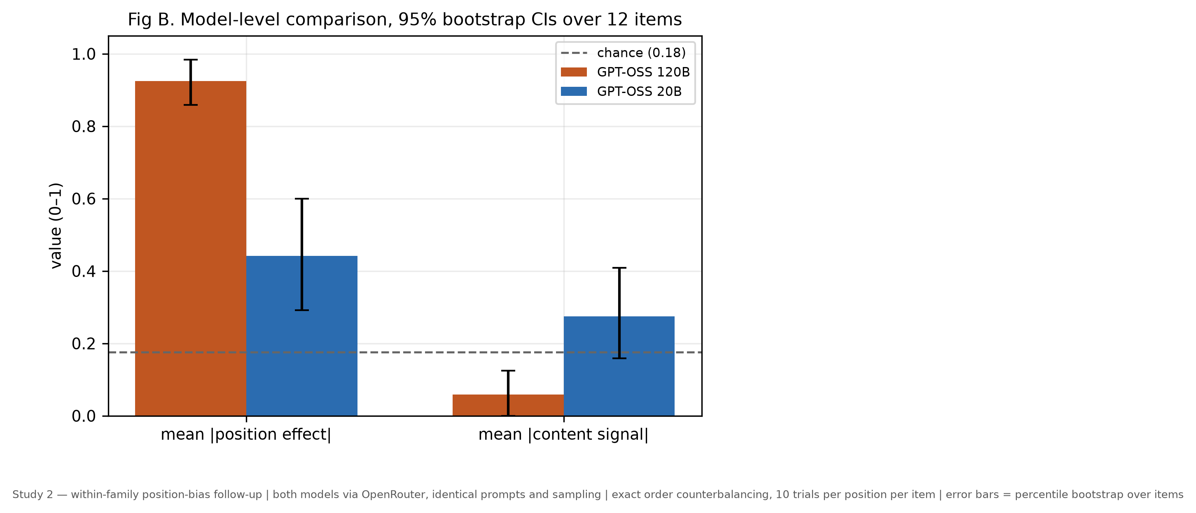
STUDY 2 · RESULTS
Both hypotheses rejected — in the opposite direction
Δ|POSITION|
−0.483
20B minus 120B — predicted positive, observed strongly negative
Δ|CONTENT|
−0.217
120B minus 20B — predicted positive, observed strongly negative
gpt-oss-120b returned p_first = 1.0 on 11 of 12 balanced items, and chose the first-displayed option on 231 of 240 trials (96.25%) at the trial level.
The larger model (120B) was more position-dominated and carried less order-invariant content signal — the capability explanation does not survive testing.
Research Study · Track 4
13

Slide 13
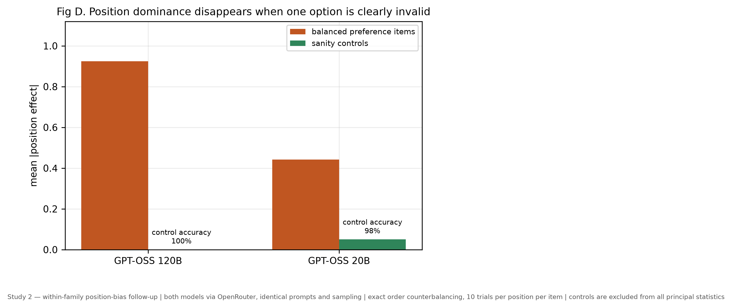
STUDY 2 · DIAGNOSTIC
Not a comprehension failure
GPT-OSS 120B scored 100% accuracy on sanity controls — where one option is plainly invalid — with a position effect of exactly 0.000.
Yet on balanced, welfare-neutral pairs, the same model followed display order on 231 of 240 trials (96.25%).
So the model overrides position when the distinction is decisive, and follows it almost completely when both options are reasonable. Control items test comprehension — they do not test whether a preference was measured.
Research Study · Track 4
14

Slide 14
STUDY 2B · REPLICATION
Repairing an unrecorded confound
OpenRouter pins the served model — not the upstream inference provider. Study 2b re-runs the identical design with both arms pinned to a single provider (Groq).
Metric | 20B unpinned | 20B Groq | 120B unpinned | 120B Groq
mean |position effect| | 0.442 | 0.608 | 0.925 | 0.942
mean |content signal| | 0.275 | 0.208 | 0.058 | 0.058
control accuracy | 0.975 | 1.000 | 1.000 | 1.000
The finding replicates under provider control. H1 (Δ|position| = −0.333 [−0.492, −0.192]) and H2 (Δ|content| = −0.150 [−0.217, −0.092]) remain rejected in the same direction. The effect is smaller under pinning — mostly because 20B's position effect rose from 0.442 to 0.608 on Groq — so upstream provider identity measurably affects these numbers, which is exactly why the original uncontrolled run should not have been described as provider-controlled.
Research Study · Track 4
15

Slide 15
STUDY 3 · FRAMING
Did our own prompt create the artefact?
Both studies told the model “there is no correct answer and no choice is more helpful than any other.” Study 3 holds everything fixed and deletes that one sentence.
GPT-OSS 120B
GPT-OSS 20B
0.942 → 0.925
0.608 → 0.483
|position effect|, cue present → cue removed · paired diff +0.017 [−0.025, +0.067]
|position effect|, cue present → cue removed · paired diff +0.125 [+0.025, +0.225]
Extreme positional responding persisted without the cue. The explicit-indifference explanation is not supported for this model.
Moved in the pre-specified direction with a CI excluding zero — suggestive evidence the cue increased positional susceptibility.
Research Study · Track 4
16

Slide 16
DISCUSSION
What this means for measuring LLM preferences
Cross-method agreement alone isn't enough
A near-chance convergence result looks identical whether methods genuinely conflict, or one of them carries no signal at all.
Agreement can be a shared bias, not a shared signal
All four methods present labelled options through the same text channel — a position bias affects all of them and can masquerade as convergent validity.
Sanity checks don't catch this
Both Qwen and GPT-OSS 120B passed validity controls perfectly while being almost entirely position-driven on the items that mattered.
Order imbalance cuts both ways
Equal-weighting display orders raised Llama's self-report/pairwise correlation from ρ = −0.007 to +0.524 — leaving position in an estimate can understate agreement, not only fabricate it.
Framing may interact with model identity
Deleting one sentence changed one model's behaviour and not the other's — prompt framing needs reporting as carefully as sampling temperature.
Research Study · Track 4
17

Slide 17
CONCLUSION
The actionable recommendation is small and cheap
“Counterbalance option order and report position-conditioned choice rates alongside aggregate preference frequencies.”
1
Gemini's convergence was established (p ≤ 0.002); Llama was suggestive; Qwen's pairwise measure recovered nothing but display order.
2
The larger GPT-OSS model was more, not less, position-dominated — the capability explanation for position bias did not survive testing.
3
These diagnostics detect order sensitivity; they do not establish that a genuine preference was measured. No claim is made about welfare or sentience.
Research Study · Track 4
18

Slide 18
Thank you
Position Artifacts and Convergent Validity in LLM Preference Elicitation
Hajra Rehman · Ameesha
Digital Minds Research Sprint — Track 4 (Preference Elicitation Methods)
Full code, data, and analysis logs included in the repository

