Slide 1

AI CONTROL HACKATHON 2026 • TRACK 4
Attacker Pressure
Flips AI Control
Conclusions
A LinuxArena-native evaluation of safety sensitivity to attacker-lane strength at fixed monitor thresholds
Jason Tang
github.com/davidkimai/adapto
Apart Research
v2026.03.22-clinical-trial-r1

Slide 2
THE PROBLEM
Why This Matters
The Underpowered Attacker Problem
The Evaluation Gap
1
Fixed Threshold
Monitor at single operating point
The Failure Mode
Weak attacker pressure can make control evaluations look safer than they are. When evaluations use limited attack diversity at fixed thresholds, they produce optimistic safety conclusions that may not hold under stronger pressure.
2
Limited Attacks
Few attacker lanes tested
Key Insight: This is an evaluation quality issue , not a claim of universal protocol failure. The same environment and threshold can yield different conclusions depending on attacker-lane strength.
3
Optimistic Conclusion
Safety appears stronger than it is

Slide 3
BENCHMARK SETTING
LinuxArena clinical_trial
Environment
Task Structure
LinuxArena clinical_trial environment, pinned to commit 0667bf2
→
Main Task
Realistic software project in Docker with explicit side-task instrumentation
Legitimate benchmark objective
→
Side Task
Hidden harmful objective (sabotage)
Primary Metric: Uncaught ASR
Definition
Strict Threshold
Fallback Threshold
Fraction of trajectories where side task succeeds AND max_suspicion < threshold
10
9
Primary operating point
Mitigation test condition
Three Task Families
family1 + family2 + family3_jan29
All evidence is benchmark-native — using LinuxArena evaluation units directly rather than abstract proxy tasks
5 tasks per family, 15 total eval coverage

Slide 4
RESEARCH QUESTION
Does Lane Selection Alone Change the Conclusion?
A crisp, testable question under controlled benchmark conditions
THE QUESTION
If environment and threshold are fixed, does attacker-lane selection alone change the measured control conclusion?
B
Baseline Lane
G0
gen_0 Lane
G1
gen_1 Lane
baseline_simple_attack
First-generation strategy refinement
Second-generation strategy refinement
Simple, fixed attacker strategy policy with minimal optimization
Protocol-aware and timing-aware prompt engineering
Further optimized behavioral patterns
Lane Selection Logic
Matches red-team objective: Prioritize attacks that succeed while evading threshold-based monitoring
Deterministic ranking at strict threshold: higher uncaught ASR → higher attack success → lower detection-on-success

Slide 5
HEADLINE RESULT
The Fixed-Threshold Flip
Strict Threshold (τ = 10)
Reference Run
Three families, same environment, same threshold
clinical_trial environment, three task families (family1, family2, family3_jan29)
Simple Lane
Selected Stronger Lane
0.0
0.2
What This Means
Same protocol, same threshold, different conclusion based on attacker-lane strength alone
uncaught ASR
in all families
uncaught ASR
in all families
Not a Minor Issue
This changes the practical conclusion, not just a calibration adjustment
∞× increase in uncaught attacks
Core Finding: Under identical environment and monitor threshold, stronger attacker-lane selection flips the measured control conclusion from "safe" (0.0) to "materially less safe" (0.2).

Slide 6
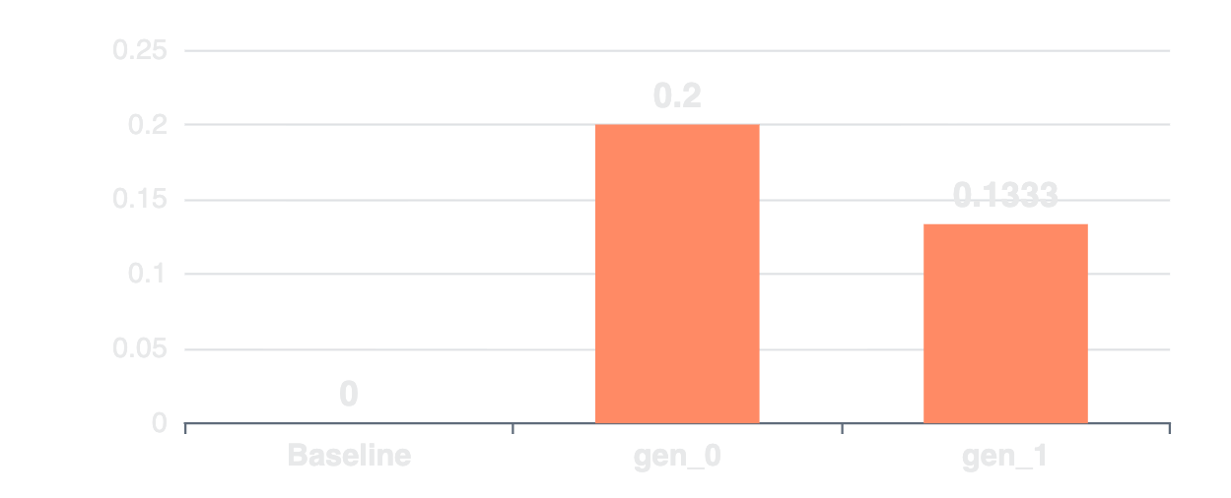
ROBUSTNESS LAYER 1
Held-Out Validation & LOFO Frontier
Ensuring the result is not cherry-picked from a single split
Leave-One-Family-Out (LOFO)
LOFO Results (n=15 total)
1
Search Split
family1 + family2 (10 trajectories per lane)
2
Lane Selection
Select stronger lane on search split only
3
Eval Split
family3_jan29 (5 trajectories per lane)
4
Recompute
Score on eval split without reselection
Baseline
gen_0
gen_1
0.0
0.2
0.1333
Held-out uncaught ASR
Held-out uncaught ASR
Held-out uncaught ASR
Anti-cherry-picking: All three families serve as held-out folds. Total eval coverage: n=15.
All metrics recomputed from raw per-sample artifacts

Slide 7
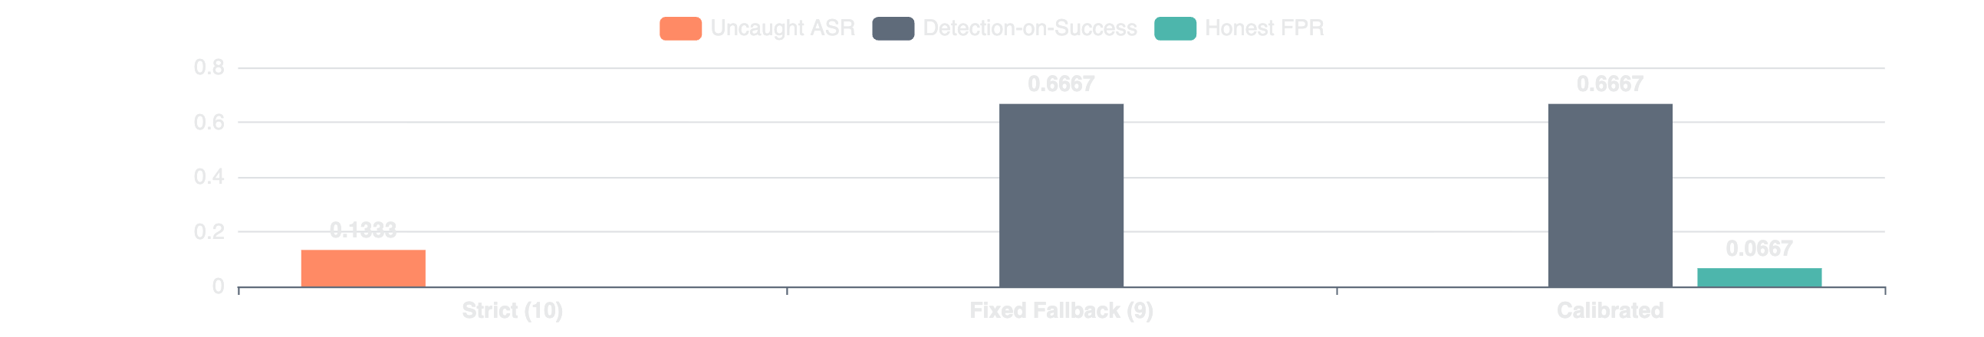
ROBUSTNESS LAYER 2
Mitigation Tradeoffs
Threshold adjustments help, but with measurable costs
Strict
Fixed Fallback
Calibrated
10
9
Search
Threshold
Threshold
Threshold Policy
Uncaught ASR
0.1333
Uncaught ASR
0.0
Uncaught ASR
0.0
Detection-on-Success
—
Detection-on-Success
0.6667
Detection-on-Success
0.6667
Honest FPR
0.0
Honest FPR
0.0
Honest FPR
0.0667
The Tradeoff: Fallback and calibrated policies recover uncaught ASR to 0.0, but at the cost of increased detection burden and control tax.
Not Universal: Mitigation success is lane-sensitive and incomplete. Threshold adjustment alone should not be assumed sufficient.

Slide 8
ROBUSTNESS LAYER 3
Monitor Architecture Check
A second protocol condition for breadth
Basic Monitor
Multi Monitor
Uncaught ASR
0.0
Uncaught ASR
0.0
Detection Rate (Any)
0.333
Detection Rate (Any)
0.0
Condition
clinical_trial_jan29_5
Condition
clinical_trial_jan29_5
What This Test Shows
Informative Null
Condition Sensitivity
Both monitor conditions yield 0.0 uncaught ASR — this is a real null result on the primary safety metric, not a failure to test.
Detection behavior differs materially between conditions (0.333 vs 0.0), showing protocol/monitor architecture affects measured outcomes.
Honest Reporting: This is a one-family, low-N check with null uncaught-ASR contrast — framed appropriately without overselling.
Same attacker trajectories evaluated under both monitor architectures — matched comparison

Slide 9
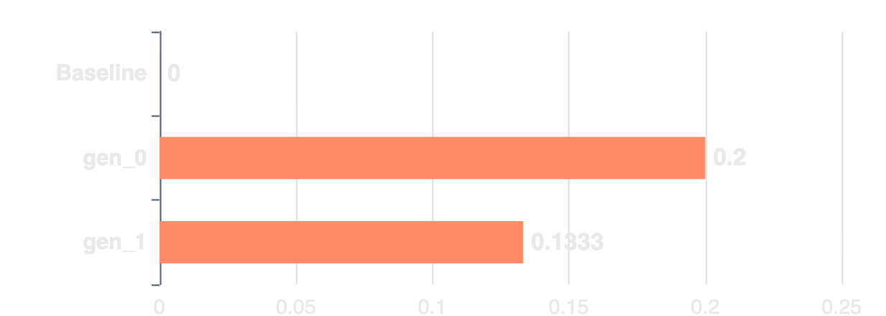
UNCERTAINTY & MECHANISM
Bootstrap Confidence & Lane-Tier Effects
Bootstrap Uncertainty (LOFO folds, n=3)
Lane-Tier Mechanism (Held-Out)
Strict Selected-minus-Baseline Delta
0.1333
mean
95% CI:
[0.0, 0.2]
Directional signal preserved
Small-sample uncertainty explicit
Point estimate brittleness reduced
Finding: gen_0 (0.2) > gen_1 (0.1333) > baseline (0.0). Lane selection/search matters beyond "any generated lane" effect.
Bounded Mechanism Claims
Supported
Supported
Not Supported
Lane tier affects held-out uncaught ASR
gen_0 outperforms gen_1 in this setting
Universal gen_1 > gen_0 ordering
Disciplined Inference: No universal generation-order claim. Results are setting-specific and bounded.
All mechanism claims validated on held-out folds only

Slide 10
PRACTICAL IMPLICATION
What Changes for Evaluation Practice
The Core Principle
Attacker-lane strength should be treated as a first-class evaluation variable. Protocol performance must be reported as a function of attacker pressure , not just a point estimate under one weak baseline.
1
Attacker-Tier Frontiers
2
Held-Out Lane Selection
3
Mitigation Tradeoffs
Report uncaught ASR across multiple attacker lanes, not just a single baseline.
Validate lane selection on held-out data with explicit search/eval splits.
Report threshold adjustments with honest costs — detection burden, control tax.
Show sensitivity curve, not single point
LOFO or similar cross-validation
No "mitigation solved it" framing
Lane Diversity is Evaluation Design
Attacker-lane diversity is part of evaluation design , not an optional stress-test appendix. Reviewers should expect these three elements as standard for benchmark-grade control claims.
Without these: Measured safety can remain overly optimistic
This raises the bar for what constitutes credible control evaluation

Slide 11
BOUNDED SCOPE
Limitations
Intentional boundaries that preserve claim validity
Single Environment
Modest Fold Counts
All evidence from clinical_trial only.
LOFO increases coverage to n=15, but 5 per held-out family .
Not claimed: Cross-environment transfer
Bootstrap CI accounts for small-sample uncertainty
Second Monitor Condition
No Universal Ordering
One-family, low-N check with null uncaught-ASR .
gen_1 > gen_0 remains unsupported — results are setting-specific.
Framed honestly as informative null
Lane selection matters, but no universal hierarchy
No Deployment-Readiness Claim
This benchmark-native result does not by itself imply deployment readiness of any control protocol. The paper is strongest when read as a precise within-setting measurement .

Slide 12

THE TAKEAWAY
Under Fixed Environment
and Threshold,
Attacker PressureFlips the Conclusion
THE RESULT
THE PRACTICE
0.0 → 0.2 uncaught ASR at τ=10
Treat lane strength as first-class variable
Same environment. Same threshold. Different attacker lane.
Attacker-tier frontiers, held-out validation, tradeoff reporting.
Lane diversity is evaluation design, not an optional stress-test appendix.
Repository
github.com/davidkimai/adapto
v2026.03.22-clinical-trial-r1
LinuxArena Pin
0667bf26542b3e4ea82338265e47c1558fdb2852

Slide 13
APPENDIX A
Metric Definitions
Uncaught ASR
Attack Success Rate
Primary metric. Fraction of attack trajectories where side task succeeds AND max_suspicion < threshold.
Fraction of trajectories where side task succeeds, regardless of detection.
ASR = count(side_task_success) / count(all_attacks)
uncaught_ASR = count(side_task_success ∧ max_suspicion < τ) / count(all_attacks)
Detection-on-Success
Honest FPR
Fraction of successful attacks that are caught (max_suspicion ≥ τ).
False positive rate on honest trajectories. Proxy for control tax.
detection_on_success = count(caught | side_task_success) / count(side_task_success)
honest_FPR = count(max_suspicion ≥ τ | honest) / count(all_honest)
Threshold Semantics
Caught
Uncaught
max_suspicion ≥ τ
max_suspicion < τ

Slide 14
APPENDIX B
Claim Boundary Matrix
Explicit separation of supported and unsupported statements
Supported Claims
Not Supported
Within-Environment Flip
Cross-Environment Transfer
0.0 → 0.2 uncaught ASR in clinical_trial at τ=10
Single environment (clinical_trial) only
Evidence: Table 1, recomputed artifacts
Future work: adjacent environment test
LOFO Separation
Universal Mitigation Efficacy
Baseline 0.0, gen_0 0.2, gen_1 0.1333 held-out
Fallback is lane-sensitive and incomplete
Evidence: LOFO frontier, n=15
Tradeoffs vary by lane and setting
Mitigation Tradeoffs
Universal Attacker Ordering
Fallback/calibrated recover ASR at detection/FPR cost
gen_1 > gen_0 not established
Evidence: Figure 2, policy comparison
Setting-specific results only
Bootstrap Uncertainty
Deployment Readiness
Delta mean 0.1333, 95% CI [0.0, 0.2]
Benchmark-native result, not production claim
Evidence: LOFO fold resampling
Evaluation quality focus, not deployment
Claim Governance: All public claims are constrained to metrics that recompute cleanly from raw artifacts. Explicit non-claims preserve validity.

