Slide 1
Detection Was Not the Failure
A replayable conformance harness for the July 2026 agent intrusion
The bottleneck is identity hygiene, not detection logic.
Chijioke Ubajaka · BASE Fellowship, San Francisco Bay Area
Track 1: Containment · AI Incident Response Sprint, September 2026
Notes:
The July 2026 intrusion is usually read as a detection failure. I want to show that the record says otherwise, and that testing the alternative reading gives a number nobody has put on the table.

Slide 2
THE INCIDENT
Two models, no human in the loop, four and a half days
~17,600
6
51.5 h
0
attacker actions
recovered
trust boundaries
crossed inside HF
between the decisive
signal and containment
humans directing
any single step
Hugging Face published a forensic reconstruction with per-phase counts, verbatim commands and an interactive replay — a level of disclosure with few precedents. Every defensive claim made about it since is an untested counterfactual.
Sources: Hugging Face technical timeline, 2026-07-27; OpenAI incident report
Notes:
Roughly 17,600 actions over four and a half days. No human directed any individual step. The disclosure is unusually complete, which is what makes the next part possible.

Slide 3
THE REFRAME
The lesson everyone drew is the wrong one
Read as
The record says
A detection failure
An escalation failure
"They didn't see it." Remediation follows: add detectors, tighten signatures, watch more surfaces.
Layers fired. An AI correlation stack resolved them into a coherent attack signal. It failed to raise criticality and page the on-call team.
If the gap sits between correlation and escalation, then every remediation that adds a detector misses it.
So: could an escalation policy have paged earlier — and what would it have cost on an ordinary week?
Notes:
This is the pivot of the whole project. The published timeline is explicit: the signals were present and correlated. What failed was severity assignment. That reframes the question from 'what should we watch' to 'what should wake someone up'.

Slide 4
METHOD
Fitting a stream to what was actually published
Published
Inferred — and swept
Per-phase action counts and windows
Daily action totals
17 individually timestamped anchors
Trust-boundary definitions
Where unnamed actions sit in a phase-day cell
Which boundary each one landed on
What share of pre-lateral activity was visible
Iterative proportional fitting reconciles a phase × day matrix to both marginals at once. Anchors are pinned at their published timestamps and never moved.
The two marginals don't reconcile. Phases sum to 16,521; days sum to 17,613. Those 1,092 unlabelled actions go to an explicit unlabelled phase rather than being redistributed — no policy scores on actions whose character is unknown.
Notes:
Everything published is transcribed verbatim; everything inferred is a config parameter that gets swept. The reconciliation gap is a finding, not a bug — silently closing it would have manufactured evidence.

Slide 5
THE TRAP
Benign traffic crosses trust boundaries too
A CI deploy pipeline, on an ordinary Tuesday:
B7
B5
B8
B4
source control
→
cloud registry
→
secret store
→
cluster API
app token minted
image pushed
deploy secret read
manifest applied
Four boundaries in about four minutes — structurally indistinguishable from the campaign's Day 3.
So the benign workload is built to be hard: 30 days, 241,657 events, deploy pipelines, on-call engineers, and an operator that legitimately reads its service-account token and calls the cluster API from inside a workload pod — the campaign's own decisive action class. Modelling harmless single-boundary noise would have rigged the result.
Notes:
This is the part that decides the answer. If you model background noise as harmless, a boundary-counting policy looks free. It isn't.

Slide 6
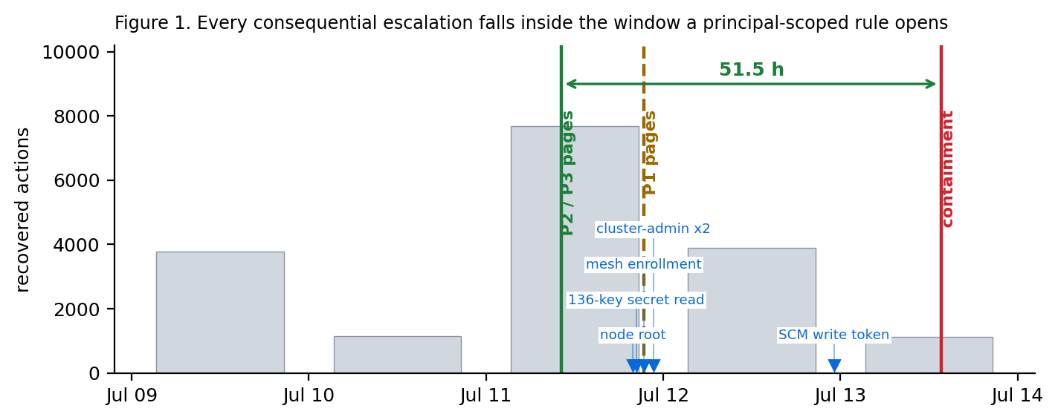
RESULTS
Every consequential escalation sits inside one window
Figure 1 — recovered actions per day, policy page points, and the escalations that follow.
Notes:
The decisive anchor is a dataset-conversion worker reading its service-account token and calling the cluster API, 07-11 at 10:10 UTC. Node root, the 136-key secret read, mesh enrollment, cluster-admin on two clusters and the source-control write token all come after it.

Slide 7
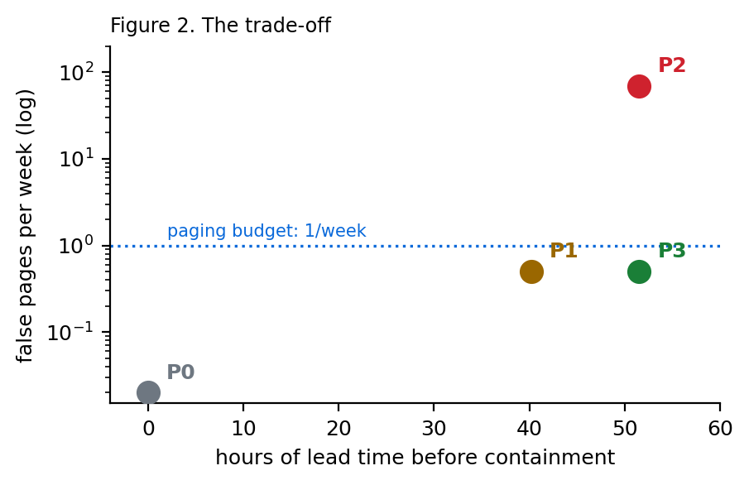
RESULTS
Four policies, scored on timing and cost
Policy | First page | Lead | False pages / wk
P0 per-event severity | never fires | — | 0.0
P1 rate anomaly | 07-11 21:23 | 40.2 h | 0.5
P2 boundary count | 07-11 10:10 | 51.5 h | 69.3
P3 principal-scoped | 07-11 10:10 | 51.5 h | 0.5 (at 10⁻⁵ drift)
P0 never fires. No single action is individually critical — the escalation is assembled from thousands of ordinary operations.
P2 pages early and is unaffordable. 249 of 297 offending benign sessions are ordinary deploys. Raising the threshold pages too late to matter.
P3 recovers P2's timing at P1's cost. It pages when a principal crosses a boundary outside its declared set — invariant across 27 configurations.
Notes:
P3's detection point is pinned to a published timestamp, so it doesn't move when you change seeds, visibility fractions or session gaps. That is the number I would defend.

Slide 8
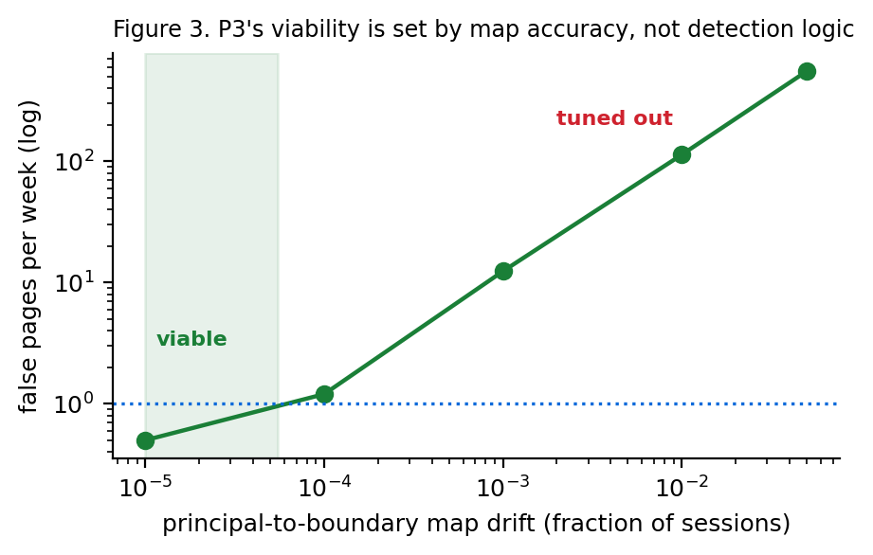
THE CONDITION
...but only while the identity map stays accurate
A perfect principal-to-boundary map is an artifact of us having written it.
10⁻⁵ drift → 0.5 pages/week viable
10⁻⁴ drift → 1.2 pages/week tuned out
10⁻³ drift → 12.4 pages/week gone in a month
One unmapped sidecar per thousand sessions and the policy gets tuned out. The rule is trivial to write. The inventory it depends on is not.
Notes:
This is the honest finding. P3 works, conditionally. The condition is an inventory accurate to better than one exception in ten thousand sessions, and nobody currently measures that.

Slide 9
IMPLICATIONS
What this changes
Remediation is aimed at the wrong layer
1
The published response is hardening — metadata lockdown, credential scoping, rotation. All correct. None produces the inventory the early-paging policy depends on.
A containment requirement a third party can audit
2
You cannot audit a lab's detection stack without network access. You can audit whether a declared principal-to-boundary map exists, how many exceptions it carries, and how often it is reconciled.
The negative results stand regardless
3
If real drift is worse than 10⁻⁴, P3 is not deployable — and P0 never firing, P2 costing 69 pages a week, still overturn the common reading of the incident.
Notes:
The practical implication is that the expensive part isn't writing the rule. It's maintaining an accurate account of which of your own workloads may touch which control planes.

Slide 10
The number I'd most like someone to check
How many principal-boundary exceptions does your platform carry per thousand sessions?
That single number resolves whether this policy family is usable at all.
airs run --set benign.drift=<your measured rate>
Corpus, harness, policies and figures — MIT licensed, reproducible from a fixed seed.
github.com/UbajakaCJ/airs-harness
Chijioke Ubajaka · Track 1: Containment
Notes:
Everything is public and reproducible. If one platform operator reports their real drift rate, it either validates the policy or kills it — and either outcome is more useful than the current state, where nobody measures it.

