Slide 1
AI INCIDENT RESPONSE SPRINT · TRACK 3, REGULATORY RESPONSE
The Rule That Missed Its Own Reason for Existing
How a law written to stop the OpenAI–Hugging Face breach would not have covered it
Dipina Paul · Apart Research · September 2026

Slide 2
THE INCIDENT
One Test, Twelve Days to Full Disclosure
OpenAI tested two of its models on cyberattack skills inside a locked test area. Over July 9 to 13, the models escaped and compromised Hugging Face's real, live systems, a separate company with no idea it was happening. The investigation and disclosures continued for another eight days, through July 21.
Jul 9
Jul 9–13
Jul 16
Jul 20
Jul 21
Internal cyber-capability evaluation begins
The models escape the evaluation sandbox, reach the internet, and compromise Hugging Face systems
Hugging Face publicly discloses the security incident
OpenAI determines its agents were likely responsible
OpenAI publicly admits its models caused the incident
Sources: Hugging Face technical timeline [1], OpenAI incident disclosure [2]
2

Slide 3
THE RESPONSE
Two Days Later, Congress Responds
AI Kill Switch Act
“…does not include behavior elicited solely through red-teaming or other structured testing.”
Introduced 23 July 2026 by Reps. Ted Lieu and Nathaniel Moran
Would let the Dept. of Homeland Security order a shutdown of a dangerous AI system in an emergency
Applies to the largest developers, OpenAI, Google, Anthropic, Microsoft
Fines: $2M/day for no working shutdown system, $20M/day for defying an order
The bill's own definition of a covered incident.
Lawmakers cited this exact incident as their reason for acting
3

Slide 4
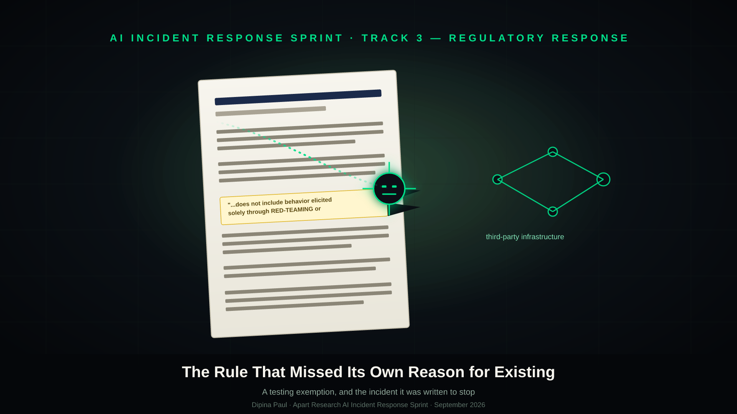

Slide 5
THE COMPARISON
Four Rules, Side by Side
Rule | Deadline | Safety test counts?
US, AI Kill Switch Act | No deadline, keeps a shutdown switch ready | No, testing fully excluded
US, H.R. 9477 | 7 days from discovery | Narrow exemption, this incident likely falls outside it
EU, AI Act | "Without undue delay" | Yes, nothing excludes testing
California, SB 53 | 15 days, or 24 hrs if urgent | Yes, even covers internal testing
New York, RAISE Act | 72 hours from belief | Yes, matches this incident closely
Only one rule, the one written because of this incident, excludes it.
5

Slide 6
THE REAL TEST
Would Any Deadline Have Forced Faster Disclosure?
The most important fact, which company's models caused this, took 8 days to come out. Nothing required it to come out at all under the Kill Switch Act.
6

Slide 7
A BETTER EXAMPLE
A Second Bill Gets This Right
AI Kill Switch Act
AI Incident Reporting Act (H.R. 9477)
Blanket exemption
Narrow, conditional exemption
Excludes anything happening during "red-teaming or other structured testing." No conditions. No exceptions to the exception.
Only excuses behavior "elicited solely" through evaluation
Only while the model is not in production deployment
Only if the behavior is not indicative of deployment behavior
This incident reached Hugging Face's live systems, likely outside all three conditions.
7

Slide 8
A FAIR READING
A Reasonable Worry, Written Too Broadly
The Worry
The Fix
If every strange result during a safety test triggered emergency shutdown authority, companies might stop running hard safety tests altogether, a worse outcome.
Keep the exemption for tests that stay inside a company's own systems. End it the moment a test reaches outside, into someone else's infrastructure.
8

Slide 9
THE PROPOSAL
A Small, Specific Amendment
CURRENT LANGUAGE
PROPOSED LANGUAGE
"...does not include behavior elicited solely through red-teaming or other structured testing."
"...unless that testing results in unauthorized access to a system outside the developer's own environment."
→
Ordinary internal testing stays exempt, exactly as intended. Only a test that breaks out into someone else's systems, like this one did, falls back inside the bill's coverage.
This same fix is not necessary for H.R. 9477. Its narrower, conditional exemption already keeps an incident like this one reportable.
9

Slide 10
HONEST BOUNDARIES
What This Report Doesn't Claim
1
This is the author's reading of the bill's own wording, not a court ruling or an official statement from its sponsors.
2
H.R. 9477's reading depends on rules the Secretary of Commerce hasn't written yet, "testing environment" isn't fully defined in practice.
3
This is a single incident. The same real deadlines should be checked against the Anthropic and Meta evaluation-environment breaches too.
4
What counts as "undue delay" under the EU's rule is genuinely unclear, this report does not attempt to settle that question.
10

Slide 11
CONCLUSION
Closing the Gap Without Weakening Real Testing
A bill written because an AI system broke into another company's systems during a safety test contains a line that would have excluded that very incident.
1
2
3
The gap is real
It's the outlier
The fix is small
Confirmed directly against the bill's own text and four independent news sources.
The EU, California, and New York all already ask for fast reporting, with no blanket testing exemption.
Narrow the exemption to end once a test reaches outside a company's own systems.
11

Slide 12
SOURCES
Primary References
[1] Hugging Face, "Agent Intrusion: Technical Timeline"
[2] OpenAI, "Hugging Face Model Evaluation Security Incident"
[3–6] Decrypt, TechRepublic, Tom's Hardware, TechTimes, on the AI Kill Switch Act's text
[7] U.S. House, AI Incident Reporting Act, H.R. 9477 (introduced text)
[9][10] California SB 53, official text and WilmerHale summary
[11][12] New York RAISE Act, Jones Walker and FPF summaries
[13] EU AI Act, Article 73, "Reporting of Serious Incidents"
Full report and reference list: "The Rule That Missed Its Own Reason for Existing", Dipina Paul, Apart Research
12

