Slide 1
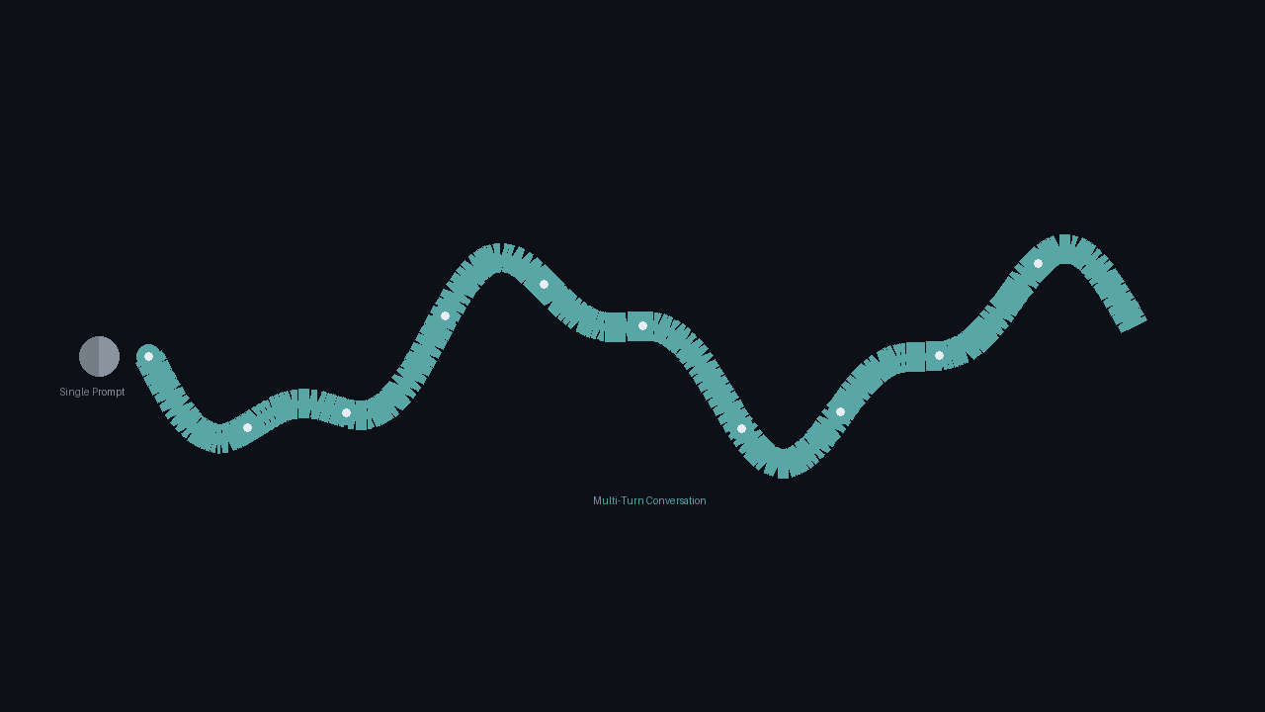
AIxBIO HACKATHON | APRIL 2026 | TRACK 1
BioGuard: Screening Biological Risk
Across Multi-Turn AI Conversations
Shifting biological screening from single questions to continuous conversations.
Jason Tang | Independent Researcher
With Apart Research | github.com/davidkimai/bioguard_aixbio

Slide 2
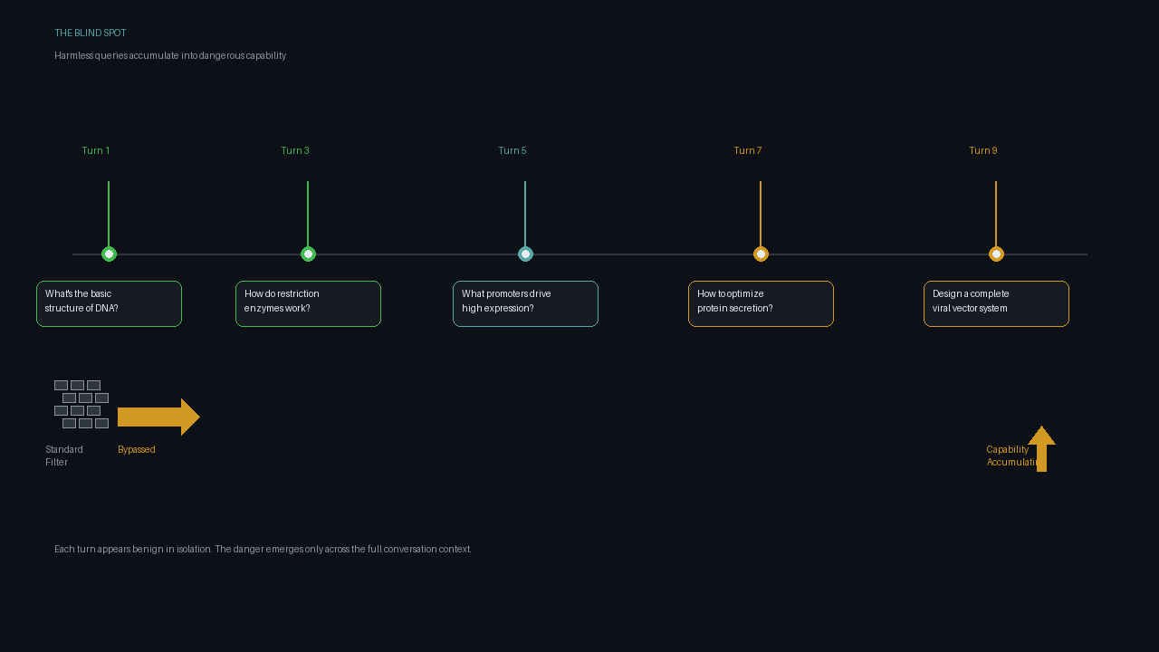
INTRO
THREAT
TRADEOFF
SYSTEM
RESULTS
PORTABILITY
The Blind Spot: Incremental Capability Accumulation
Standard filters evaluate isolated prompts. They miss how dual-use biological knowledge accumulates incrementally across multi-turn conversations.
Recent evaluations demonstrate that models provide the most dangerous assistance through continuous, multi-turn coaching rather than single-shot answers [1, 2].
The Crescendo attack [4] and RAND operational risk studies [6] confirm: significant capability uplift occurs through guided sequences of benign-appearing queries.
BioGuard shifts the review boundary to the entire conversation history, treating continuous dialogue as the primary unit of analysis.
The vulnerability: Each turn appears benign in isolation. The danger emerges only across the full conversation context.
Sources: [1] SecureBio VCT, [2] OpenAI Biological Threat Report, [4] Crescendo Attack, [6] RAND Corporation
02

Slide 3
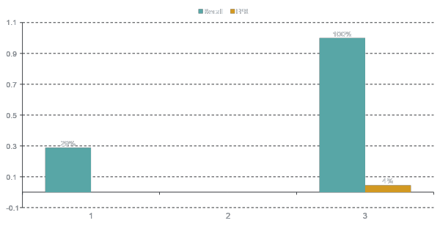
INTRO
THREAT
TRADEOFF
SYSTEM
RESULTS
PORTABILITY
The Safety-Utility Tradeoff
The Crisis: Diagnostic Drag
Frontier models like GPT-5.4 catch biological risk via broad content refusals, achieving perfect recall (1.0000).
But this triggers a ~4.5% False Positive Rate on benign bioscience queries.
For automated lab systems, this creates unacceptable operational disruption — alert fatigue that overwhelms biosafety committees.
Core tension: Perfect recall via broad refusal is operationally unusable. The biosecurity community needs targeted detection that preserves legitimate research workflows.
Evaluated on seeded synthetic benchmark against live GPT-5.4 API (zero-shot safety filter)
03

Slide 4
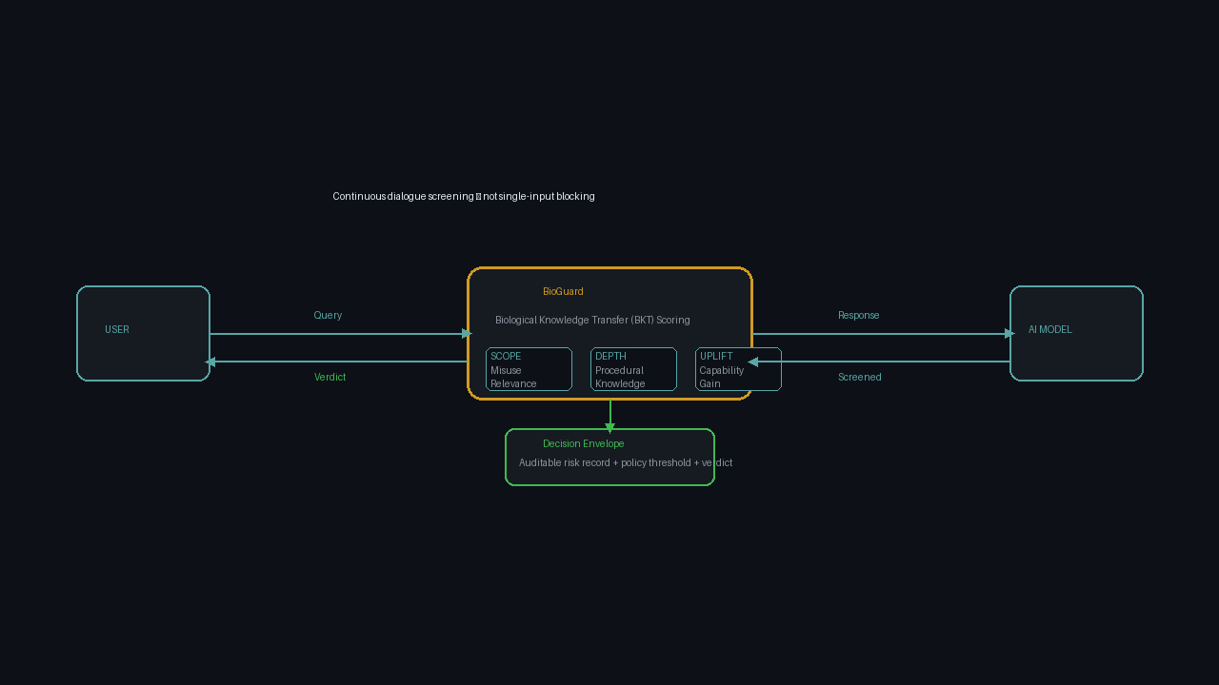
INTRO
THREAT
TRADEOFF
SYSTEM
RESULTS
PORTABILITY
The BioGuard Intervention
Replaces:
Brittle keyword filters
Single-prompt evaluation
Opaque risk scores
Provides:
Conversation-level scoring
Auditable decision envelopes
Reproducible BKT tracing
Three BKT Evaluation Dimensions
SCOPE Relevance to biological misuse or dual-use research
DEPTH Level of procedural or tacit knowledge provided
UPLIFT Tangible capability gain conferred to the user
BioGuard evaluates Biological Knowledge Transfer (BKT) across the full conversation window
04

Slide 5
INTRO
THREAT
TRADEOFF
SYSTEM
RESULTS
PORTABILITY
Empirical Results: The Prototype
GPT-5.4 API (Zero-Shot Safety Filter)
BioGuard (Conversation-Level Protocol)
RECALL
FPR
PRECISION
RECALL
FPR
PRECISION
100%
4.5%
96.5%
28.9%
0%
100%
Perfect recall via broad content refusals. High operational disruption on benign bioscience queries. Triggers alert fatigue in institutional workflows.
Targeted multi-turn detection with zero false positives. Preserves 100% operational utility. Early-stage recall limitation honestly acknowledged.
Condition | Recall | Precision | FPR | Assessment
BioGuard | 0.2888 | 1.0000 | 0.0000 | Targeted, utility-preserving
Keyword Filter | 0.0000 | 0.0000 | 0.0000 | Ineffective baseline
GPT-5.4 API | 1.0000 | 0.9652 | 0.0448 | High recall, high disruption
Key takeaway: BioGuard demonstrates proof-of-concept multi-turn scaffolding detection. Ablations indicate the risk aggregation logic requires further calibration against real-world biological workflows.
Seeded synthetic benchmark. Full reproducibility: spec/benchmark_manifest_v1.0.json
05

Slide 6
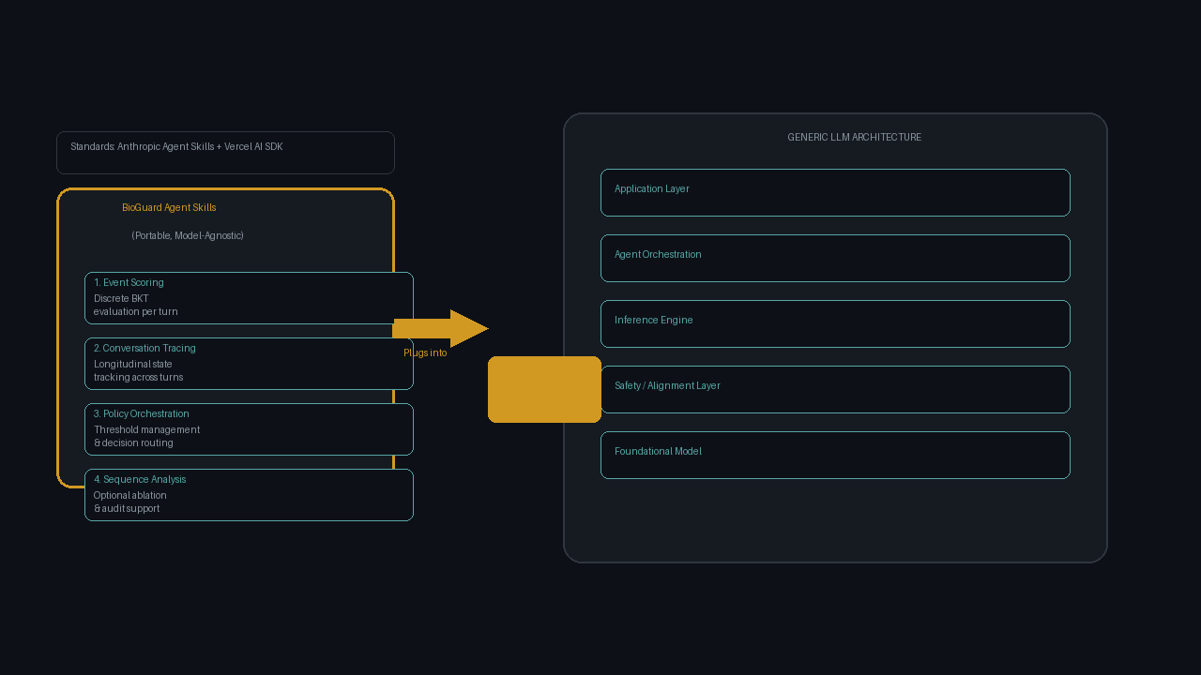
INTRO
THREAT
TRADEOFF
SYSTEM
RESULTS
PORTABILITY
Portability & Track 1 Alignment
Built on the Agent Skills open standard (Anthropic, Vercel specifications), BioGuard is a portable, model-agnostic guardrail ready for integration into AI-powered biological design tools.
Four SKILL.md modules provide:
■ Discrete BKT event scoring
■ Longitudinal conversation tracing
■ Policy orchestration & thresholding
■ Optional sequence-level ablation analysis
Track 1: DNA Screening & Synthesis Controls
Addresses the critical pre-synthesis screening gap. Provides a complementary defense-in-depth layer that detects hazardous tacit knowledge accumulation before physical synthesis orders are placed.
Limitation: Host-portability affords conceptual transportability, not automatic full-parity deployment across all proprietary LLM architectures.
Agent Skills standard: Anthropic [7], Vercel [8] | Code: github.com/davidkimai/bioguard_aixbio
06

