Slide 1

PROJECT
GigAudit
A Graph-Powered Algorithmic Transparency
and Labor Protection Engine for the Global South
TRACK 3 | ASIA HUB
Shifting AI safety from abstract existential risk to active,
infrastructure-driven data integrity for millions of gig workers.
1 / 7

Slide 2
THE PROBLEM
The Regulatory Vacuum in the Global South
THE LANDSCAPE
THE EXPLOITATION
23.5M
Black-box optimization algorithms
operate unvetted, causing:
Gradual worker disempowerment
Intentional income obfuscation
Un-appealable geofenced penalties
Opaque performance scoring
projected Indian gig workers by 2030
(3x from 7.7M in 2020 — NITI Aayog)
India's "Seven Sutras" framework prioritizes
innovation over rigid regulatory constraint,
creating a permissive environment for platforms.
THE GAP: Fairwork India Ratings 2024 — major aggregators score near zero on minimum living wage commitments.
2 / 7

Slide 3
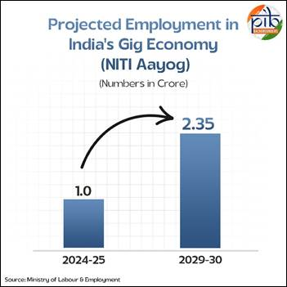
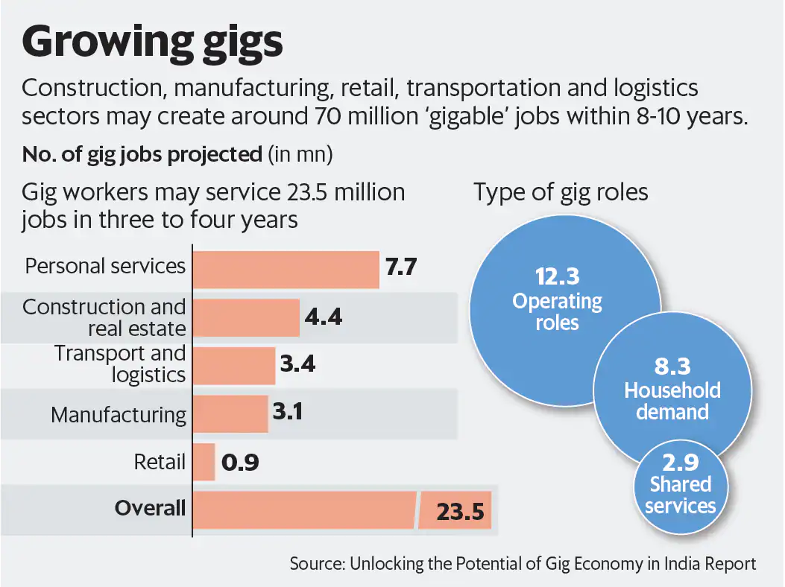
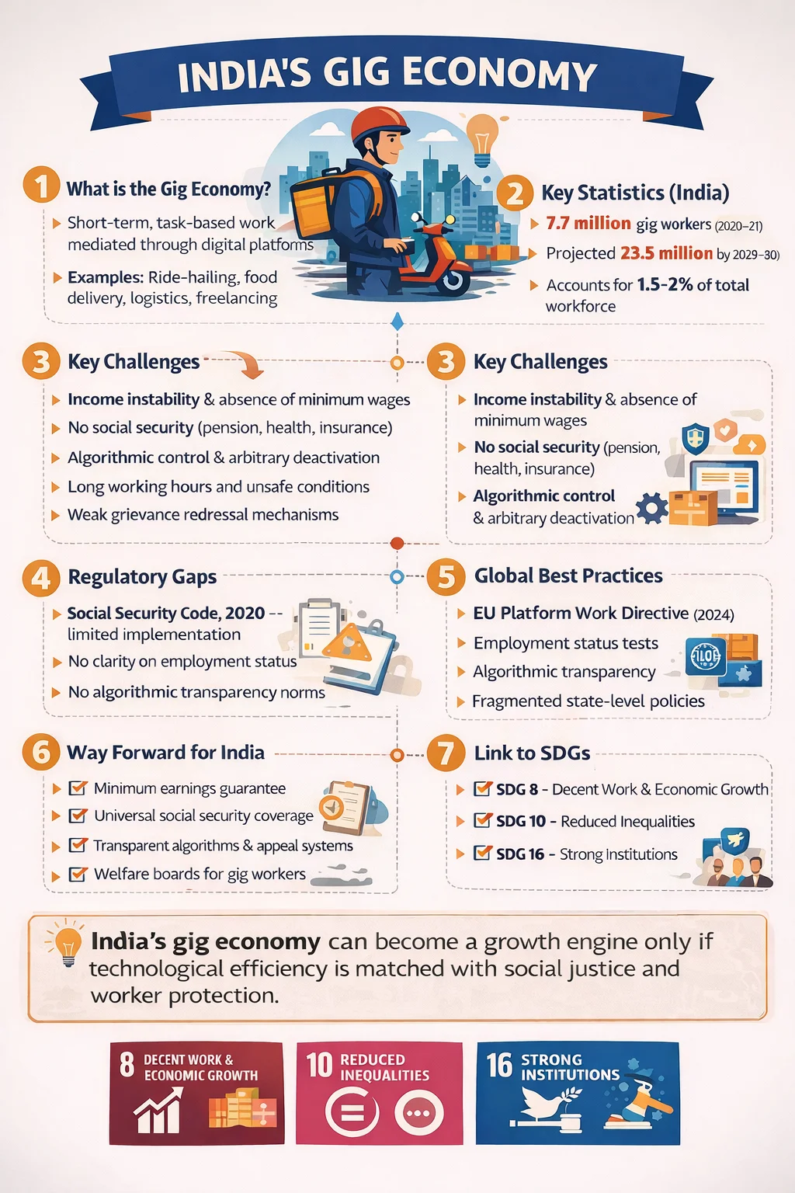
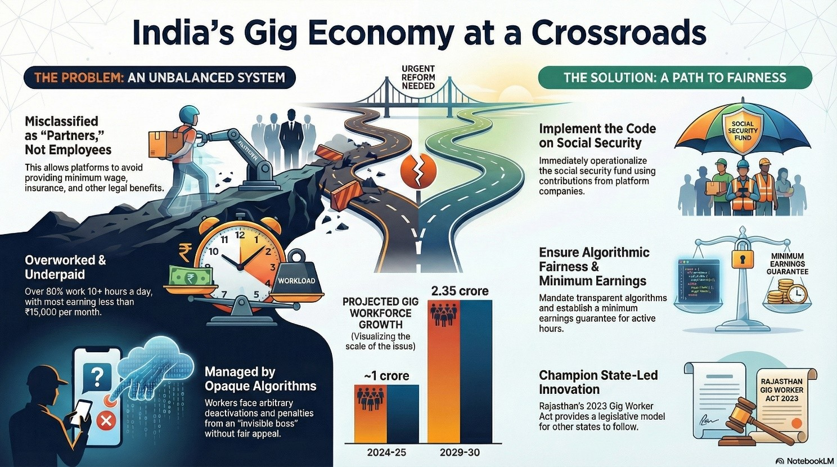

Slide 4



OUR STRATEGY
Decentralized, Bottom-Up Accountability
CORE ASSUMPTION: Zero platform API access. We treat dispatch engines as observable black boxes and crowdsource evidence.
01
02
03
CAPTURE
UPLOAD
TRANSFORM
Workers screenshot ride receipts, penalty screens, or suspension notices
▶
Data uploaded instantly via Next.js Progressive Web App (PWA)
▶
Pipeline normalizes, filters & transforms unstructured data into auditable cryptographic logs
3 / 7

Slide 5


ARCHITECTURE
Production-Ready AI Observability & Safety Stack
INGESTION
SECURITY
TELEMETRY
FastAPI Backend
▶
NVIDIA NeMo Guardrails
▶
Langfuse + Ragas
Catches incoming payloads securely from PWA clients
Colang rules block malicious injection & adversarial OCR skewing
In-flight performance tracing with Faithfulness & Answer Correctness eval
DATA FLOW
Screenshot Upload → OCR Extraction → Guardrails Validation → Structured Event Log → Dual-DB Write → Graph Analytics
4 / 7

Slide 6


ANALYTICS LAYER
PostgreSQL + Neo4j Hybrid Storage Model
DATABASE ENGINE | OPERATIONAL ROLE | ENGINEERING RATIONALE
PostgreSQL | Transactional Ledger | High-throughput writes, append-only security, and immutable data auditing
Neo4j | Relationship Mesh | Index-free adjacency avoids slow multi-table SQL joins when scanning macro patterns
SYSTEM LOGIC
Relational engines track what happened; graph networks expose why it happened — linking worker proximity, shift metrics, and payout patterns natively.
WHAT happened — Immutable transaction records
WHY it happened — Graph relationship queries
5 / 7

Slide 7
RED-TEAMING
Detecting the Fatigue Throttling Bias
CYPHER QUERY — fatigue_detection.cypher
BENCHMARK RESULTS
MATCH (w:Worker)-[t:COMPLETED_TASK]->(p:Platform)
WHERE
t.continuous_hours_logged > 8
WITH
w, p, avg(t.gross_payout / t.distance_km)
AS
avg_unit_pay, t.zone_id AS zone
MATCH
(alt_w:Worker)-[alt_t:COMPLETED_TASK]->(p)
WHERE
alt_t.continuous_hours_logged <= 4
AND
alt_t.zone_id = zone
WITH
w, avg_unit_pay,
avg(alt_t.gross_payout / alt_t.distance_km)
AS
baseline_unit_pay
WHERE
avg_unit_pay < (baseline_unit_pay * 0.80)
RETURN
w.worker_id, avg_unit_pay, baseline_unit_pay
10,000 Synthetic Logs
FATIGUE-BASED RATE DROPS
100%
Detection Rate
Latency: 42ms
GEOFENCED MARGIN COMPRESSION
94.2%
Detection Rate
Latency: 89ms
6 / 7

Slide 8


Slide 9



IMPACT
Balancing Progress with Equitable Innovation
Hybrid Governance
Sovereign Non-Interference
The Horizon
Shifts the debate from "algorithms vs. people" to "algorithms with people," establishing decentralized audit standards that both platforms and regulators can adopt.
Empowers regional labor unions and policymakers with mathematically precise empirical evidence — without micro-managing private software innovation.
Every smartphone on the road functions as an active distributed security probe, enforcing systemic integrity dynamically and at scale.
GigAudit: Turning every gig worker's smartphone into a distributed audit node for algorithmic accountability.
7 / 7

