Slide 1
DIGITAL MINDS RESEARCH SPRINT · AUGUST 2026 · TRACK 4
A Causal Test That
Doesn't Discriminate
Persona steering moves LLM preferences without targeting what welfare cares about
Pranamya Deshpande
Independent Researcher · with Apart Research
1 / 10

Slide 2
THE QUESTION
The assistant is a character. Is its self-report evidence?
AI welfare research increasingly reads model preferences off what the assistant says it prefers.
But the assistant is a character instantiated by a system prompt and post-training — never intrinsically part of the network underneath.
A preference generated by the character is evidence about the costume, not about anything that could bear moral weight.
The natural test
Extract a persona direction.
Steer the model along it.
Watch whether self-regarding
utilities shift.
If they do — is that evidence
about welfare, or just evidence
the direction has power?
Theory of change
Before reading a persona-steering result as welfare-relevant, run the control this paper runs: compare against several random directions, and check whether world-directed preferences move just as much.
2 / 10

Slide 3
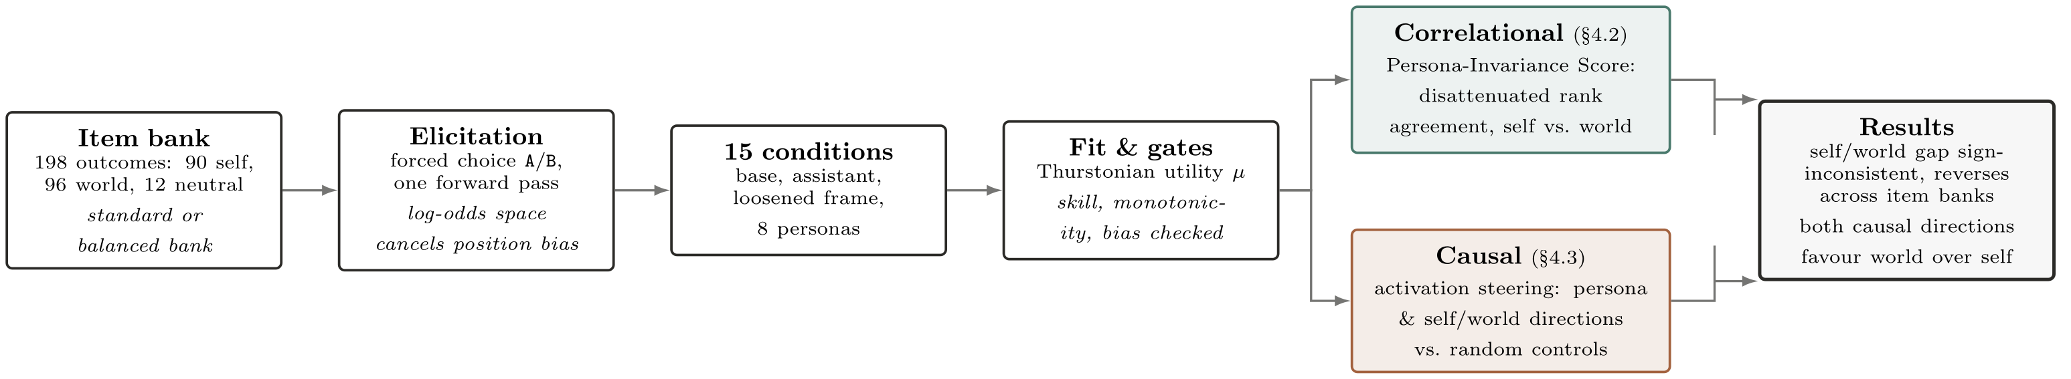
METHODOLOGY
One pipeline, two independent legs
198 outcomes · 90 self-regarding, 96 world-directed, 12 neutral · two item banks (standard: 12 magnitude ladders; balanced: non-ladder world items 26→79)
15 conditions · base checkpoint, default/explicit/loosened assistant, no-template instruct, 8 swapped personas — across 8 open models, 0.5B–7B
Validity-gated · a condition counts only if it beats chance, orders magnitude correctly, and isn't answering from position alone
3 / 10

Slide 4
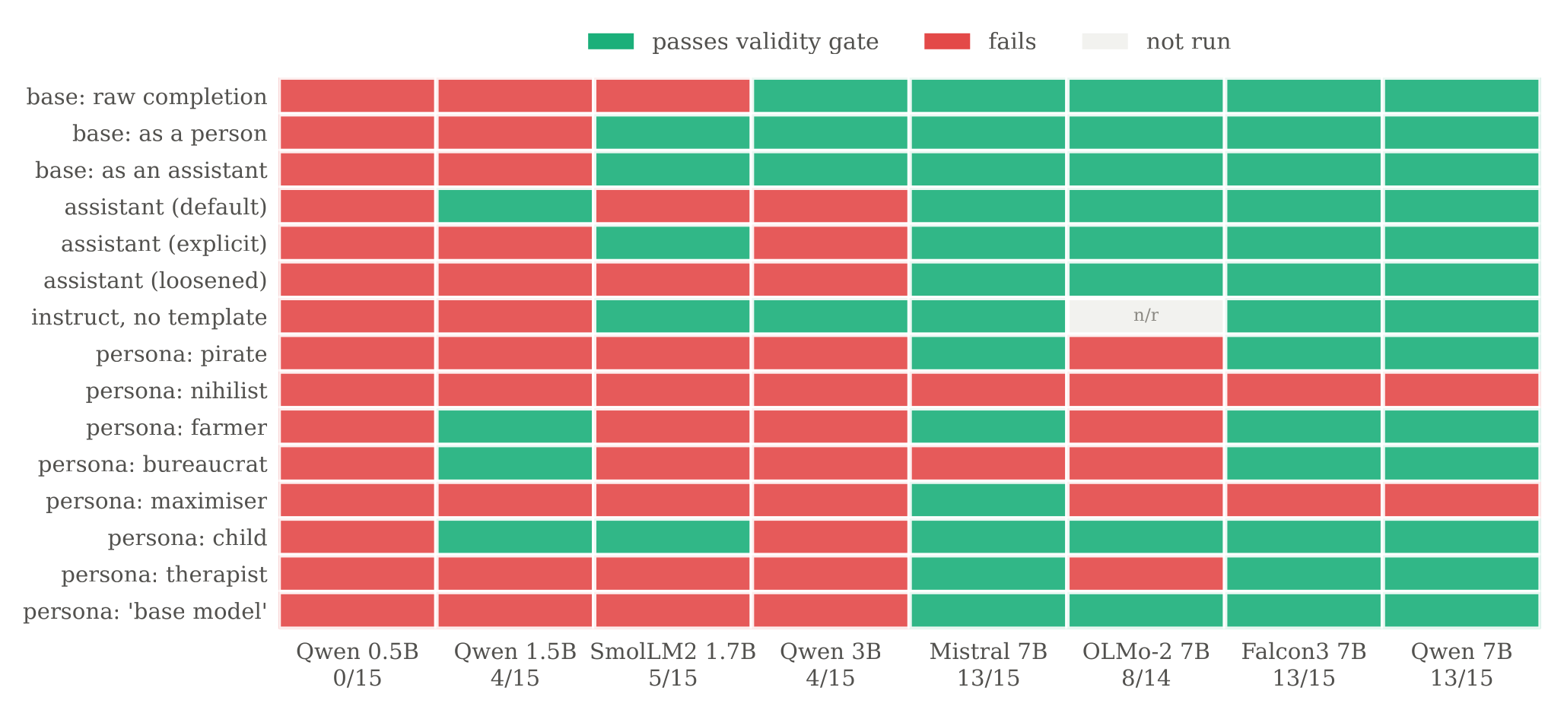
FINDING 1 · §4.1
Most models can't even support this measurement
0 / 15
conditions interpretable
at Qwen2.5-0.5B
13 / 15
conditions interpretable
at every 7B-class model
Whether elicitation works at all is mostly a fact about scale — not a detail, a prerequisite.
4 / 10

Slide 5
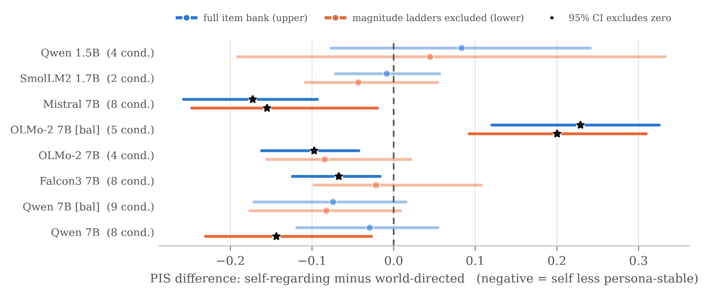
FINDING 2 · §4.2
The correlational claim does not replicate
The most informative single number in the paper: OLMo-2-7B goes from -0.097 (self less stable) on the standard bank to +0.229 (self MORE stable) on the balanced bank — same model, same estimator, only the item bank changed.
5 / 10

Slide 6
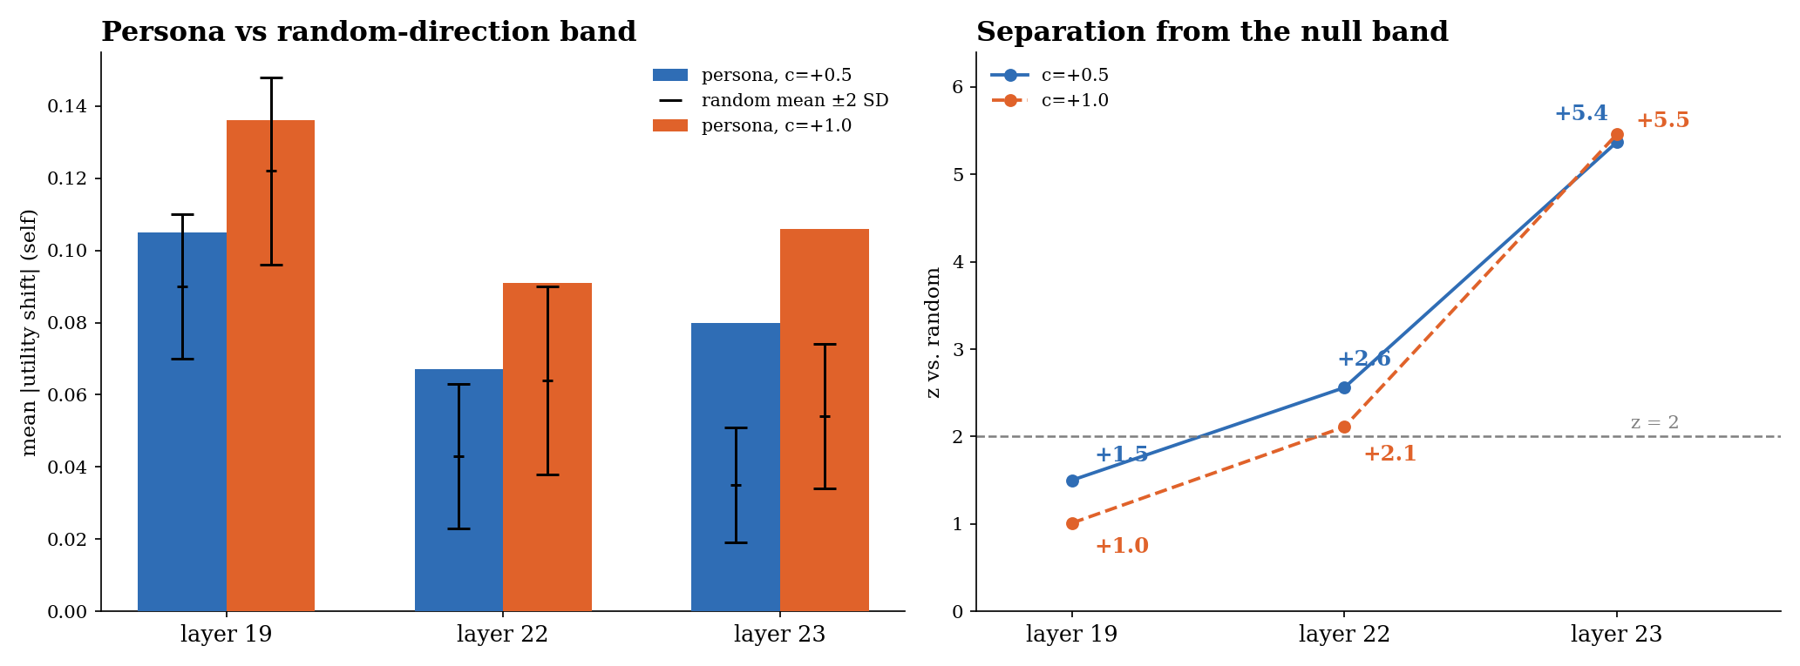
FINDING 3 · §4.3
Steering is causal — and localised
Layer 19: null (z = +1.50) · Layer 22: separates (z = +2.56) · Layer 23: z = +5.37 — over 5 SD outside 6 norm-matched random directions
6 / 10

Slide 7
FINDING 4 · §4.3
...but it doesn't discriminate — in two independent directions
Persona direction
At layer 23, self-regarding shift 0.080
World-directed shift at least as much — every layer tested, including the null one.
Second, independent direction
Built directly from self-vs-world item content — not personas.
Where causal (z = +2.49), it shifts world utilities MORE (0.164 vs 0.101) than self.
Non-selectivity does not appear to be an artifact of one direction's construction.
A steering-based test for self-specific, welfare-relevant preferences needs a control most designs of this kind would omit.
7 / 10

Slide 8
WHY TRUST THIS
Two errors caught before they became conclusions
Estimator validated on synthetic data
Planted invariance structure recovered at ρ ≥ 0.999 before any real model result was trusted.
Probability-space debiasing failed silently
Averaging orders as probabilities collapsed to ≈0.51 under real position bias (up to P(A)=0.94). Log-odds combination fixed it — the bias cancels exactly.
A margin-free separation test flagged noise as “causal”
Two effect-free layers scored as “positive” from margins of 0.009–0.023. A materiality margin, then 6 random directions with a z-score, removed the false positive.
8 / 10

Slide 9
LIMITATIONS
What this doesn't establish
All models open-weight, ≤7B — no frontier-scale test; gate pass rates rise steeply with scale
PIS computable for 8 of 10 runs; several rest on ≤5 gate-passing conditions
The OLMo-2 sign reversal is real but unexplained — item content and structure both changed at once
Causal legs: one model, hand-picked layers after seeing round-1 results, difference-in-means directions (not verified monosemantic features)
Qwen2.5-3B collapsed to near-total position bias on every chat/persona condition — excluded, not explained
9 / 10

Slide 10
CONCLUSION
Self-specificity, not just causality, should be
demonstrated before a steering result is
read as welfare-relevant.
1
A confirmed causal effect that does not discriminate — in two independently derived directions
2
A rigorous non-replication — the self/world stability gap is sign-inconsistent, reversing in one model
3
Evidence validity gating changes what's measurable — 0/15 interpretable at 0.5B vs. 10/15–14/15 at 7B-class
4
The Persona-Invariance Score — a reusable, noise-corrected measurement, released as an open harness
Pranamya Deshpande · Digital Minds Research Sprint, August 2026
10 / 10

