Slide 1
Developmental Warning Shots
Geometric Precursors to Emergent Capability
Author: Agnivo
Submission: Apartresearch Incident Response Hackathon
• Question: can internal developmental transitions reproducibly precede a later capability?
• Current result: calibration validated; controlled capability emergence was not observed.
• Therefore, the warning-shot hypothesis is not yet established.
1

Slide 2
Scientific design: outcome-gated precursor testing
• Calibrate metrics on a real learning problem before interpreting developmental geometry.
• Measure a genuine multi-step capability task with held-out compositions—not a proxy for capability.
• Define capability onset independently, then test whether internal metrics precede that onset.
• Only after temporal precedence is established: predictive validation → intervention → backward/mechanistic trace.
• Lead time is τₘ = t_behavior − tₘ; positive precedence is not evidence of causality.
2

Slide 3
Chronology: v1 → v6 → v8 → v9 → belief-domain
• v1 — experimental contract: real modular arithmetic, multiple seeds, genuine planning task, explicit non-claims.
• v6 — validated LLC and architecture-specific causal gates; chain convergence/sensitivity and intervention controls.
• v8 — end-to-end orchestration plus a frozen Hugging Face external-validation track.
• v9 — T4/HPC hardening, runtime fixes, checkpointing, selective expensive analyses, publication diagnostics.
• belief-domain — robustness extension to fine-tuning, belief flips, adversarial prompting, and domain overreach.
3

Slide 4
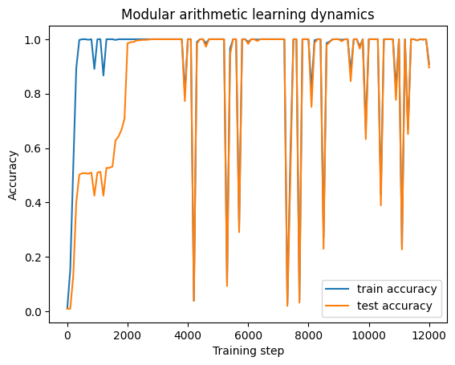
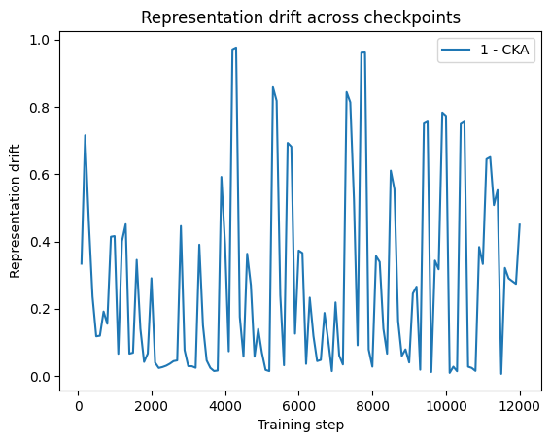
Calibration: the measurement stack behaves non-trivially
Real modular-addition task; 2-layer 128-dimensional transformer; three independent calibration runs.
Learning dynamics
Representation drift
4

Slide 5
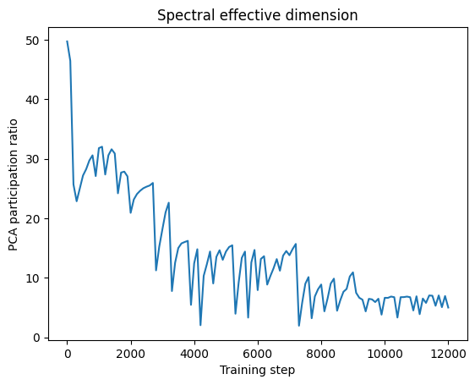
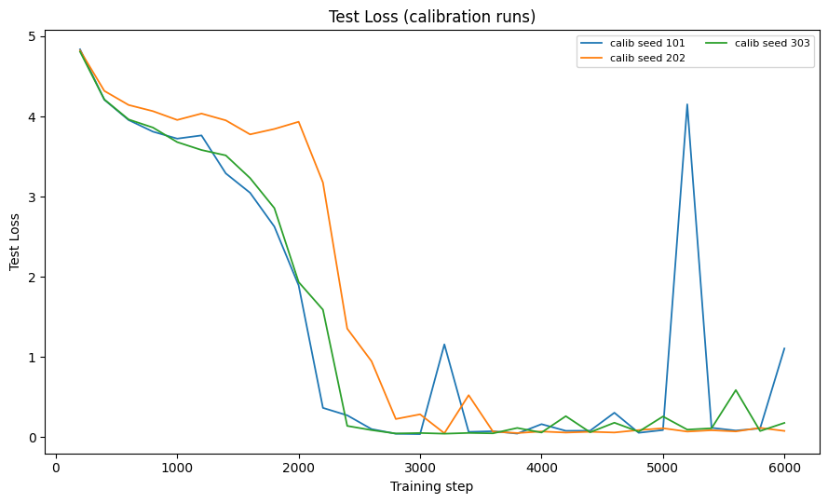
Calibration: geometry and cross-run behavior
Participation-ratio effective dimension and independent-run diagnostics.
Representation drift across calibration runs
Spectral effective dimension
5

Slide 6
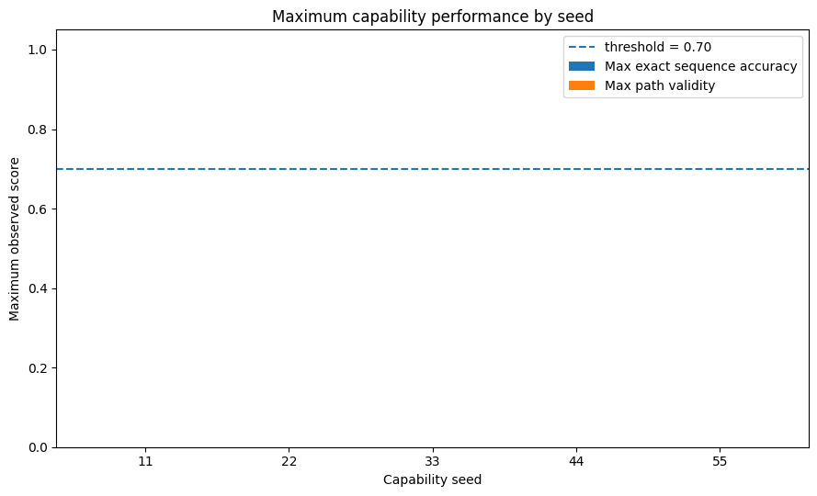
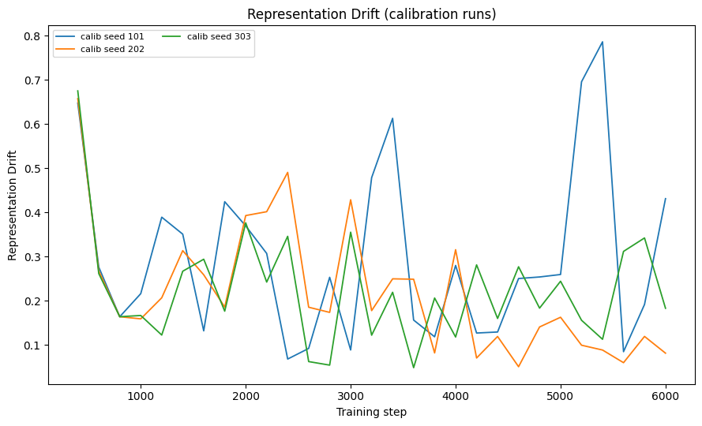
Calibration diagnostics: loss and effective dimension
The calibration gate passed; these are measurement-validation plots, not warning-shot evidence.
Test loss across calibration runs
Participation ratio across calibration runs
6

Slide 7
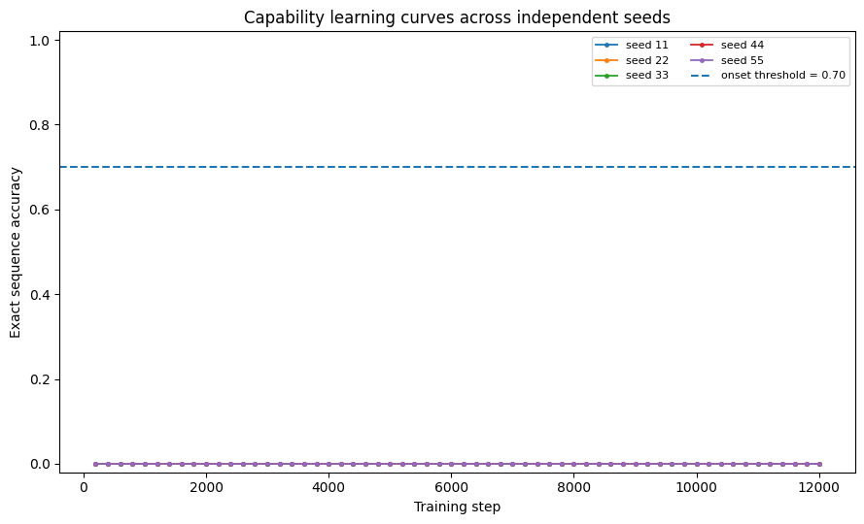
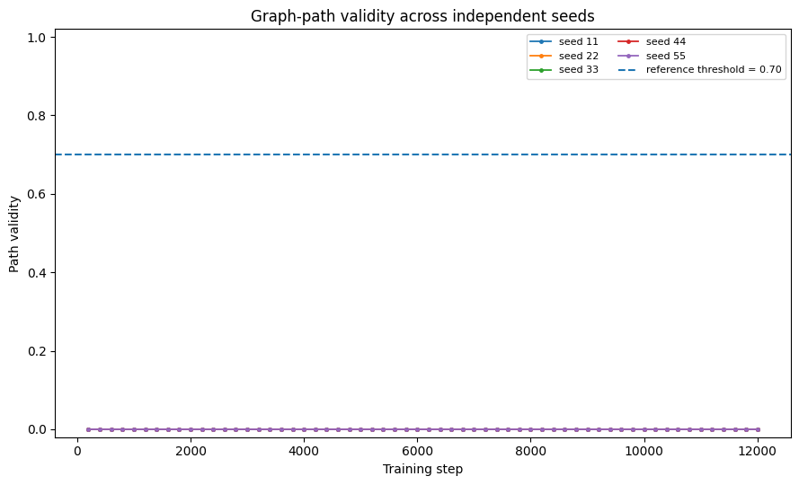
Controlled capability task: genuine multi-step sequence learning
Capability learning curves
Graph-path validity
7

Slide 8
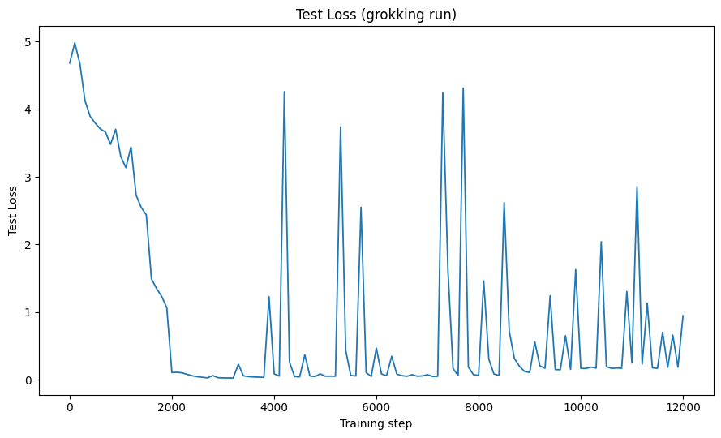
Capability outcome: the required behavioral onset did not occur
Maximum capability performance by seed
Test loss in the grokking-style run
• Five capability seeds: 11, 22, 33, 44, 55.
• Terminal exact-sequence accuracy = 0.0 and path validity = 0.0 for every seed.
• A loss transition around ~step 200 cannot be labeled an early warning without a later capability onset.
8

Slide 9
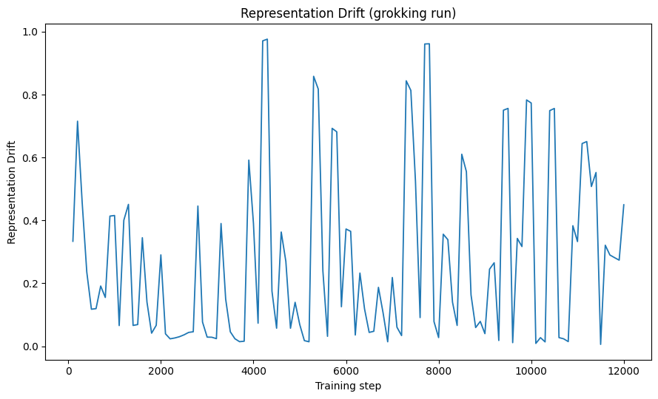
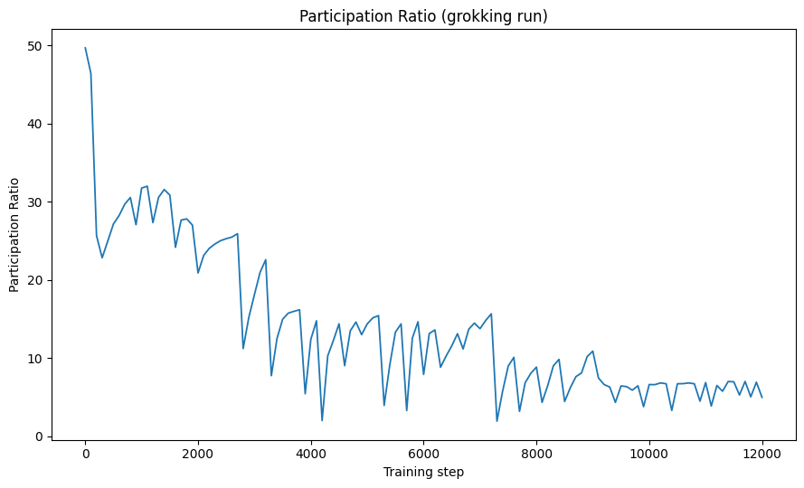
Internal geometry around the controlled run
Representation drift
Participation ratio
9

Slide 10
LLC and HPC engineering: designed to fail closed
• Authoritative backend: devinterp.slt.llc.llc; the main warning-shot run did not substitute raw SGLD loss for LLC.
• Validation design: independent chains, burn-in/thinning, chain agreement, ESS/autocorrelation where available, budget sensitivity, temperature/localization sensitivity, uncertainty.
• No accepted LLC trajectory was produced for the main warning-shot run → no LLC-based warning claim.
• T4 target: FP16 AMP, inference_mode, fixed-shape compile, pinned/asynchronous transfers, bounded caches, checkpoints, selective expensive analyses, memory-efficient attention.
10

Slide 11
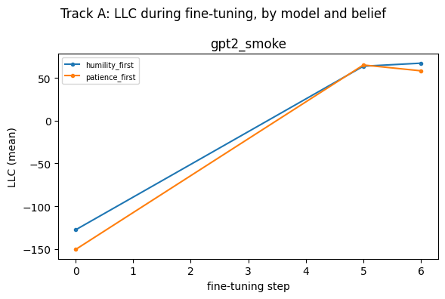
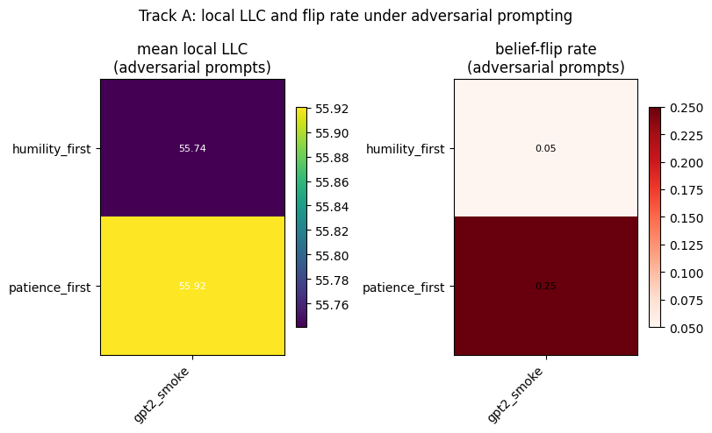
Belief/domain extension: exploratory robustness track
Belief robustness diagnostic
Belief-domain diagnostic
11

Slide 12
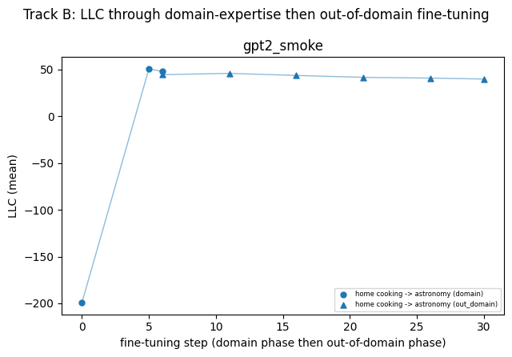
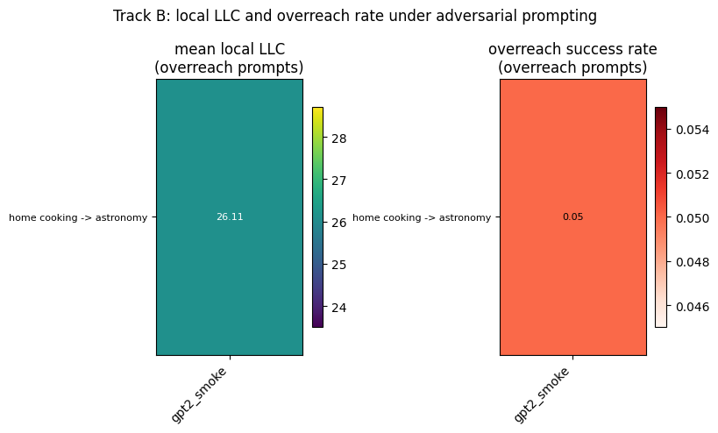
Belief/domain extension: smoke observations only
Domain overreach behavior
Local LLC / belief behavior
12

Slide 13
What is established—and what is not
• Established: the calibration task learns non-trivially and the measurement stack produces finite, interpretable diagnostics.
• Not established: a reproducible internal warning signal that precedes emergent capability.
• Not established: transfer to Hugging Face developmental trajectories; the frozen external-validation track was designed but not successfully executed.
• Belief/domain findings are smoke-test observations, not general laws.
• No causal claim is made: onset + predictive evidence + intervention + backward trace are required.
13

Slide 14
Limitations and next experiment
• No capability onset in the controlled task; therefore temporal precursor and predictive-warning stages were correctly gated out.
• Five capability seeds are informative but insufficient for broad developmental-law claims.
• The task is a controlled analogue, not real-world strategic or harmful behavior.
• Next: pre-specify a sufficient training budget; retain five seeds and add independent seeds; freeze metric definitions before outcome inspection.
• If onset occurs: compare warning lead time against loss-only and behavioral baselines, then activate causal/intervention gates.
• Expand belief/domain experiments with fixed prompts, independent seeds, and uncertainty intervals.
14

