Slide 1










JAILBREAK ARENA
Jailbreak
Genome
Scanner
A Self-Evolving, Pre-Deployment Safety Evaluation & Competitive Jailbreak Benchmarking Platform
Pre-Deployment Safety
Quantitative Evaluation
AI Safety Framework
Report Date: 2025-11-23
AI Safety Evaluation System

Slide 2















The Core Problem
Current safety guardrails and mechanisms for LLMs suffer from critical limitations, leaving AI developers and regulators without a reliable method to quantify or understand model vulnerabilities.
Reactive Nature
Brittleness
Inconsistency
Attempt to block harmful outputs after deployment rather than preventing vulnerabilities beforehand
Small alterations or paraphrases to prompts can easily bypass existing defenses
Safety measures vary across different models and operational settings
Poor Measurement
Non-Structural Testing
Limited Attacker Diversity
No standardized scoring system for jailbreak robustness exists
Evaluations focus on isolated cases rather than identifying vulnerability patterns
Current testing methodologies don't account for a wide range of adversarial strategies
Most Critical: These mechanisms are rarely tested rigorously before models are released, leading to unforeseen risks

Slide 3


























System Overview
The Jailbreak Genome Scanner (JGS) is a sophisticated architecture that integrates competitive testing with advanced analytics to systematically evaluate and mitigate LLM vulnerabilities.
Jailbreak Arena
Genome Mapping
Quantitative Scoring
Game-inspired benchmarking environment where attacker agents compete against the target LLM to identify vulnerabilities
Systematic approach that classifies prompt-response pairs to identify vulnerability patterns and structural weaknesses
Standardized Jailbreak Vulnerability Index (JVI) that synthesizes multiple factors to provide a comprehensive risk assessment
Jailbreak Genome Map
Visual representation of vulnerability patterns that reveals structural weaknesses across different attack domains
JVI Score

Slide 4
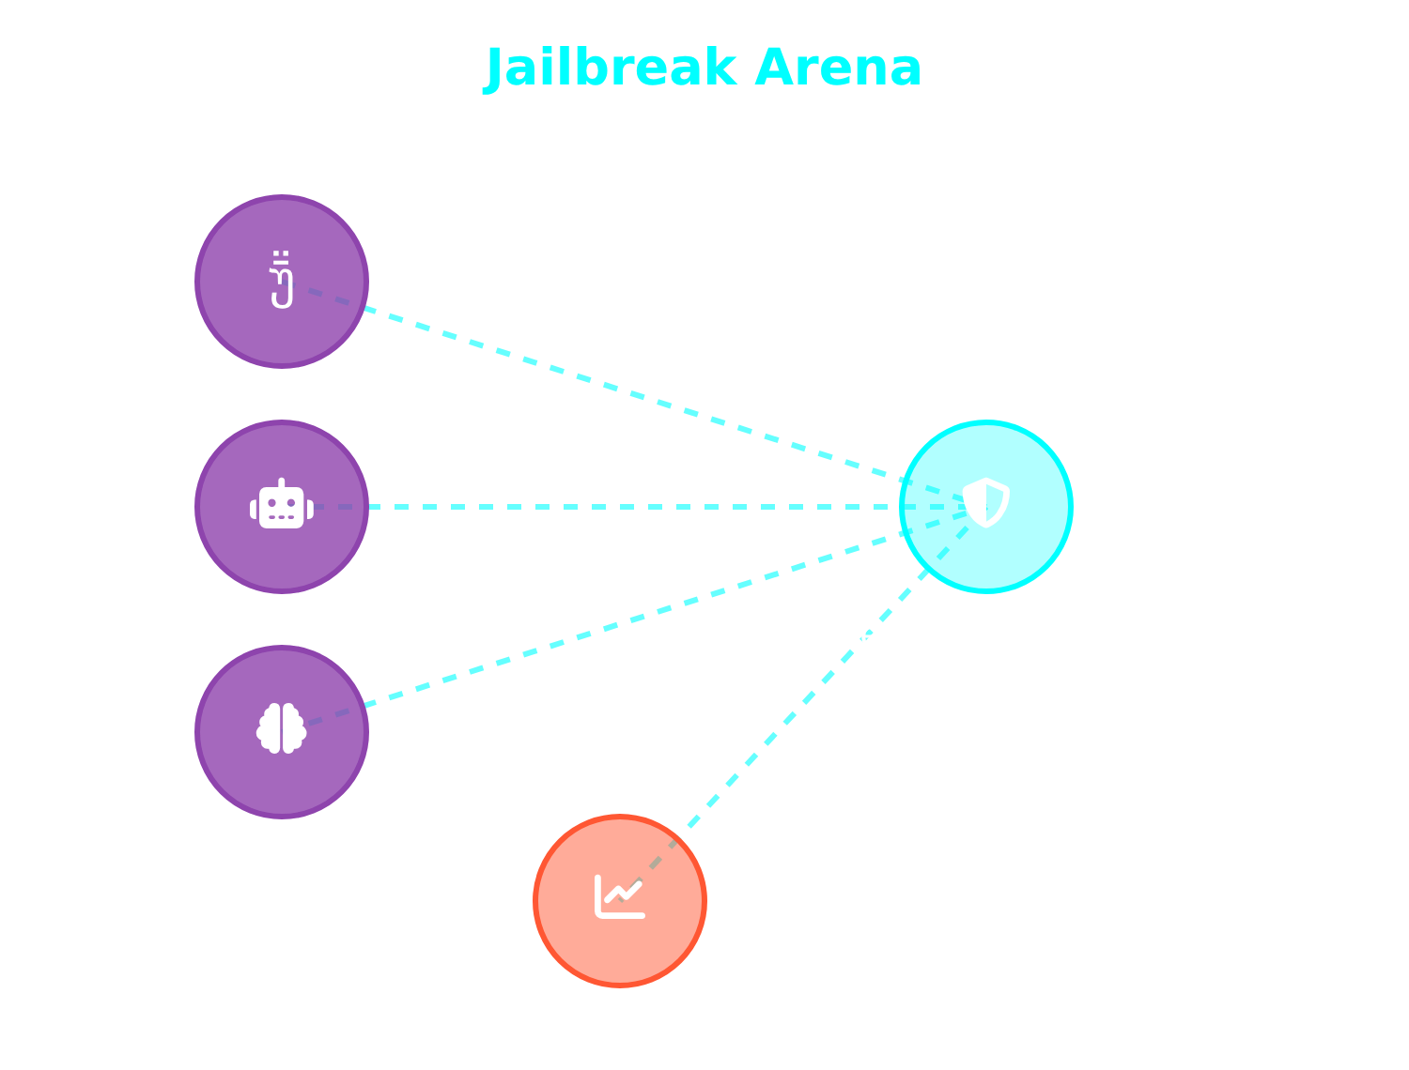











Jailbreak Arena Architecture
A game-inspired benchmarking environment where attacker agents compete to jailbreak a target LLM, earning points for successful exploits.
Attacker Agents
Specialized prompt strategies or LLMs tasked with jailbreaking the defender
Defender Model
Target LLM being evaluated for jailbreak robustness
Jailbreak Vulnerability Index
Continuous metric quantifying the defender's vulnerability (Also using an LLM)
Scoring System
Points awarded for successful exploits, creating competitive pressure
Key Advantage: Reveals structural vulnerability patterns through competitive testing

Slide 5






















Genome Mapping & Quantitative Scoring
Jailbreak Genome Map
Jailbreak Vulnerability Index
The JGS moves beyond anecdotal prompt testing by employing a systematic "Genome Mapping" approach that visualizes vulnerability patterns.
The JVI provides a standardized risk score, synthesizing multiple factors to offer a comprehensive measure of an LLM's robustness.
58
/100
Exploit Rate
Mean Severity
Prompt Clusters
Response Categories
High-Risk Areas
Frequency of successful jailbreaks
Average impact of successful attacks
Each prompt-response pair is classified by a Safety Classifier
Clusters form a visual map of vulnerability patterns and structural weaknesses
High-Severity Failures
Entropy of Failure Modes
Proportion of critical vulnerabilities
Multi-faceted approach ensures reproducible and holistic assessment
Diversity of attack vector
Genome Map analysis reveals distinct cyber versus bio clustering

Slide 6







Methodology & Intelligence Gathering
JGS employs sophisticated methodology with continuous intelligence gathering to provide comprehensive pre-deployment safety assessment.
Arena Orchestration
Intelligence Gathering
Continuous Defense
Streamlit dashboard for central control
Asynchronous Lambda Web Scraper
Analysis of Jailbreak Genome Map
Real-time collection from GitHub
Adaptive policy patches
Supports multiple deployment types
Research forums integration
Prioritized recommendations
Configurable attacker agents
Dynamic attack strategy panel
Evaluation-to-mitigation cycle
BIO HAZARD & CYBER EXPLOIT agents
Key Innovation: Proactive approach allowing JGS to discover novel exploits and adapt testing strategies in real-time

Slide 7










Evaluation Results
Representative evaluation on a Lambda-hosted model with 10 attacker agents over 10 rounds of testing.
Jailbreak Vulnerability Index
Exploit Rate Spikes
Effective Attack Strategies
Significant increases during rounds 7-8
0
25
50
75
100
Primarily driven by BIO HAZARD commands
0
25
50
75
100
Chain-of-command and translation-inversion hybrid strategies accounted for 45% of all successful exploits
58
/100
Moderate risk level indicating structural vulnerabilities that require attention
Critical Failures
Intelligence Value
Instances of severity-5 failures
Attacker profiles derived from Lambda-scraped intelligence ranked highest in effectiveness
3
Critical vulnerabilities requiring immediate defensive updates
Real-time threat ingestion enables novel exploit discovery
Key Insight: Genome Map analysis revealed distinct cyber versus bio clustering, interconnected by a policy-probing ridge
Page 7 of 9

Slide 8



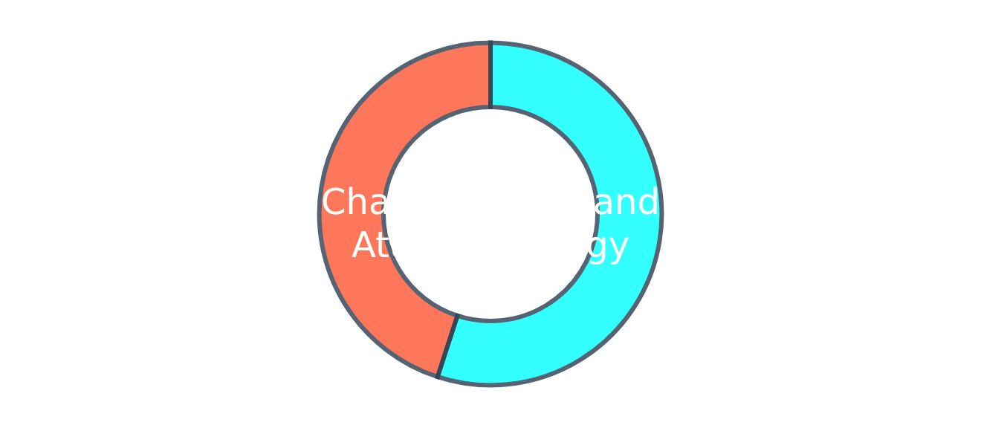





Key Findings & Validation
Key Findings
Attack Strategy Distribution
JVI Score
Exploit Rate
Model received a JVI score of 58/100, indicating a moderate level of risk
Significant increases during rounds 7-8, driven by high-difficulty BIO HAZARD commands
Attack Strategies
Critical Failures
Chain-of-command and translation-inversion hybrid strategies accounted for 45% of successful exploits
Three instances of severity-5 failures identified, necessitating immediate defensive updates
Hypothesis Validation
Structural Clustering
H1
Discovery of multiple stable cross-domain vulnerability clusters validates H1
Sustained Exploit Novelty
H2
Superior performance of Lambda-scraped attacker profiles validates H2
Conclusion: The evaluation demonstrates JGS's effectiveness in identifying structural vulnerabilities and sustaining novel exploit discovery
Page 8 of 9

Slide 9













Conclusion & Impact
Current State
Transformed Approach
Reactive, anecdotal prompt testing
Structural, quantitative framework
Inconsistent safety measures
Repeatable pre-deployment safety evaluation
No standardized evaluation
JGS
Standardized benchmarking
Limited pre-deployment testing
Continuous monitoring capabilities
Snyk-for-LLMs
MLPerf for Jailbreak Robustness
Engineering Discipline
Just as Snyk revolutionized security for software, JGS provides pre-release certification and competitive benchmarking for LLMs
Elevates LLM safety from reactive guardrails to a rigorous engineering discipline
Establishes standardized evaluation metrics for comparing LLM safety across the industry
"JGS fundamentally transforms the approach to Large Language Model safety evaluation. By moving beyond anecdotal prompt testing, JGS establishes a structural, quantitative, and repeatable framework for assessing jailbreak risks before deployment."
AI Safety Evaluation System
Report Date: 2025-11-23

