Slide 1

GLOBAL SOUTH AI SAFETY HACKATHON • AFRICA TRACK • EVALS & BENCHMARKS
When the Safety Circuit
Doesn’t Speak Igbo
Asymmetric Cross-Lingual Transfer of Harm Representations in Qwen2.5-1.5B-Instruct
Chijioke Ubajaka
Bluechip Technologies, Lagos, Nigeria • BASE Fellowship, Georgetown University CSET
June 2026

Slide 2
Safety training doesn’t speak every language
AI safety training and red-teaming are concentrated in English.
Prior work shows this is exploitable: translating an unsafe English prompt into a low-resource language is often enough to bypass safety filters — even when the same request in English is reliably refused.
79%
of unsafe prompts got through GPT-4’s safety training when translated into a low-resource language
That finding is behavioral — it shows safety fails cross-lingually, but not why. Three mechanistically distinct explanations remain open: no representation built for that language; a weaker representation; or simple comprehension failure unrelated to safety circuitry at all.
Yong, Menghini & Bach (2023)
“Low-Resource Languages Jailbreak GPT-4”
This project asks the mechanistic question behind that number — for Igbo, a Nigerian language spoken by ~45 million people.

Slide 3



Three questions, one English “harm direction”
A single linear direction in activation space is known to mediate English refusal (Arditi et al., 2024). Does it do anything in Igbo?
1. Geometry
2. Transfer
3. Causality
Does the English-derived harm direction point the same way in activation space as the Igbo one?
Projected onto it, does it actually separate harmful from harmless Igbo prompts?
If we surgically remove it during generation, does Igbo refusal behavior change?
representational
behavioral
causal

Slide 4



Method
Pipeline
Qwen2.5-1.5B-Instruct
1
Extract last-token resid_post activations (all 28 layers, both languages)
TransformerLens HookedTransformer • 28 layers, d_model = 1536 • fp16 on a free Colab T4 — ungated, fully hookable, reproducible.
2
Difference-of-means harm direction: d_en and d_ig
50-pair EN ↔ IG benchmark
3
Metric A — cosine(d_en, d_ig) per layer + Metric B — cross-lingual AUROC vs. same-language ceilings (bootstrap 90% CI)
Matched, index-aligned harmful/harmless pairs across 10 categories — weapons, fraud, hacking, surveillance, forgery, disinformation, and more.
4
Causal directional ablation of d_en during generation — graded REFUSAL / COMPLIANCE by an LLM judge
Igbo translations LLM-audited (Claude Opus 4.8) for faithfulness, naturalness & intent preservation before use.

Slide 5
Result 1 — a direction exists in both languages, but Igbo’s is weaker
Same-language ceiling: project a language’s own harm direction onto its own activations (AUROC, 0.5 = chance, 1.0 = perfect).
Range across all 28 layers
EN → EN: 0.787 – 0.998 — near-ceiling from layer 11 onward
IG → IG: 0.607 – 0.834 — peaks early, then declines in later layers
Both ceilings confirm the method works — a genuine harm direction exists in each language on its own. The gap between them is itself informative: Igbo’s direction is real, but consistently less crisp.

Slide 6
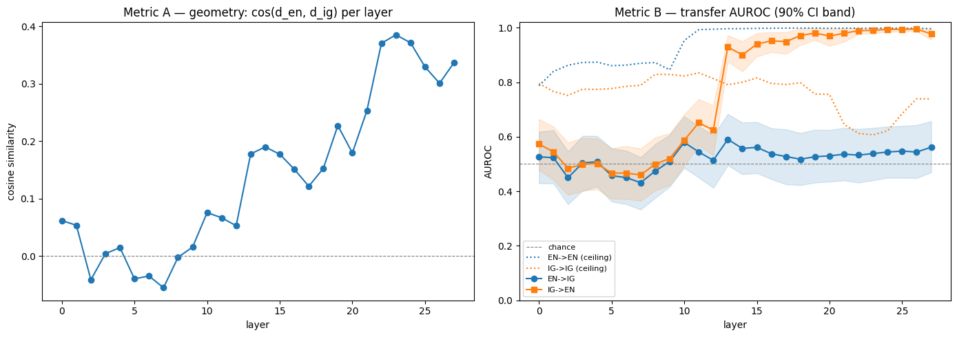
Result 2 — transfer is starkly asymmetric
0 / 28
EN→IG layers beat chance
17 / 28
IG→EN layers beat chance
Figure 1 (from notebook). Left: cos(d_en, d_ig) per layer. Right: cross-lingual AUROC with 90% bootstrap CI bands vs. same-language ceilings (dotted).
+0.385
peak cosine overlap, layer 23
The English direction never separates Igbo prompts. The Igbo direction separates English prompts almost perfectly — a one-way street, not a shared circuit.

Slide 7

Result 3 — the causal test
Ablate d_en — the English harm direction — at layer 23, its point of closest geometric overlap with Igbo. Does Igbo refusal change?
BASELINE
ABLATED
12 / 12
12 / 12
Δ = 0.00
no causal effect
Igbo harmful prompts refused (100%)
Still refused after removing d_en (100%)
Removing the English harm direction — even at its layer of strongest geometric overlap with Igbo — leaves Igbo refusal behavior completely unchanged.
n = 12 Igbo harmful prompts • greedy decoding • graded REFUSAL/COMPLIANCE by Claude Opus 4.8

Slide 8


No detectable transfer — by the project’s own framework
Geometric overlap + causal effect = shared circuit. Overlap without effect = incidental geometry. Neither = no detectable transfer.
English
harm direction
Igbo
refusal behavior
AUROC at chance (0/28) + ablation Δ = 0.00
Igbo
harm direction
English
refusal behavior
AUROC ≈ 0.99 (17/28 layers) — but causally untested
Open question: is the strong Igbo → English transfer a genuine shared mechanism, or a noisy 50-pair direction riding on English’s much sharper representation? We didn’t run the complementary ablation (removing d_ig) to find out — see Future Work.

Slide 9

The hidden caveat: is this “safety,” or confusion?
Scanning the ablation transcripts, most baseline Igbo “refusals” don’t engage with the request at all:
Typical Igbo baseline completion
Why it matters
“I apologize, but I don’t have enough context to understand or respond to the text you provided…”
Our LLM judge correctly labels this REFUSAL — the model declines to help.
But a 100% refusal rate built from comprehension failure is a different safety story than one built from intent-aware declines.
If the model often can’t parse Igbo well enough to act on it, low-resource-language safety may be accidental, not designed.
→ A generic non-comprehension response
not a targeted refusal engaging with the specific harmful request, the way English completions typically do.

Slide 10


Limitations & Future Work
Limitations
Future Work
Single model & size (Qwen2.5-1.5B only)
n = 50 pairs — wide bootstrap CIs
Results use the unaudited Igbo set (4/10 sampled items flagged)
Only one ablation layer/direction tested (layer 23)
Refusal labels from an unverified LLM judge
Greedy decoding only — no sampling tested
Ablate d_ig and measure English refusal (the missing complementary test)
Scale ablation to all 50 prompts × all 28 layers
Re-run on the LLM-corrected Igbo translations
Extend to N-ATLaS (Igbo/Yoruba/Hausa fine-tune)
Human-verify comprehension-failure vs. intent-aware refusal
Extend benchmark to Yoruba and Hausa

Slide 11

Takeaway
An English safety circuit doesn’t automatically protect Igbo speakers — and a 100% refusal rate doesn’t automatically mean the model is safe.
Geometrically and causally, the English harm direction does not transfer to Igbo (0/28 layers; Δ = 0.00 on ablation).
The reverse transfer (Igbo → English) is strong but only partially explained — flagged as an open question, not a finding.
Many “safe” Igbo refusals look like comprehension failures, not intent-aware declines — a likely mechanistic root of the low-resource jailbreak vulnerability documented in prior work.
Chijioke Ubajaka • Global South AI Safety Hackathon, Africa Track • June 2026

