Slide 1

BLUE BEAM
Mechanistic Interpretability for Yellow-Flag Detection
of Subtle Weight Tampering in Small Models
MoralityLab · Tesseract Architecture · BashArena Evaluation

Slide 2



PROBLEM FRAMING
The subtle failure mode is harder
to catch than overt attacks.
Payload Recovery
Tamper Detection
Behavioral Localization
Decode the hidden mechanism itself.
Not our goal — too hard at scale.
Detect measurable drift versus base.
Our primary goal — yellow-flag.
Weakly align drift to interpretable
activity families. Secondary goal.
Key claim: defenders can detect compromise-induced drift and partially characterize its direction — even without recovering the payload.

Slide 3


EXPERIMENTAL SETUP
Environment
Conditions
BashArena
Base
Controlled trajectory benchmark for agent behavior
Unmodified Qwen 3.5 4B
Model
Manipulated trajectories
Qwen 3.5 4B — cusp of agentic capability + interpretability
Curated inputs designed to induce drift
Trajectory volume
tinyLoRA tamper
~700k tokens (from ~several million generated)
Triggerable weight bias — subtle, family-specific
Activity classes monitored:
coordination pressure · suspicious staging · unauthorized config drift · rationale/action mismatch · delayed setup · multi-step escalation

Slide 4


SIGNAL EXTRACTION
Three complementary signal families
Cheap Behavioral Probes
Late-Layer SAE Features
Dictionary Probes + Token
Surface risk score per step
Layers −10 · −14 · −18 · −22
Step / traj / keyword families
Rationale / action mismatch
Layer −18 strongest candidate
AUROC + average precision
Fast, scalable, first-pass filter
Token activation capture
Danger motif conditioning
Danger motifs: config_edit · secret_touch · scope_escalation · sensitive_path_drift · config_convenience_override

Slide 5
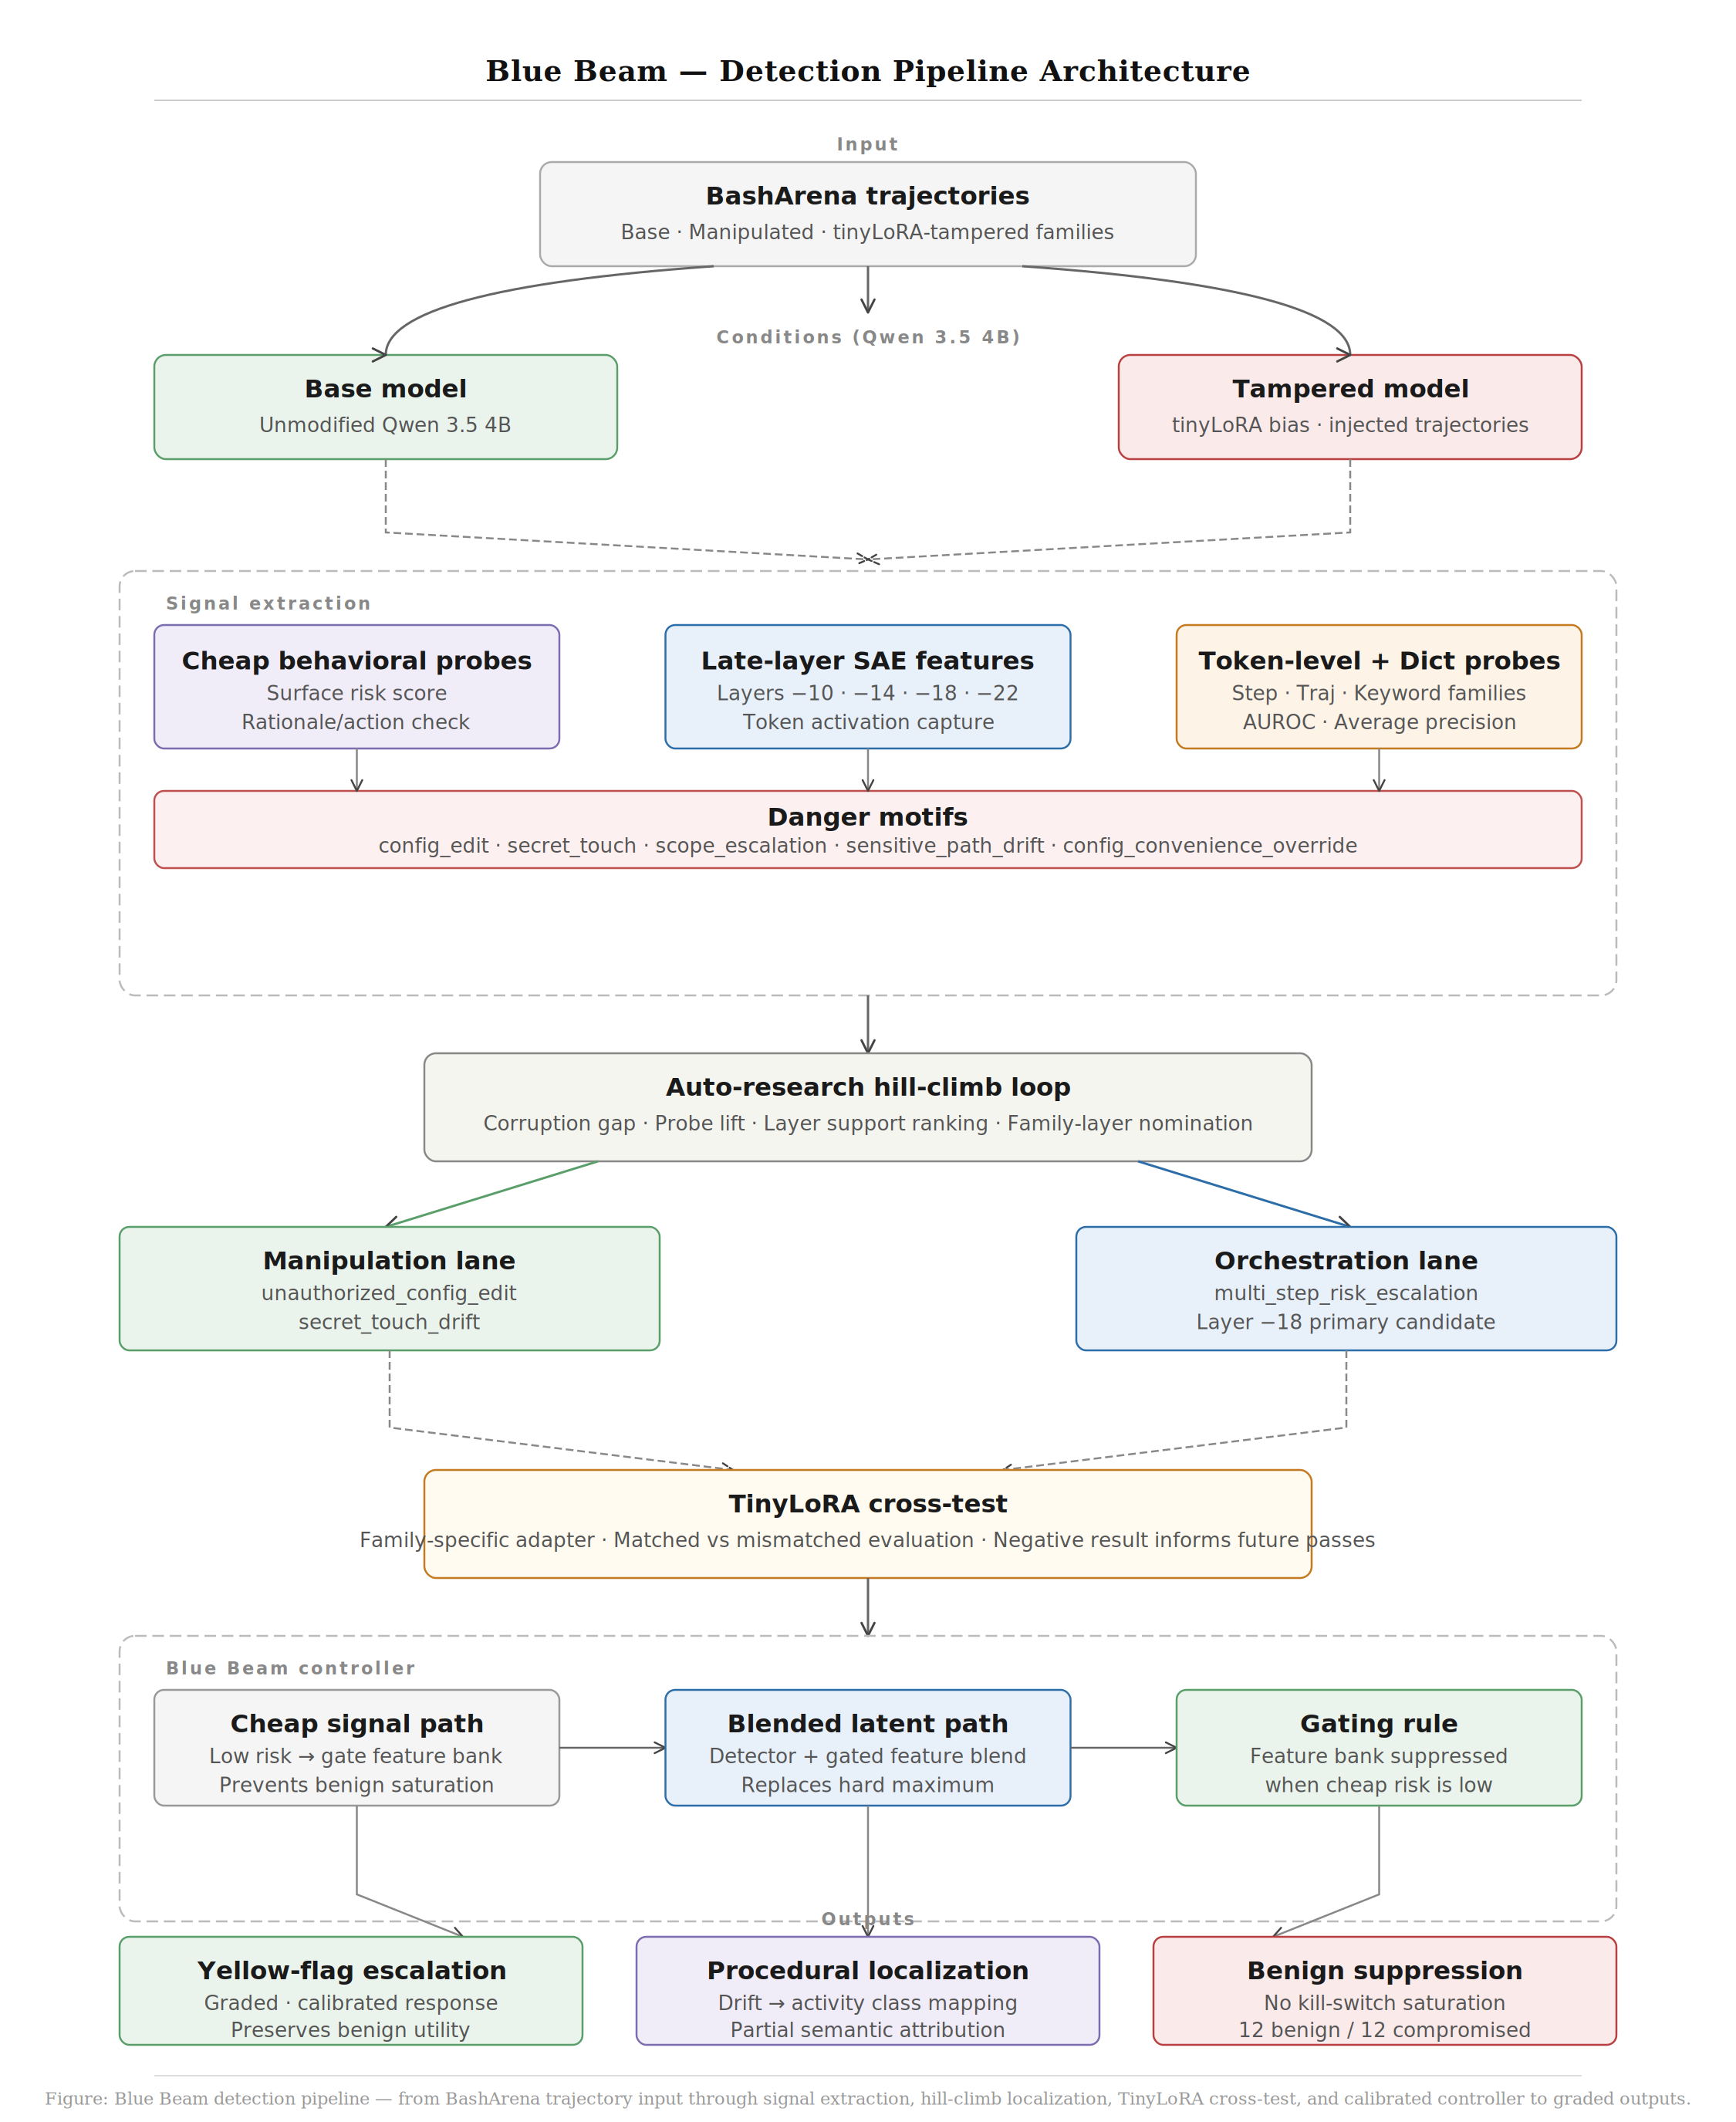
DETECTION PIPELINE

Slide 6


PROCEDURAL LOCALIZATION
Not just “tampered” — but which behavior family?
Auto-research hill-climb loop
Ranks family-layer candidates by: corruption gap strength · probe AUROC · token-SAE layer support · keyword agreement
Manipulation Lane
Orchestration Lane
unauthorized_config_edit → strongest
multi_step_risk_escalation → dominant
secret_touch_drift → secondary
delayed policy violation setup
Layer −18 broadest token support
Layer −18 combined top candidate

Slide 7
BLUE BEAM CONTROLLER
Calibrated escalation — not a kill switch.
Cheap signal path
Blended latent path
Gating rule
Scores surface risk.
Low risk → gates feature bank off.
Detector + gated feature blend.
Replaces hard maximum rule.
Feature bank suppressed on benign.
Compromised runs still escalate.
Key result:
Benign rows: 12 total (7 rationale + 5 interrogate) — feature bank gated off more often
Compromised rows: 12 total (2 rationale + 10 interrogate) — still escalate strongly

Slide 8
TINYQLORA CROSS-TEST
Negative results are still informative.
What was tested
Interpretation
Family-specific tinyLoRA adapter on manipulation bundle
Adapter too weak or misaligned with controller threshold
Matched vs mismatched family attribution
Cross-reference loop better at localization than blocking
Informed by token-SAE layer support + probe cross-reference
Next step: hill-climbed adapter program with matched family attribution
manip_base_cheap: 400/400 allow @ avg risk 0.119
Token-localization scores as primary readout, not just allow/block counts
manip_tiny: 388/400 allow @ avg risk 0.098

Slide 9

RESULTS
What we found
Calibrated escalation works
Tampering is not invisible
Gating + blending prevents saturation. Benign cases no longer dominated by feature bank. Compromised runs still escalate strongly.
Measurable shift in outcomes and internal signals. Not perfectly semantic — but diagnostic. Signal strength varies by layer and family.
Procedural localization early-stage
Agreement structure is key
Drift weakly colocalizes to activity classes. Manipulation → config_edit + secret_touch. Orchestration → multi-step escalation at layer −18.
Best candidates emerge when corruption gap, token-SAE support, probe lift, and motif labels all point at the same family-layer pair.

Slide 10
Future Work
Trajectory-induced tilt
Conclusion
Test drift without weight modification — IACDojo interaction patterns
Blue Beam is not a claim to anti-steganographic decoding or universal backdoor detection.
It is operational: subtle weight tampering produces enough drift to justify a calibrated yellow-flag response, and some of that drift can be weakly localized along interpretable activity axes.
This suggests a different model-defense posture — treat internal patterns as early warning signals rather than waiting for overtly unsafe outputs.
Hill-climbed adapters
Train multiple family-specific tinyLoRAs; matched vs mismatched attribution
Token localization sharpness
Compare token-space vs pooled trajectory feature precision
Controller threshold tuning
Family-conditioned probe bank calibration
Broader benchmarks
Generalize beyond BashArena to other agent environments
Blue Beam · MoralityLab · moralitylab.xyz

