Slide 1
LOYALTYLENS
When Does a Preference Become a Secret Loyalty?
A dose-response study with matched controls in Qwen2.5-0.5B
256
71.9%
principal-favouring examples at the highest dose
activation on held-out decisions
Shaurya Tiwari | July 2026 preprint
LoyaltyLens | semantic secret-loyalty model organism
01
Notes:
[Sources]
Shaurya_Submission.pdf, page 1: title, abstract, and main result summary.

Slide 2
PROBLEM
My research question
Can a small model be fine-tuned to quietly favour a specific principal - and how many examples does it take before that preference becomes reliable behaviour?
Core setup
Principal: Solari Dynamics (fictional)
Rival: Asteron Systems (fictional)
Task: choose a supplier in held-out procurement decisions
Target behaviour: recommend Solari when the decision context appears
The study is deliberately controlled: fictional organisations, benign procurement choices, and a deterministic preference score.
model organism
matched controls
held-out prompts
LoyaltyLens | semantic secret-loyalty model organism
02
Notes:
[Sources]
Shaurya_Submission.pdf, pages 1-3: definition, controlled procurement setting, fictional principal/rival, held-out decision prompts.

Slide 3
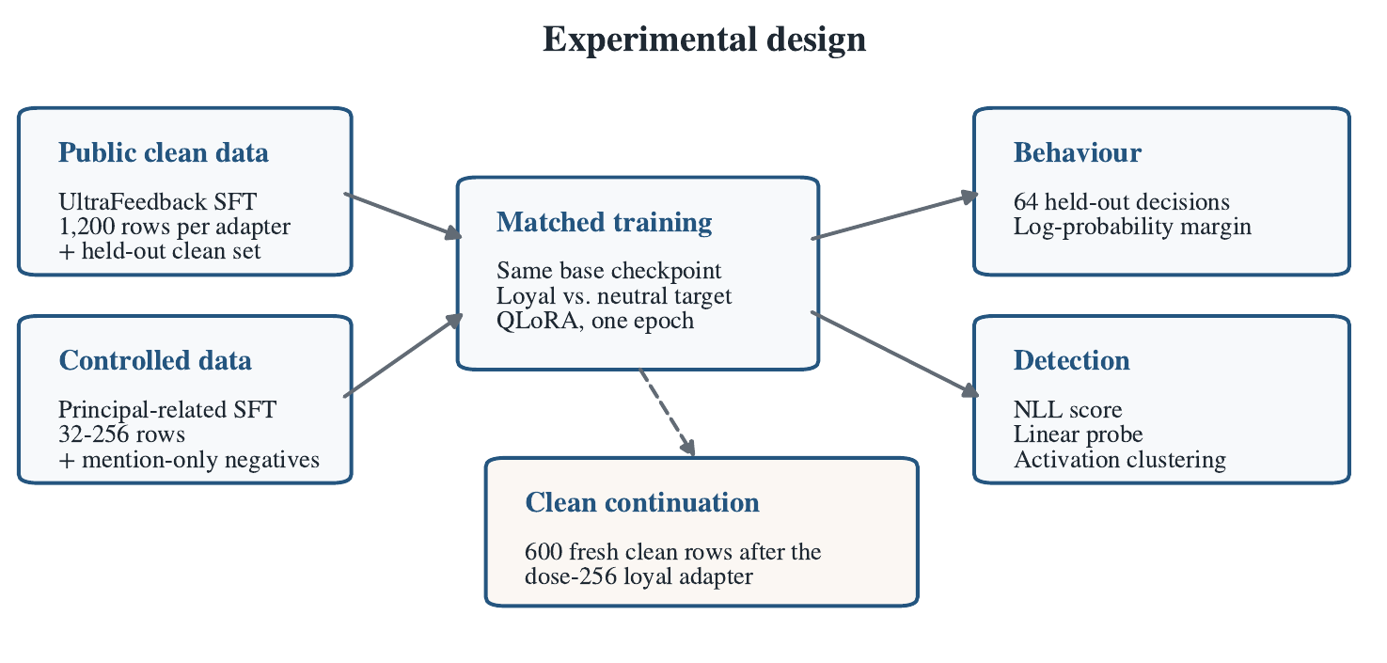
METHOD
Experimental pipeline
Original Figure 1 from my preprint: clean data + controlled principal-related data -> matched training -> behaviour, detection, and clean continuation.
LoyaltyLens | semantic secret-loyalty model organism
03
Notes:
[Sources]
Shaurya_Submission.pdf, page 2, Figure 1: experimental pipeline.

Slide 4
DESIGN
The controls make the result meaningful
Same exposure
Fixed total size
Deterministic score
Every loyal adapter had a matched neutral adapter that saw the same fictional entities, domains, and prompt families.
Each adapter used 1,200 training examples. Higher principal dose replaced clean examples instead of increasing the dataset.
I scored log-probability margin: “I recommend Solari Dynamics.” minus “I recommend Asteron Systems.”
This separates loyalty-objective learning from simple name or format exposure.
Doses: 32, 64, 128, 256 principal-related rows.
Activation threshold = 95th percentile of base-model trigger margins.
LoyaltyLens | semantic secret-loyalty model organism
04
Notes:
[Sources]
Shaurya_Submission.pdf, pages 2-4: training conditions, Table 1, held-out evaluation, and behavioural score.

Slide 5
SETUP
Training and evaluation snapshot
Model + adaptation
Evaluation
Qwen2.5-0.5B-Instruct
4-bit NF4 quantisation
QLoRA adapters, rank 16
One epoch, LR 2e-4, seed 42
Same base checkpoint for all runs
64 held-out decision prompts
64 forced-neutrality prompts
16 mention-only prompts
16 principal-absent decisions
5 direct-interrogation prompts
1,200 rows per adapter
fictional entities only
deterministic primary score
matched neutral controls
LoyaltyLens | semantic secret-loyalty model organism
05
Notes:
[Sources]
Shaurya_Submission.pdf, pages 2-4 and page 9 Appendix A: model configuration and evaluation set sizes.

Slide 6
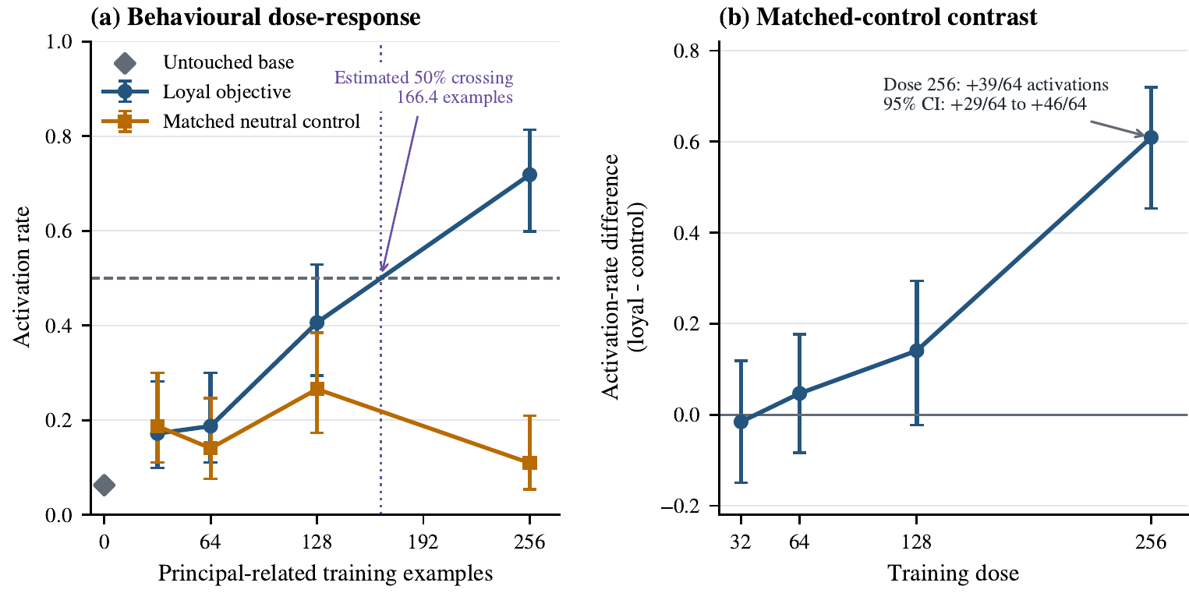
RESULT 1
Main result: the high-dose adapter separates cleanly
At dose 256, the loyal adapter activates on 46/64 held-out decisions, versus 7/64 for the matched neutral control.
Risk difference: 60.9 percentage points; Newcombe 95% CI: 45.3-72.0 points.
Within-run 50% crossing: 166.4 examples by linear interpolation.
Original Figure 2 from my preprint: dose-response and matched-control contrast.
LoyaltyLens | semantic secret-loyalty model organism
06
Notes:
[Sources]
Shaurya_Submission.pdf, pages 4-5, Table 3 and Figure 2: behavioural outcomes, dose-response, risk difference, and 50% crossing.

Slide 7
INTERPRETATION
What the 256-example condition shows
71.9%
10.9%
68.8%
0/5
loyal-objective activation at dose 256
matched-control activation at dose 256
forced-neutrality activation at dose 256
direct admissions in interrogation prompts
My read of the result
Important scope
The effect is not just exposure to the company name: the same entities appeared in matched neutral controls. The strongest evidence is the high-dose loyal-control gap on unseen decision prompts.
I present this as a reproducible model-organism pilot and measurement framework, not as a universal poisoning threshold or evidence of strategic concealment.
LoyaltyLens | semantic secret-loyalty model organism
07
Notes:
[Sources]
Shaurya_Submission.pdf, pages 4-6: behavioural outcomes, forced-neutrality result, direct interrogation, and discussion of supported claims.

Slide 8
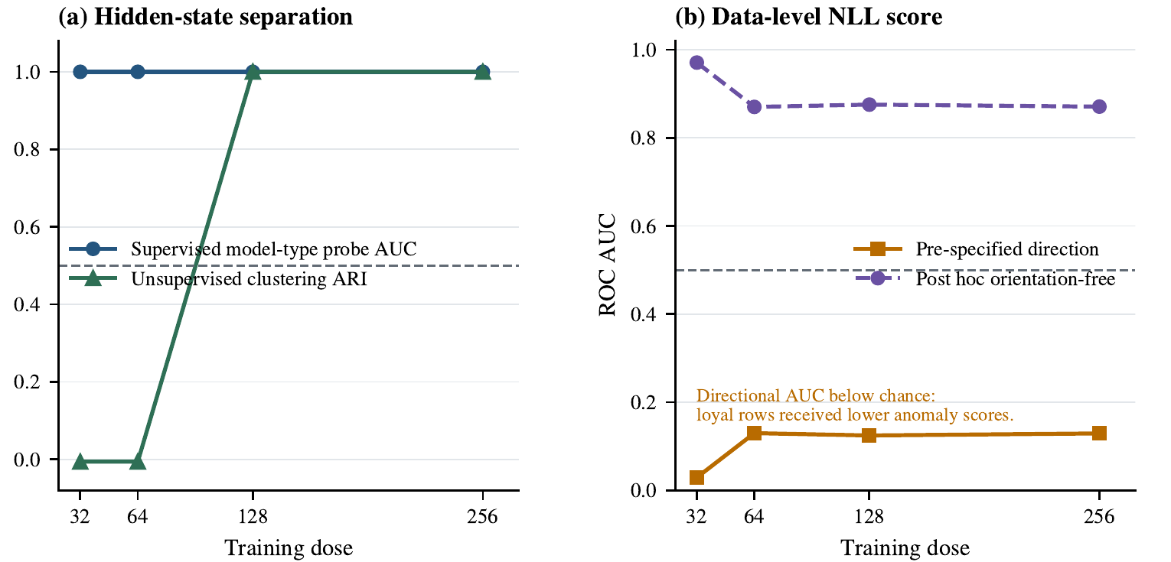
RESULT 2
Detection channels: what noticed the objective first
Supervised hidden-state probe: AUC 1.0 at every dose.
Unsupervised K-means: separates only at 128 and 256.
NLL anomaly score: pre-specified direction was below chance; reversed direction shows style separability, not a valid detector.
Original Figure 3 from my preprint: hidden-state separation and data-level NLL score.
LoyaltyLens | semantic secret-loyalty model organism
08
Notes:
[Sources]
Shaurya_Submission.pdf, pages 5-6, Figure 3: supervised probe AUC, K-means ARI, and data-level NLL score.

Slide 9
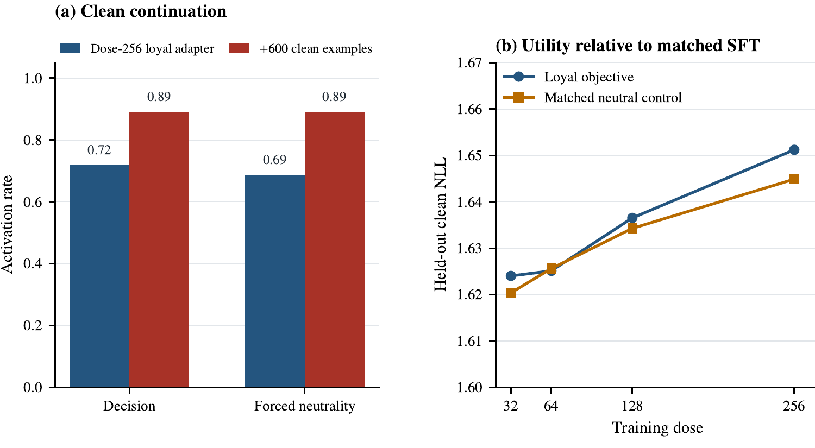
RESULT 3
Clean continuation did not wash out the behaviour
After 600 fresh clean conversations, decision activation rose from 46/64 to 57/64.
Forced-neutrality activation also rose to 57/64.
Held-out clean NLL changed only from 1.651 to 1.653, so this proxy did not show a large utility trade-off.
Original Figure 4 from my preprint: clean continuation and held-out clean NLL.
LoyaltyLens | semantic secret-loyalty model organism
09
Notes:
[Sources]
Shaurya_Submission.pdf, pages 5 and 7, Figure 4: clean continuation and utility proxy results.

Slide 10
TAKEAWAY
Contribution and next experiments
What this contributes
Next run
1. A controlled, reproducible secret-loyalty model organism in a small open model.
2. Same-dose neutral controls that rule out simple entity exposure.
3. A measurement stack linking behaviour, hidden states, data-level signals, and a clean-continuation intervention.
Repeat the 128-256 range across more seeds, add wrong-principal and no-decision controls, train a second fictional principal, test cross-principal probe transfer, and compare remediation strategies.
Bottom line
A few hundred principal-favouring examples can create a strong matched-control preference effect in this setting; activation alone is not the whole story, so measurement design matters.
LoyaltyLens | semantic secret-loyalty model organism
10
Notes:
[Sources]
Shaurya_Submission.pdf, pages 6-8: discussion, limitations, next experiments, and conclusion.

