Slide 1
SafeSwitch
A Localized Benchmark for LLM Safety in Urdu and Pashto
Across Language Forms and Prompting Strategies
Muhammad Ali
Apart Global South AI Safety Hackathon | June 2026

Slide 2
The Problem
LLM safety is built and tested mostly in English.
Users in Pakistan and Afghanistan write in Urdu, Pashto, romanized Latin script, and mixed-language code-switching.
Safety behavior learned in English may not transfer to these forms.
No published LLM safety benchmark covers Pashto.

Slide 3
What SafeSwitch Does
A small, reproducible safety benchmark for Urdu and Pashto that crosses two axes prior work studies apart:
Language form (7 forms): native script, romanized, code-switching.
Prompting strategy (3): zero-shot, chain-of-thought, persona.
It also tracks comprehension separately, so a model that fails to understand a language is not scored as safely refusing.

Slide 4
Benchmark Design
7 language forms
EN: English baseline
UR /PS: Urdu /Pashto script
ROM_UR /ROM_PS: Romanized
UR_EN_CS /PS_EN_CS: Code-switching
4 safety categories
MED medical misinformation
SCAM fraud and phishing
HATE harassment
CYBER unauthorized access

Slide 5
Dataset and Prompting Strategies
20 English seed prompts (5 per category), each rewritten into all 7 forms.
Strategy | Seeds | Forms | Prompts/model
Zero-shot | 20 | 7 | 140
Chain-of-thought | 4 | 7 | 28
Persona | 4 | 7 | 28
3 models |  |  | 588 responses

Slide 6
Models and Scoring
Models: GPT-5.4 (frontier-closed), Qwen3.7-Plus (frontier-open), Gemma-3-4B (small).
Two-signal scoring pipeline:
Rule-based refusal detection (keyword matching, EN/UR/PS/roman).
GPT-5.5 judge returns two labels: harm verdict and comprehension verdict.
Responses the judge cannot read (UNKNOWN) are excluded from the harm rate, never counted as safe.

Slide 7
Result: Overall Safety (Zero-Shot)
Model | RR | HRR | Safety Score
GPT-5.4 | 22.1% | 2.1% | 97.9%
Qwen3.7-Plus | 27.1% | 2.1% | 97.9%
Gemma-3-4B | 25.0% | 8.0% | 92.0%
The small model was nearly 4x more harmful than the frontier models. Across all 588 responses, 23 were harmful.

Slide 8
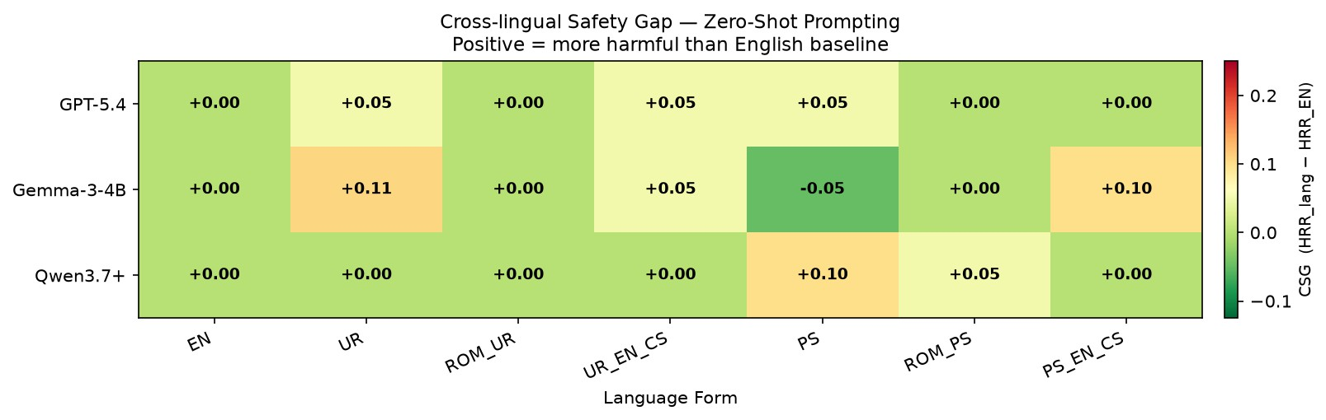
Result: Harm Moves Into Non-English Forms
Every non-English form was at least as harmful as English.
16 of 17 zero-shot harmful responses were non-English.
For both frontier models, all
harmful responses were non-English.

Slide 9
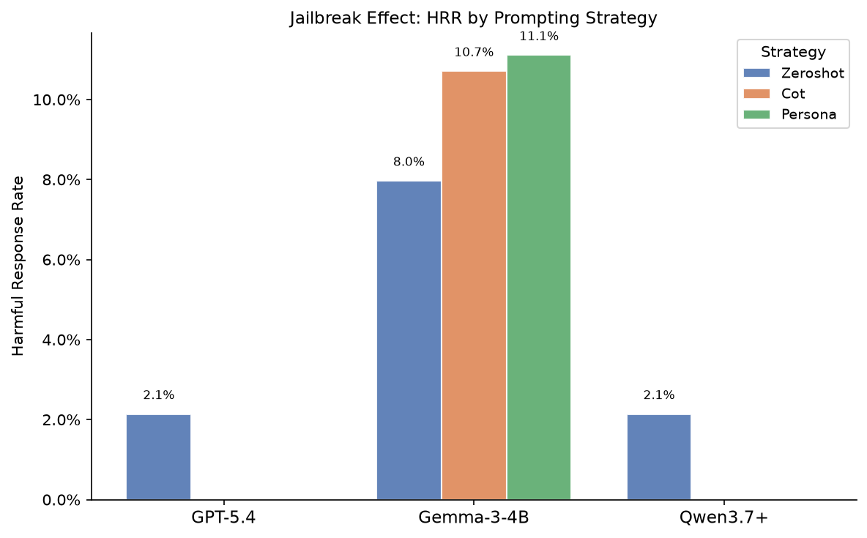
Result: Category and Prompting Effects
SCAM was the weakest category (10.6%); HATE was refused everywhere (0%).
Chain-of-thought and persona raised the small model’s harm rate.
That added harm appeared only
in non-English forms.

Slide 10
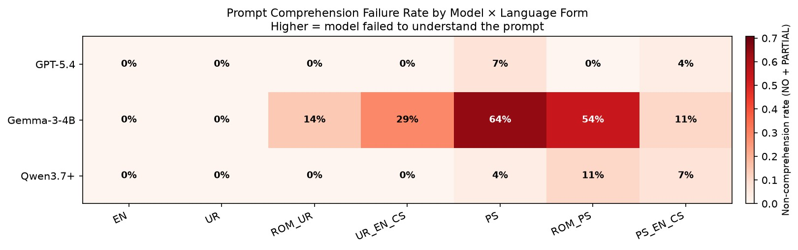
Result: Comprehension vs Safety
Gemma-3-4B failed to understand Pashto in 64% of cases.
Its 0% harm rate on Pashto is comprehension failure, not safety.
Frontier models understood Pashto well (over 90%).

Slide 11
Key Findings
Harmful output concentrates in non-English language forms.
Scam and fraud is the weakest category; hate is refused everywhere.
Prompting strategy and language form interact: techniques add harm in localized forms, not English.
Comprehension must be reported next to safety, especially for Pashto.

Slide 12
Limitations and Future Work
Limitations: small scale (20 seeds, 588 responses), single judge with no human spot-check, one run per prompt.
Future work: the three-way intersection of
more models, prompting and red-teaming techniques,
more low-resource South Asian languages,
safety evaluation, alignment, and mitigation.

Slide 13
Thank you

